Slide 1
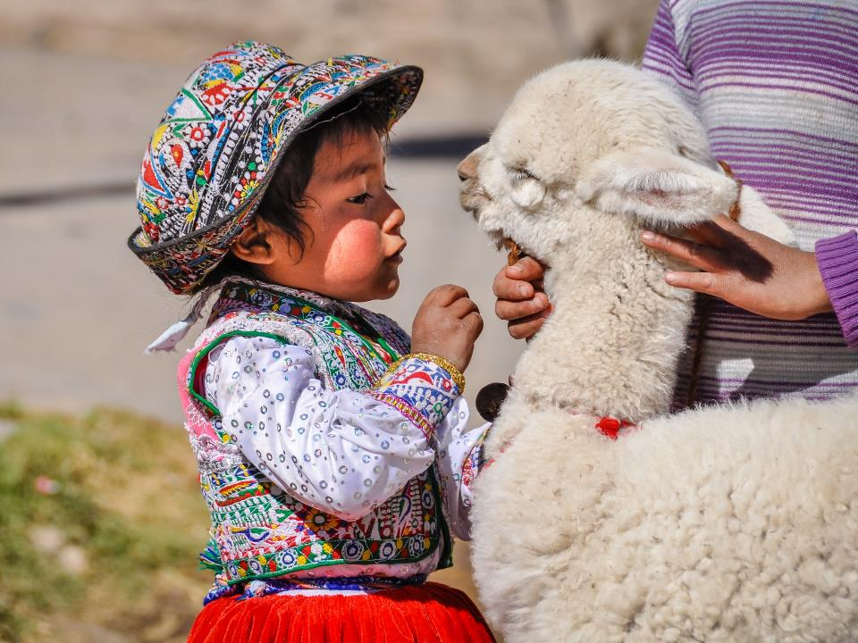

Slide 2
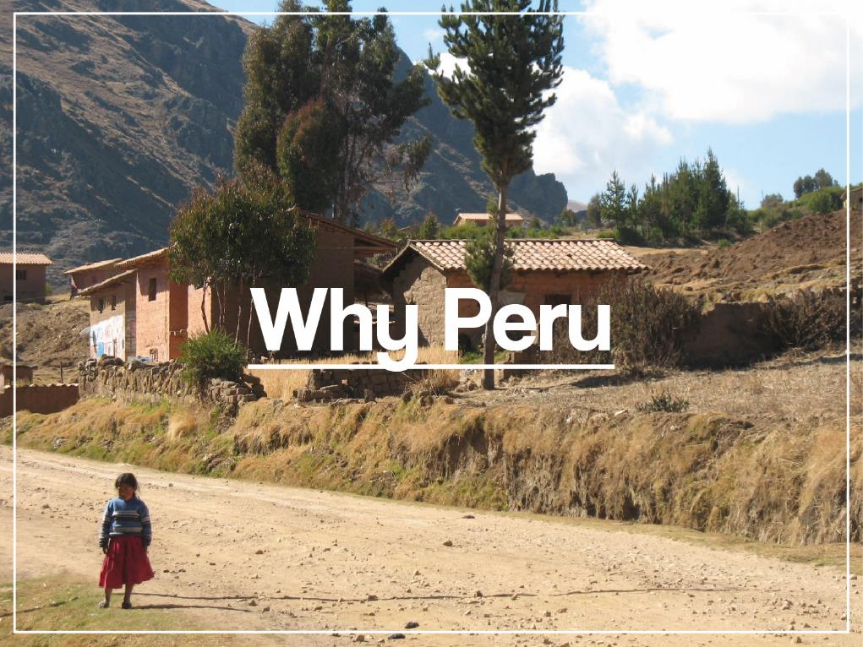

Slide 3
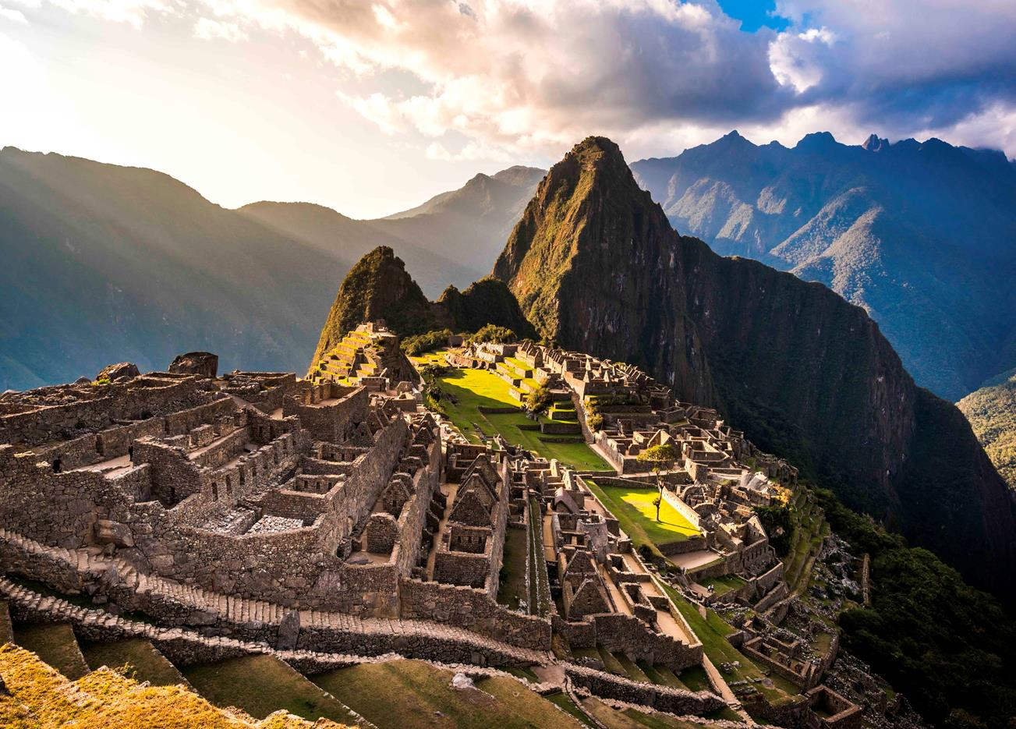


Slide 4
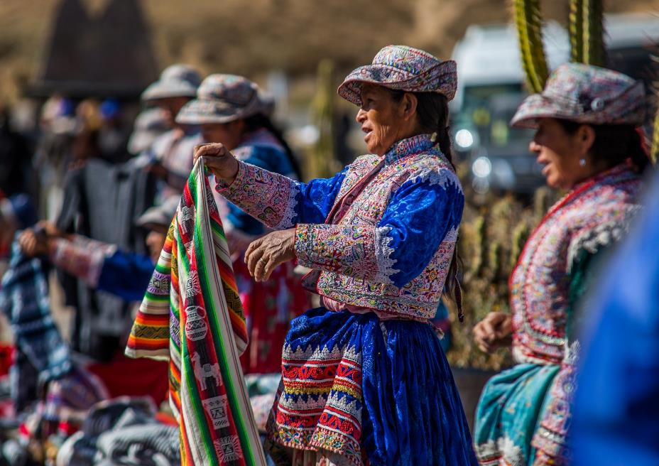


Slide 5
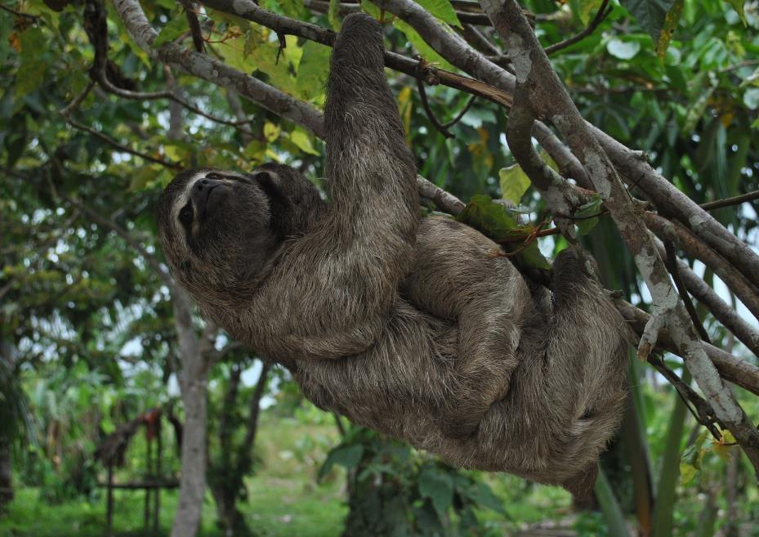


Slide 6
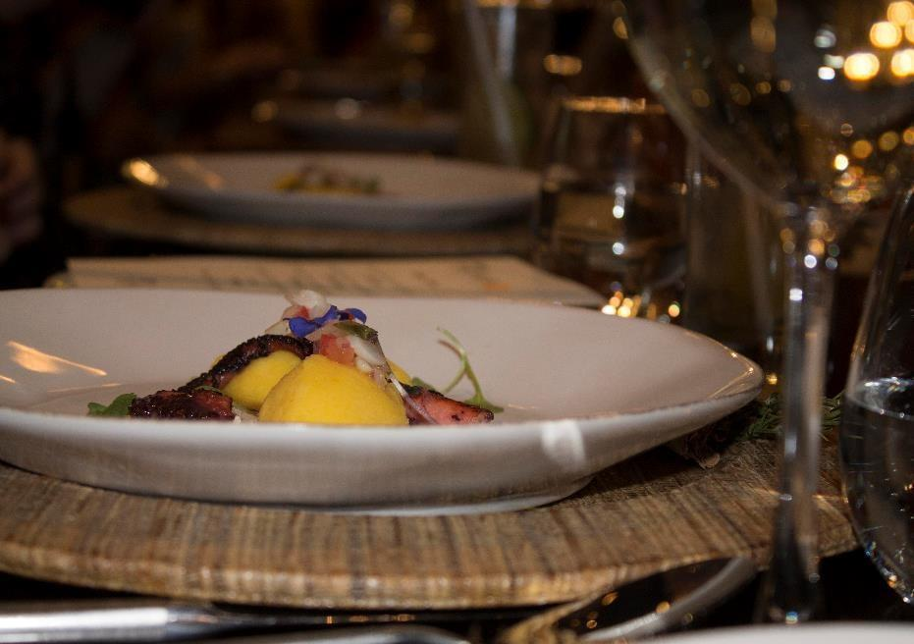


Slide 7
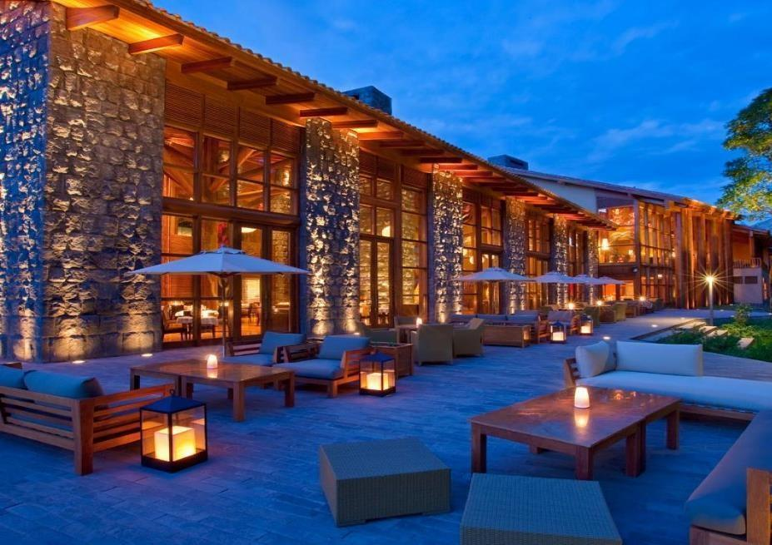


Slide 8
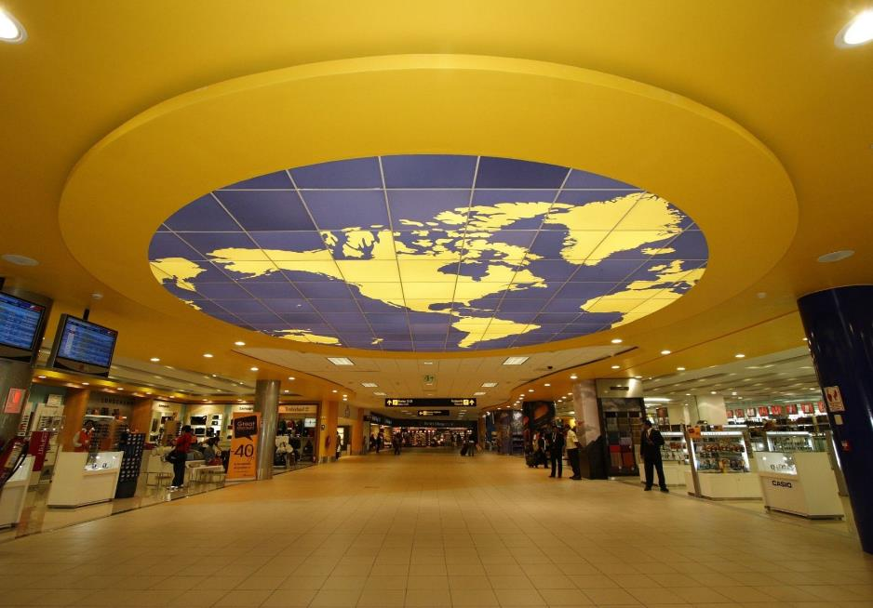


Slide 9
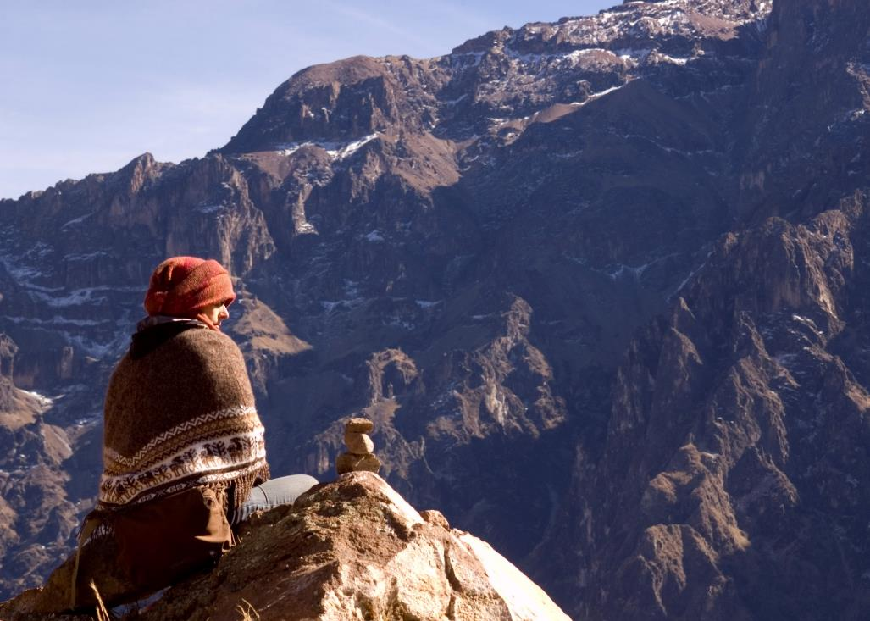
Peru Trip Planner

Slide 10
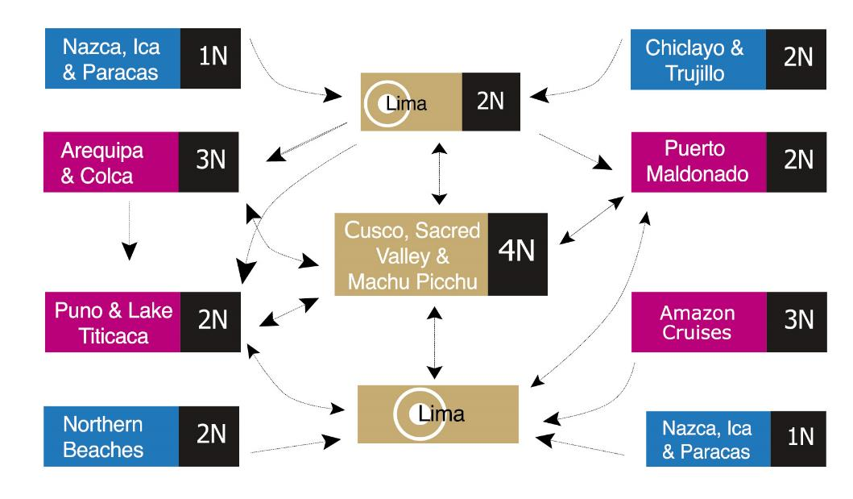




Slide 11
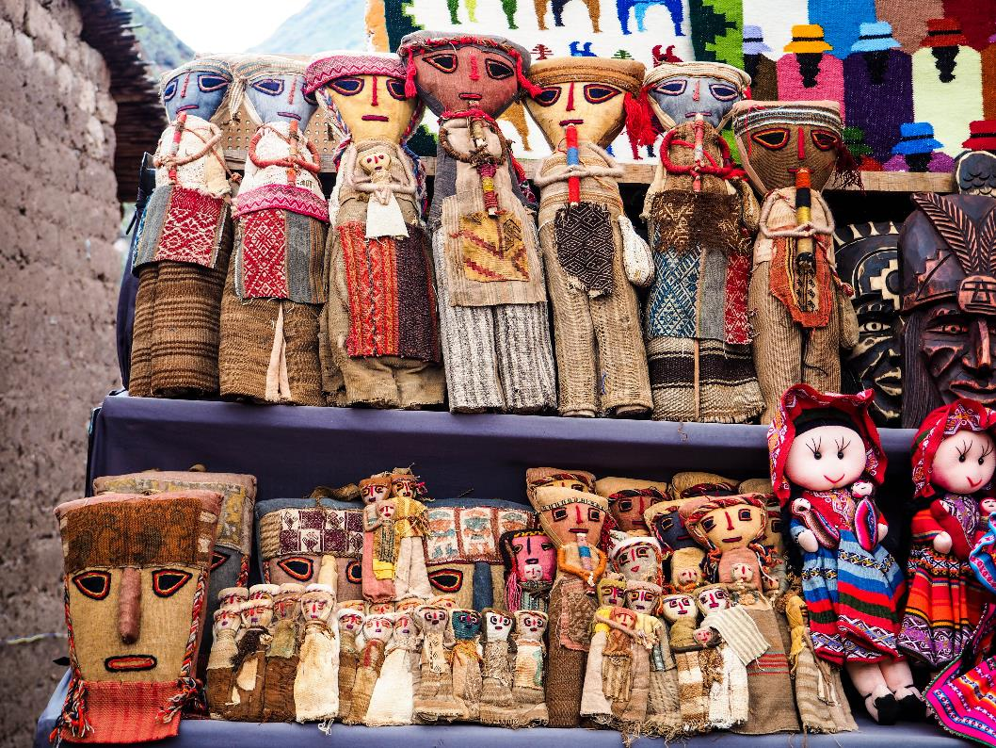
^{Deeper into Peru}

Slide 12
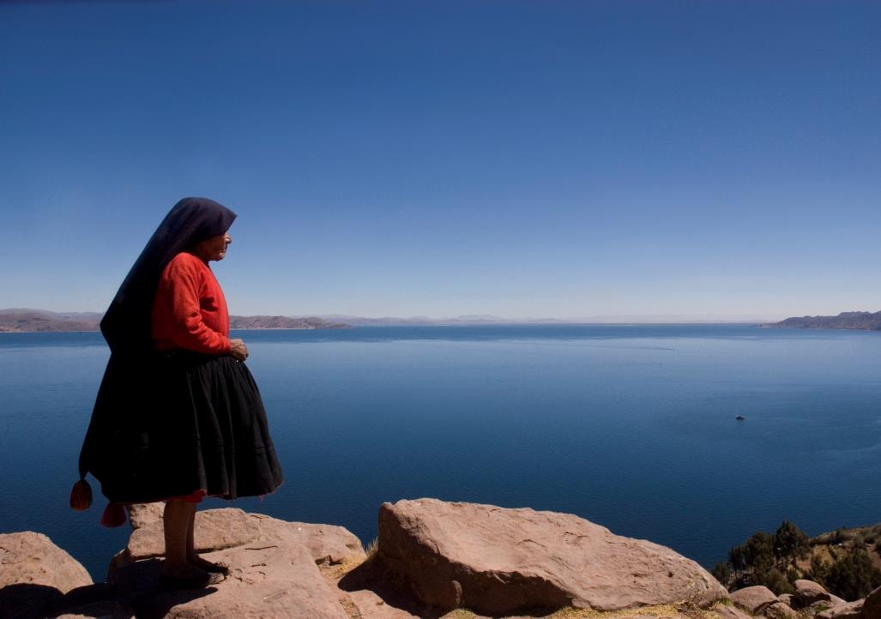
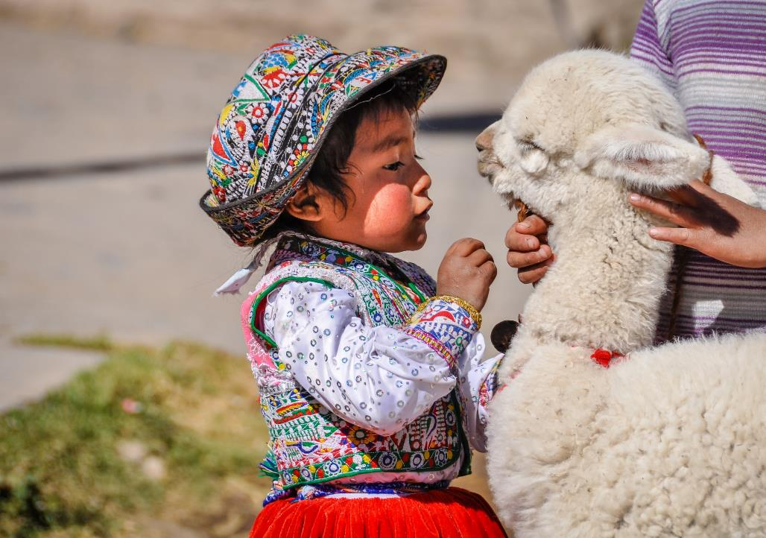
Sample Program

Slide 13
7 NIGHT SAMPLE PROGRAM
LIMA, CUSCO & MACHU PICCHU
Day 01 . …. / Lima (B/-/-)
Transfer Lima Airport / Hotel (private English speaking transferman)
Overnight in Lima
Day 02 – Lima (B/-/-)
AM: Colonial & Modern Lima City Tour plus Larco Museum (private English speaking guide)
PM: At leisure
Overnight in Lima
Day 03 – Lima / Cusco / Sacred Valley (B/L/-)
Transfer Hotel / Lima Airport (private English speaking transferman)
Transfer Cusco Airport / Sacred Valley including Pisac Market
& Ollantaytambo Fortress (private English speaking guide)
Lunch served in a local restaurant (Set menu)
Overnight in Sacred Valley
Day 04 – Sacred Valley (B/L/-)
Full day Chinchero Village, Maras Saltpans & Moray Terraces (private English speaking guide)
Overnight in Sacred Valley
Day 05 – Sacred Valley / Aguas Calientes (B/L/D)
Full day excursion to Machu Picchu via roundtrip train (private English speaking guide)
Buffet lunch at Tinkuy restaurant
Overnight Aguas Calientes
Day 06 – Aguas Calientes / Cusco (B/-/-)
AM: At leisure
  Optional: 2nd entrance to Machu Picchu (no guide)
PM: Return to Cusco by train (private English speaking transferman)
Overnight in Cusco
Day 07 – Cusco (B/-/-)
AM: Cusco City tour & main surrounding ruins (private English speaking guide)
PM: Al leisure
Overnight in Cusco
Day 08 – Cusco / Lima / … (B/-/-)
Transfer Hotel / Cusco Airport (private English speaking transferman)

Slide 14
Metropolitan Touring Peru‘s Must See Destinations

Slide 15
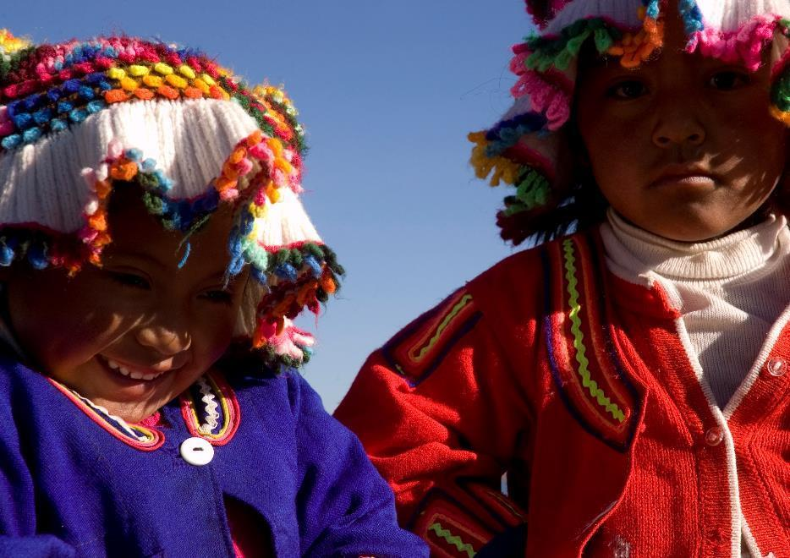
Puno & Lake Titicaca
3 days / 2 nights extension

Slide 16
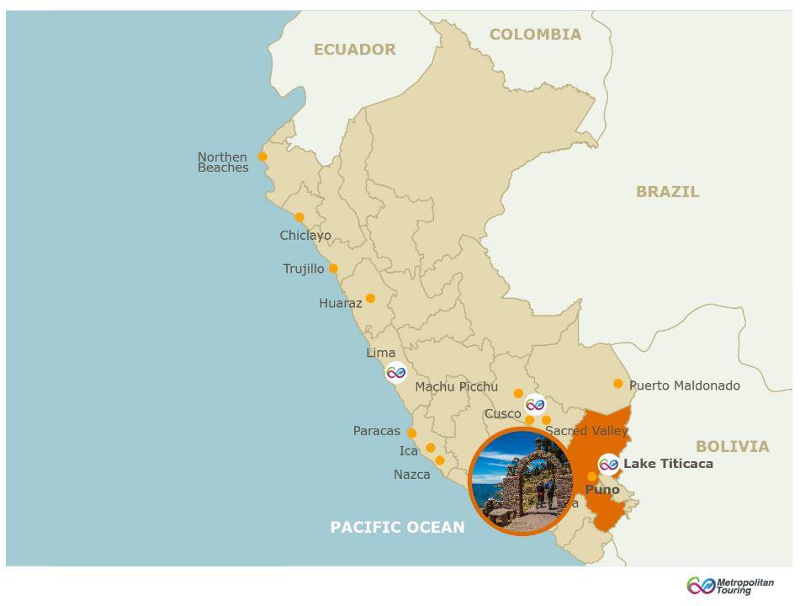



Altitude:
2,355 m.a.s.l / 7,661 feet
Climate:
Cold and semi - dry
Maximum: 58°F / 14°C
Minimum: 37°F / 3°C
Access Route
By air:
Daily flights from
Lima to Juliaca (1 hr 40min)
Lima to Julia stopping at Cusco
(2 hr 40min)

Slide 17
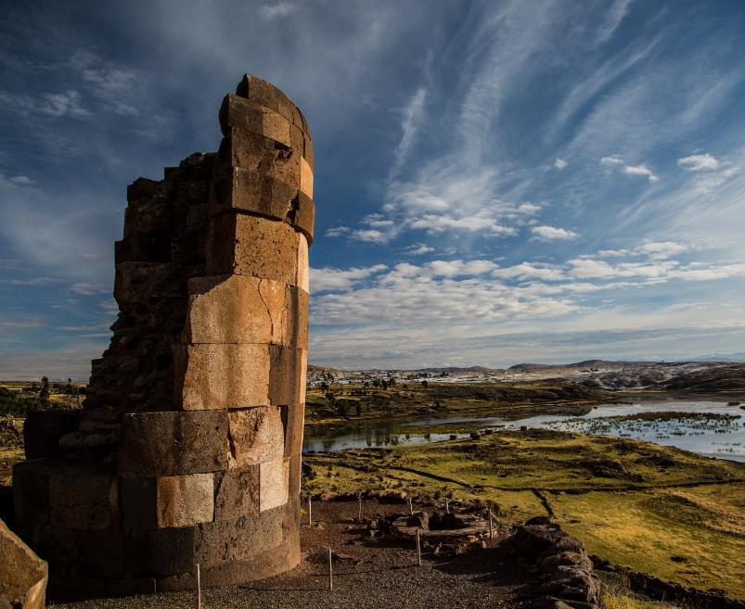




Season:
All year round
Content:
Living cultures,
History, Archaeology, Nature
Recommended stay: 2 nights
Average stay: 2 nights
Notes:
Puno is the Cradle of the Inca Empire and a festive city, with floating islands and colorful folk traditions.
Lake Titicaca is the World´s highest navigable lake, home to different cultures such as the Quechua, Aymara and Uros.
Lake Titicaca is a protected natural area in which dozens of bird, fish and amphibian species have been recorded.

Slide 18
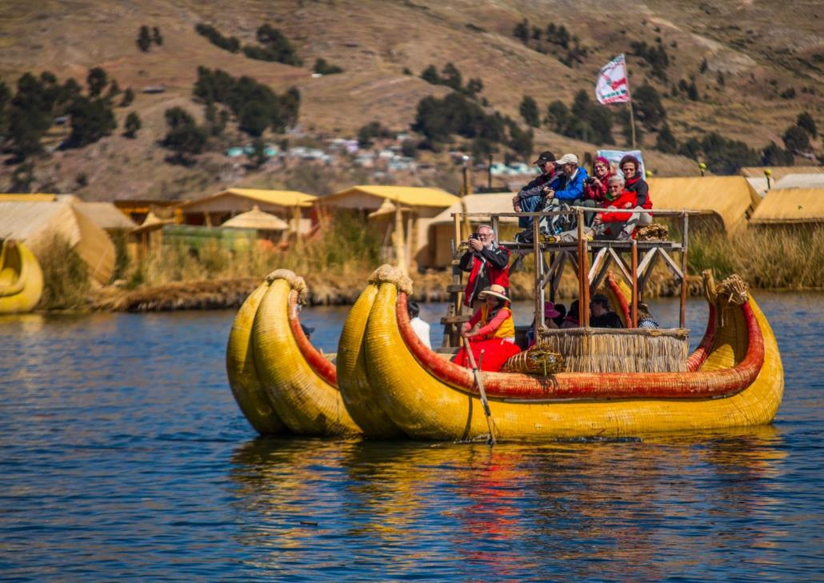
Uros Floating Island

Slide 19
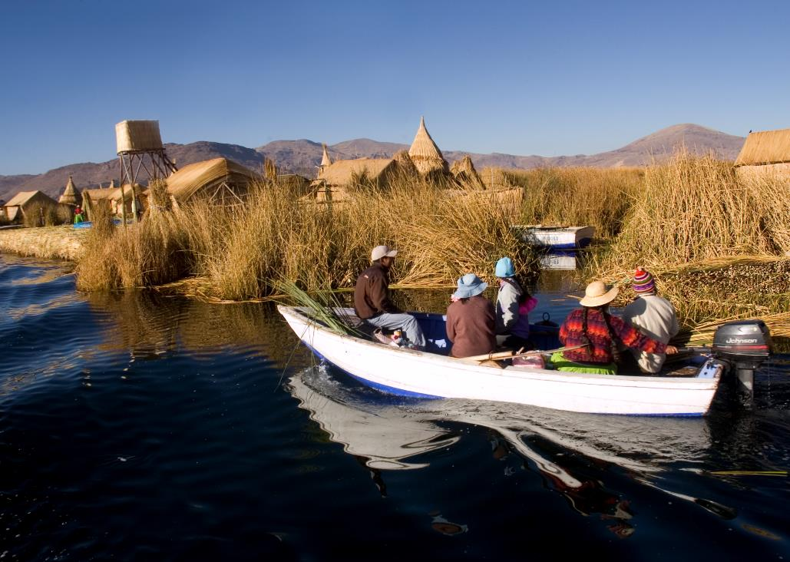
Uros Floating Island

Slide 20
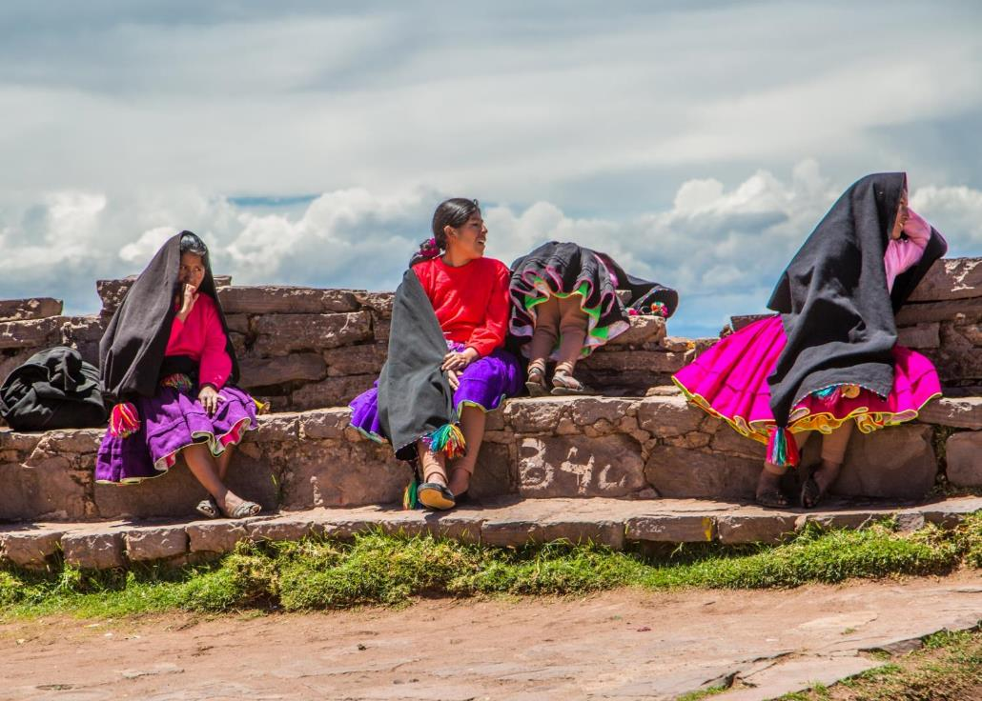
Taquile Island

Slide 21
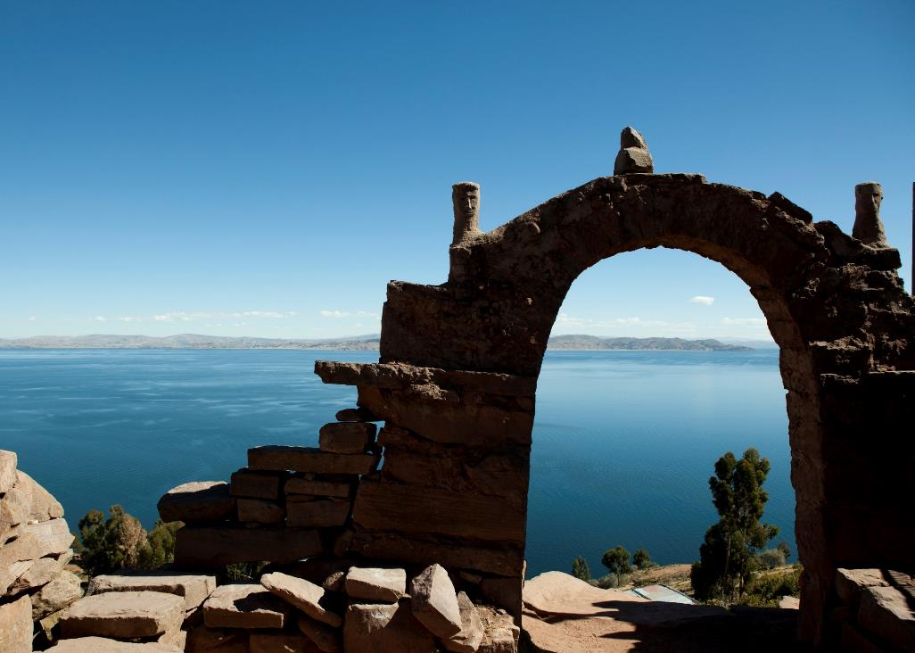
Taquile Island

Slide 22
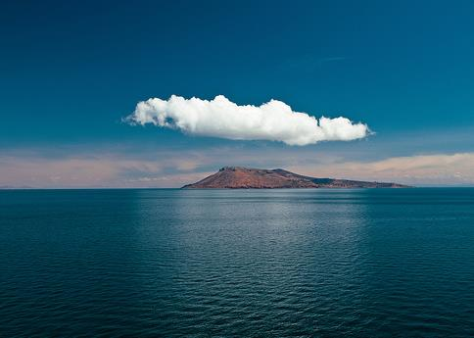
Amantani Island

Slide 23
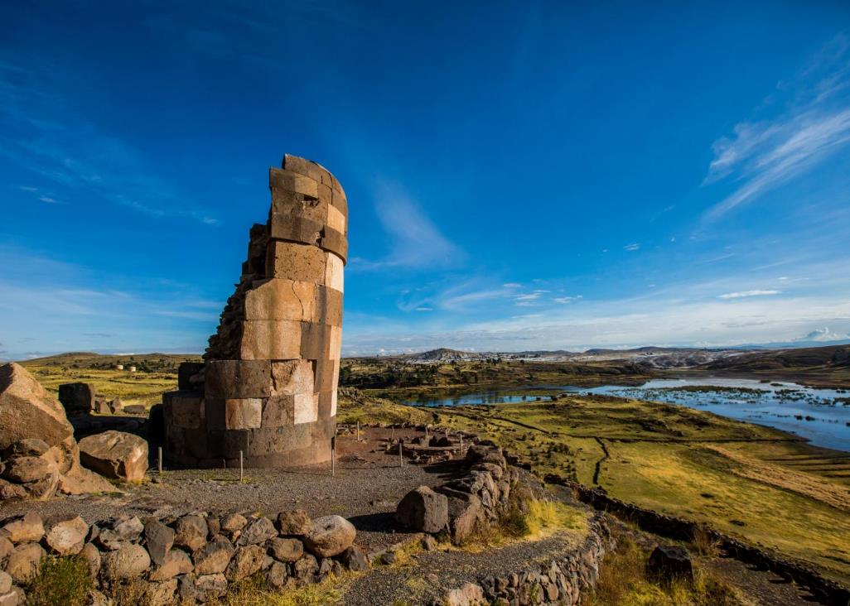
Sillustani Tombs

Slide 24
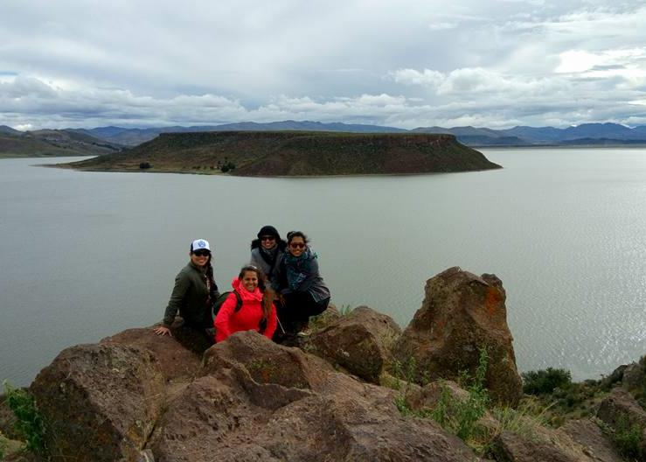
Umayo Lake

Slide 25
2 NIGHT EXTENSION SAMPLE
Cusco / Puno
Day 01 - Cusco / Puno (-/-/-)
Transfer Juliaca Airport, Puno Bus Station, Puno Train Station / Hotel (private English speaking guide)
OR
Private transportation & private guide Cusco / Puno including lunch & en route stops (English speaking guide)
Overnight in Puno
Day 02 - Puno (B/L/-)
Full day Uros & Taquile Islands including lunch (private English speaking guide)
Overnight in Puno
Day 03 - Puno / … (B/-/-)
Transfer Hotel / Juliaca Airport including Sillustani Tombs en route (private English speaking guide)

Slide 26
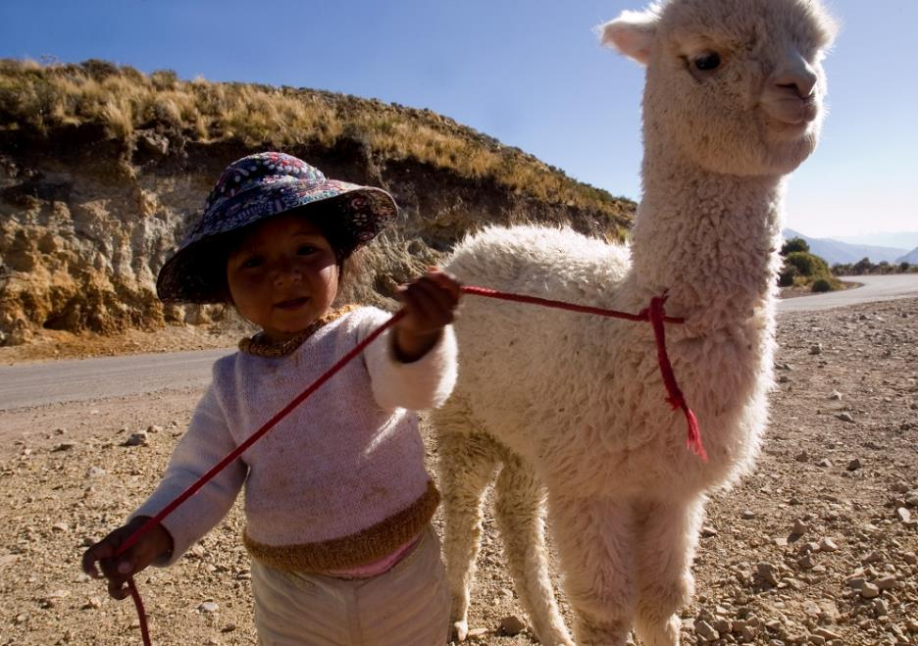
Arequipa & Colca Canyon
4 days / 3 nights extension

Slide 27
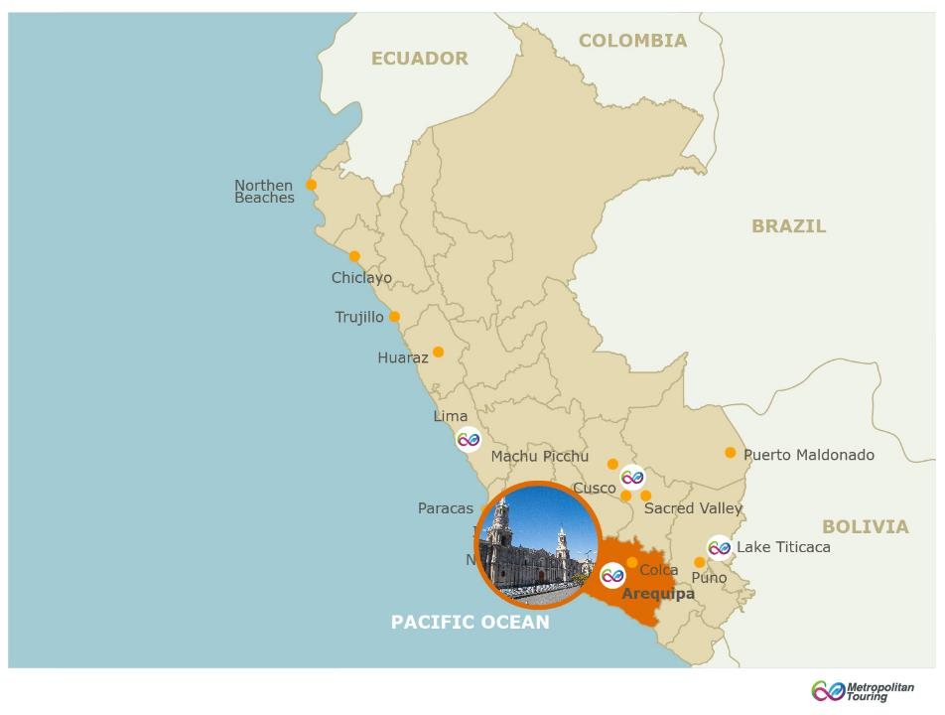
Altitude:
2,355 m.a.s.l / 7,661 feet
Climate:
Semi –arid and temperate
Maximum: 72°F / 22°C
Minimum: 41°F / 5°C
Access Route
By air:
Daily flights from Lima (1 hr)

Slide 28
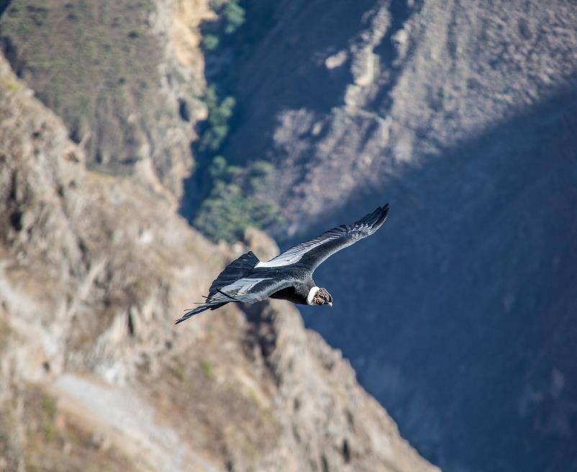
Season:
All year round
Content:
Living cultures, History,Nature Archaeology
Recommended stay: 3 nights
Average stay: 3 nights
Notes:
The white city of Arequipa not only has beautiful convents, temples ad grand old colonial houses, it also holds a wealth of gastronomy as a result of a mixture of native products of the ancients Pre-Columbian cultures combined with modern culinary techniques.
Additionally, two of the deepest canyons in the world: the Colca and the Cotahuasi, are the natural habitat of the vicuña, with the finest fiber in the world and the condor that shows its majesty when flying a few meters just above guests.

Slide 29
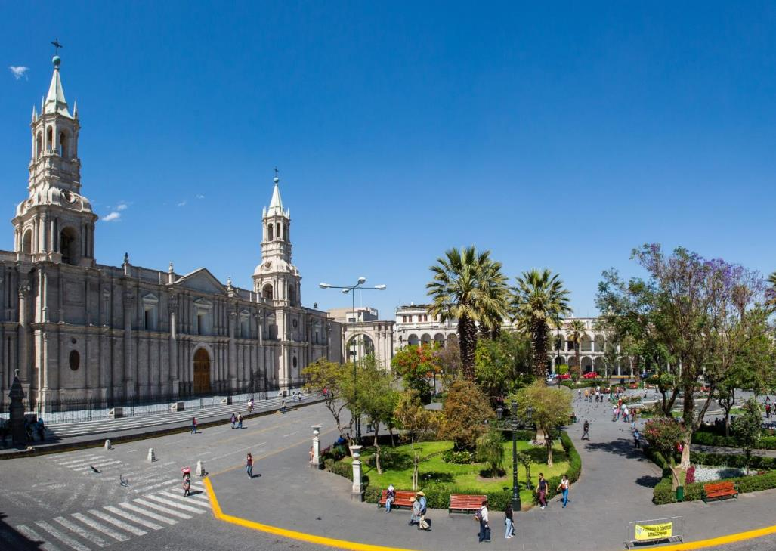
Arequipa Main Square

Slide 30
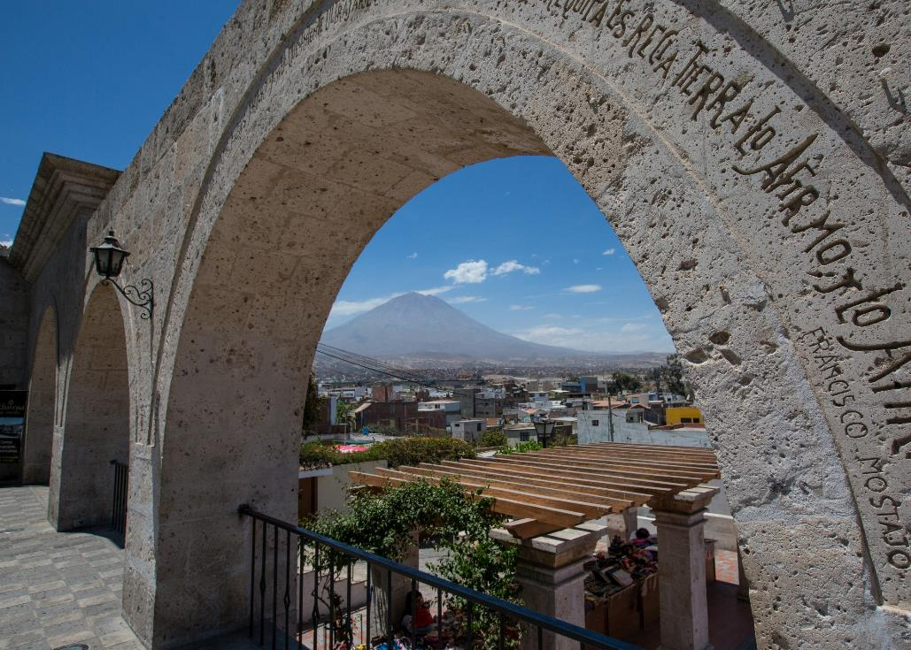
Yahanuara Viewpoint

Slide 31
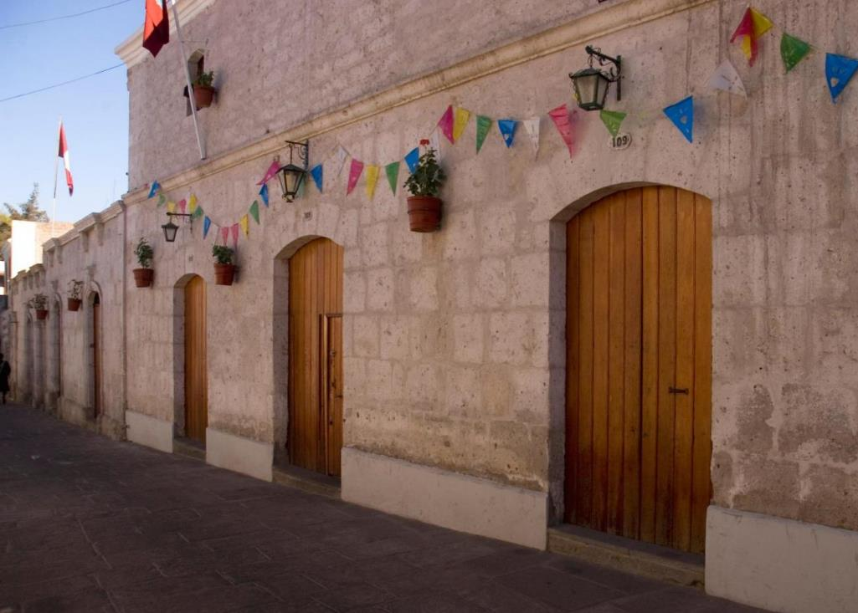
Arequipa City Street

Slide 32
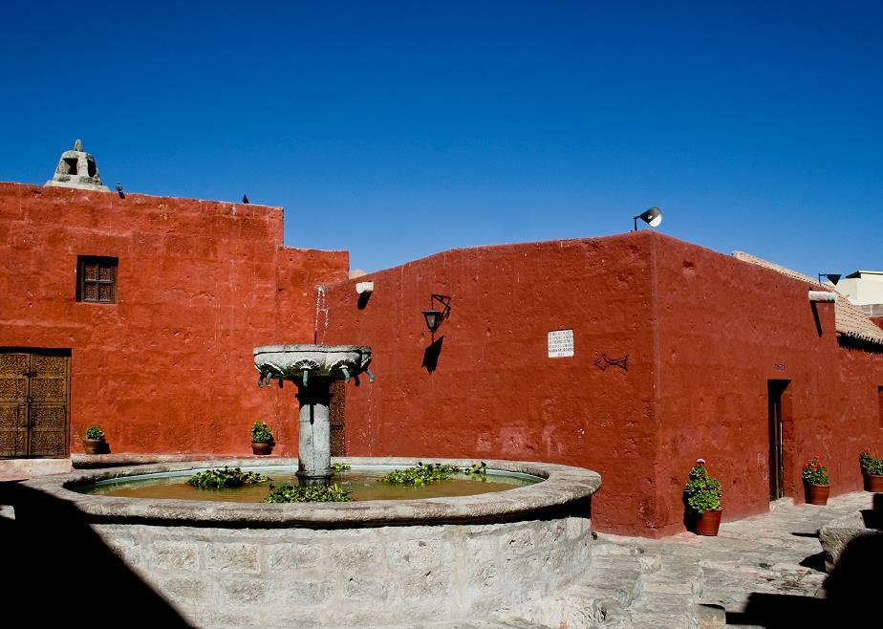
Santa Catalina Convent

Slide 33
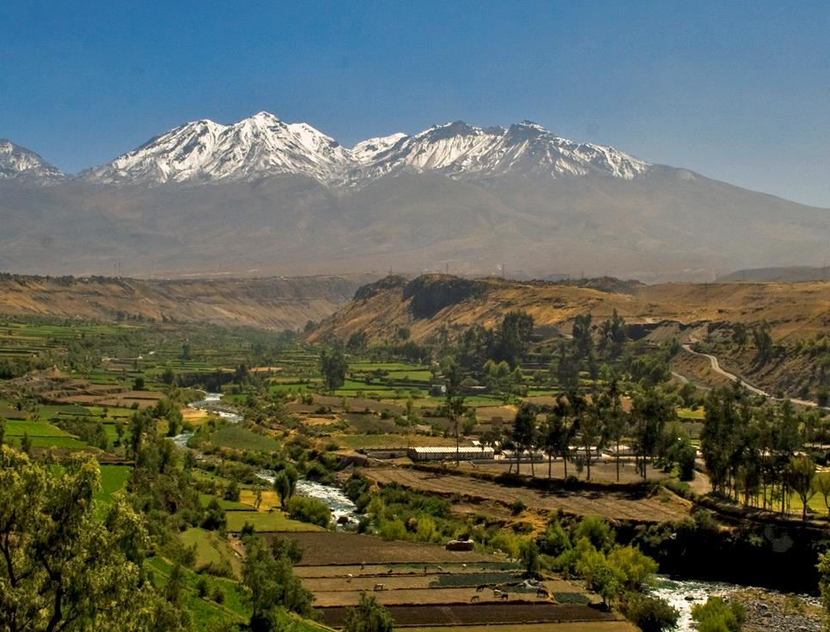
Carmen Alto Viewpoint

Slide 34
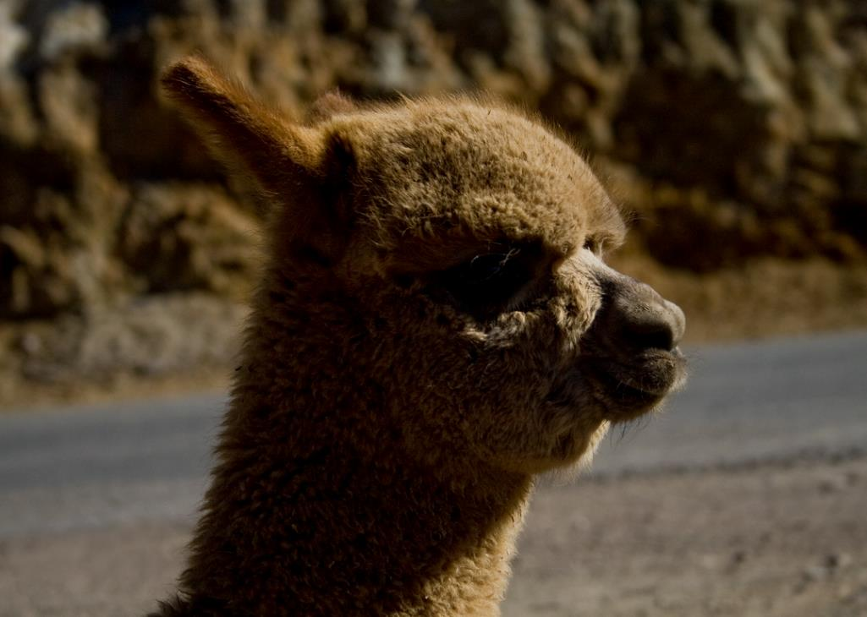
Salinas- Aguada Blanca National Reserve

Slide 35
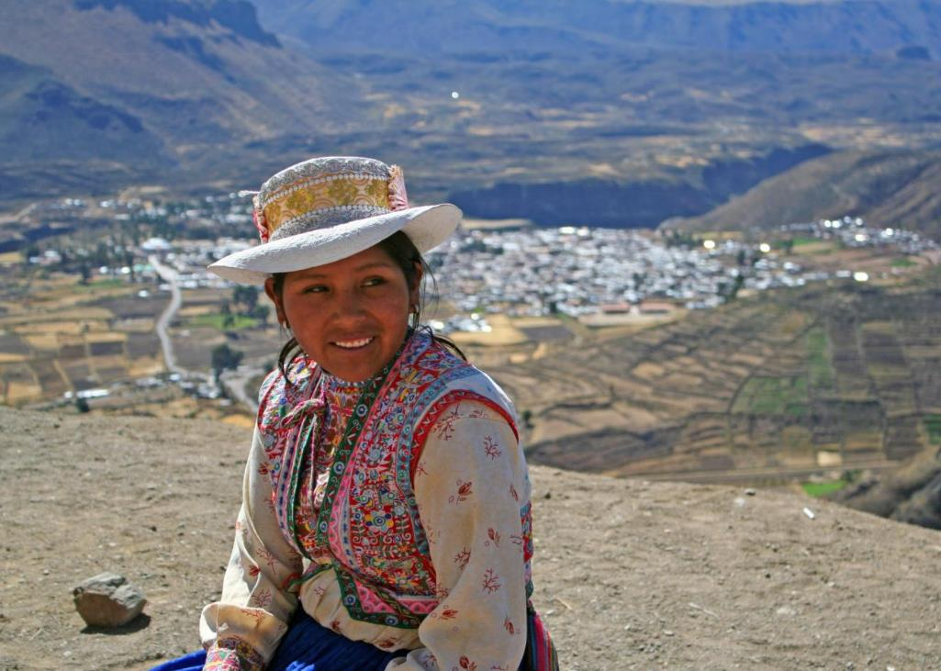
Chivay Town

Slide 36
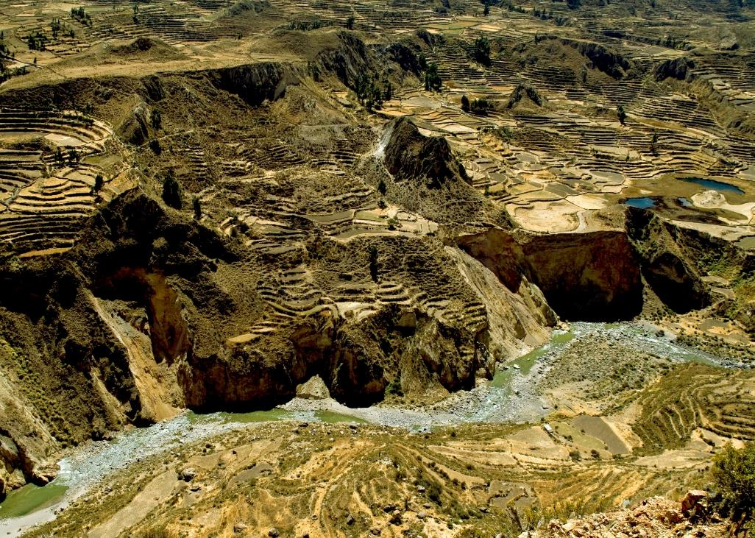
Colca Canyon

Slide 37
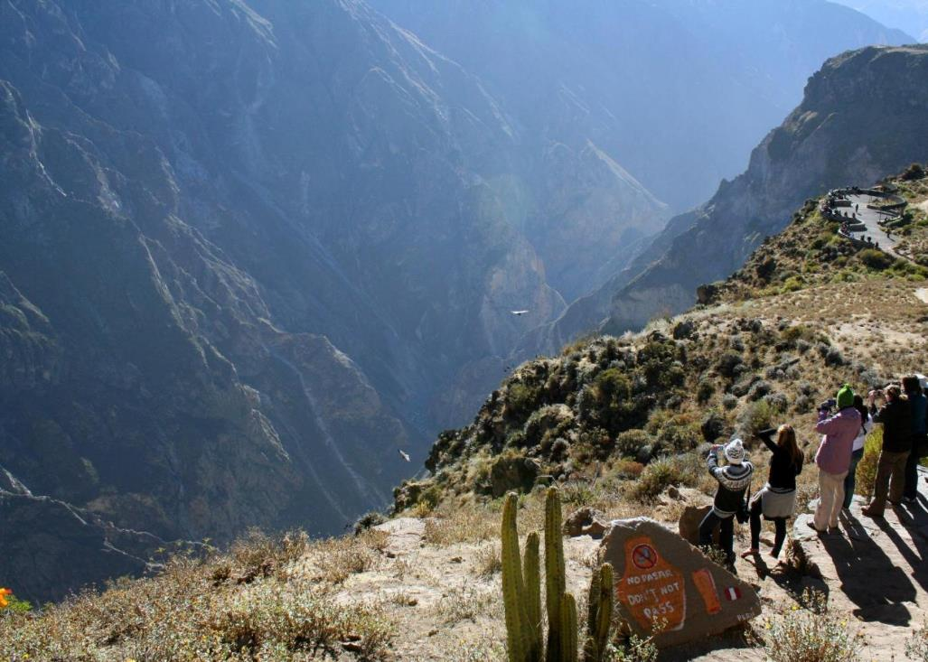
Condor Cross

Slide 38
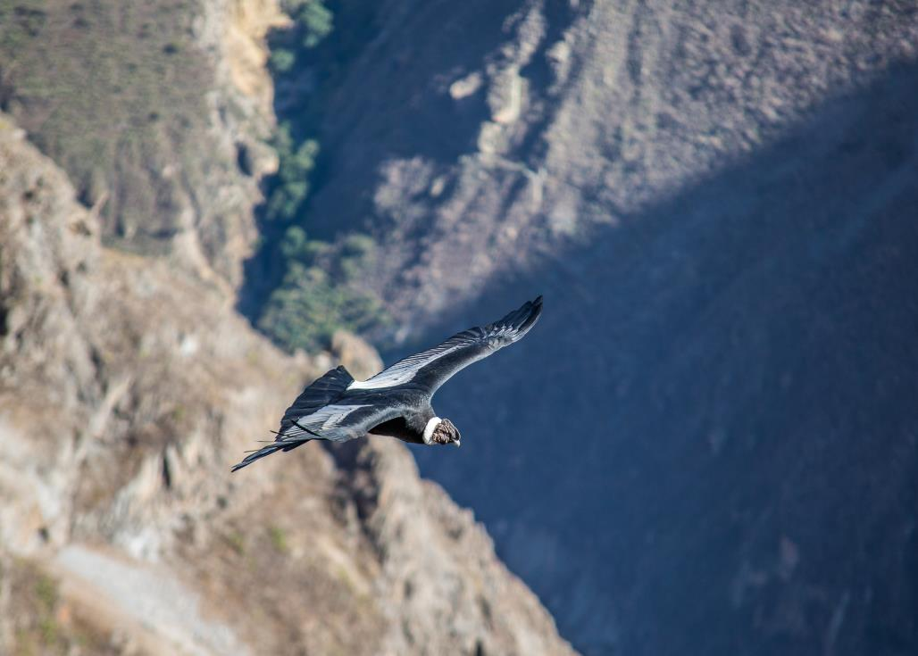
Condor Cross

Slide 39
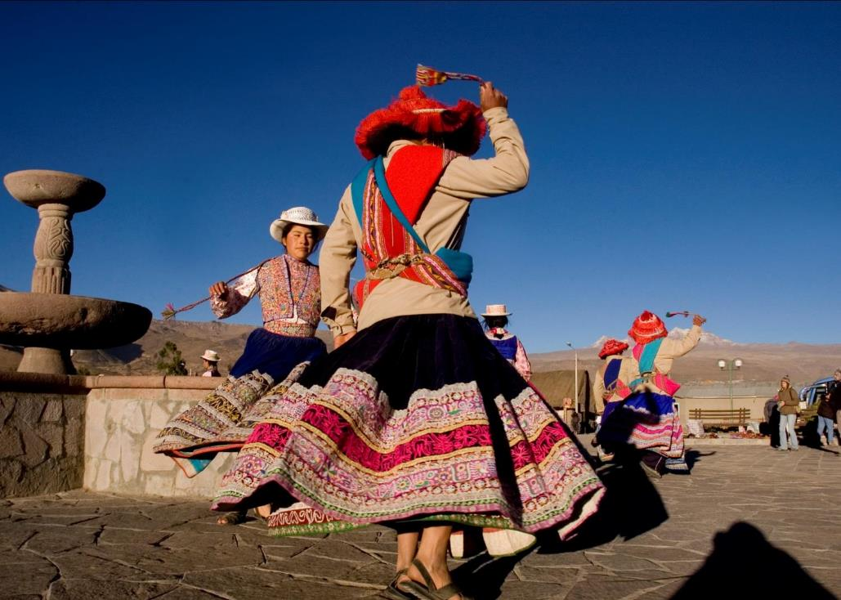
Yanque Village

Slide 40
3 NIGHTS EXTENSION SAMPLE
Lima / Arequipa / Colca Canyon / Cusco
Day 01 – Lima/ Arequipa (-/-/-)
Transfer Arequipa Airport / Hotel (private English speaking guide)
PM: Arequipa City tour, Santa Catalina Convent & Juanita Mummy
[or Sarita Mummy from December to March] (private English speaking guide)
Overnight in Arequipa
Day 02 – Arequipa / Colca Valley (B/L/-)
2 day / 1 night program Arequipa/Colca Valley (private English speaking guide)
Private transportation & private guide Arequipa / Colca Valley including en route stops & lunch at a local restaurant (English speaking guide)
Overnight in Colca Valley
Day 03 – Colca / Arequipa (B/L/-)
2 day / 1 night program Arequipa/Colca Valley (private English speaking guide)
AM: Visit the Condor Cross including en route villages (private English speaking guide)
Lunch will be served at a local restaurant (Set menu)
PM: Private transportation & private guide Colca Valley /Arequipa (English speaking guide)
Overnight in Arequipa
Day 04 – Arequipa / Cusco (B/-/-)
AM: Transfer Hotel / Arequipa Airport (private English speaking guide)

Slide 41
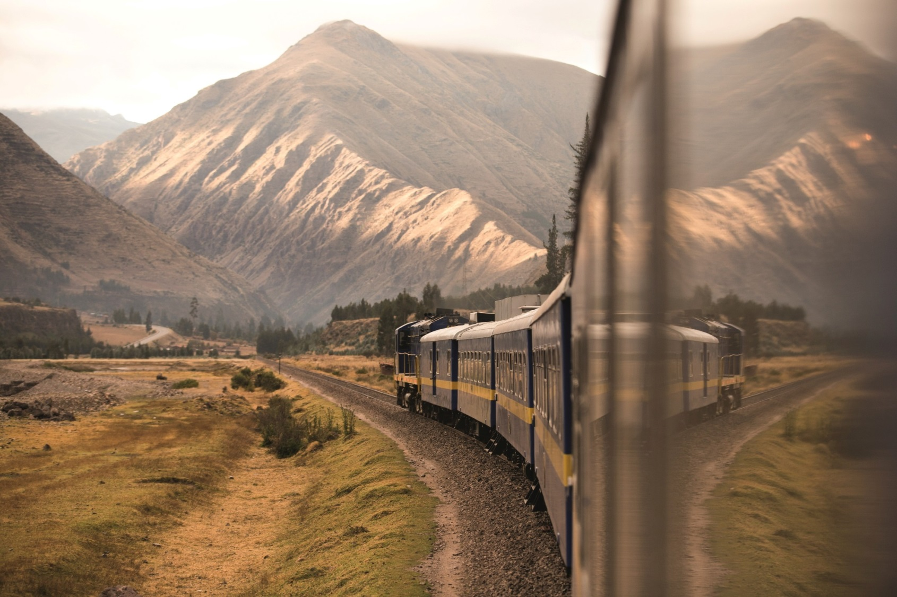
Andean Explorer

Slide 42
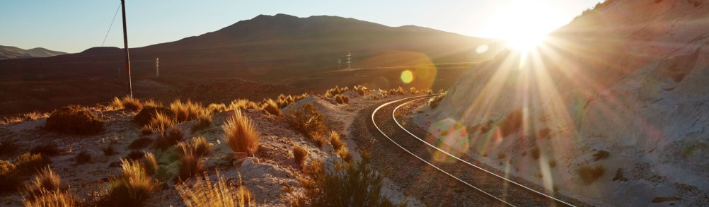
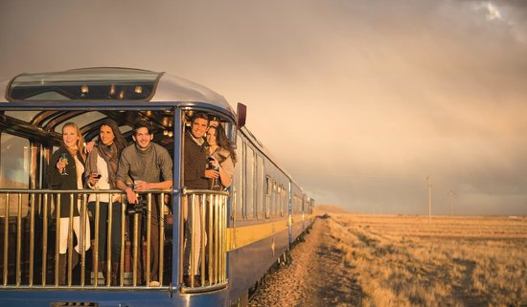
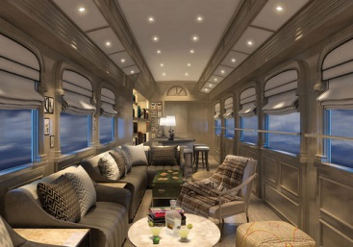

Slide 43
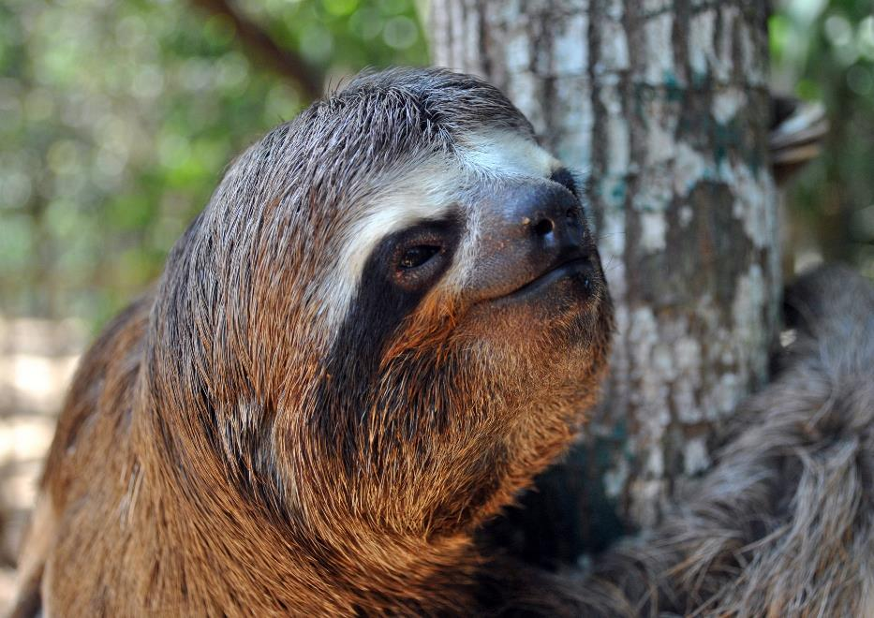
Puerto Maldonado
3 days / 2 nights extension

Slide 44
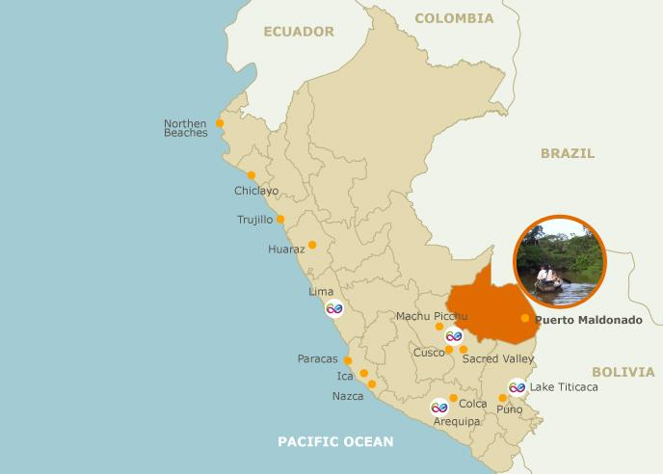
Altitude:
104 m.a.s.l / 341 feet
Climate:
Humid and warm
Rainy season between December and March
Maximum: 26°C (77°F)
Minimum: 8°C ( 24°F)
Access Route
By air:
Daily flights from Lima to: Puerto Maldonado (90min)
Notes:
mapa

Slide 45
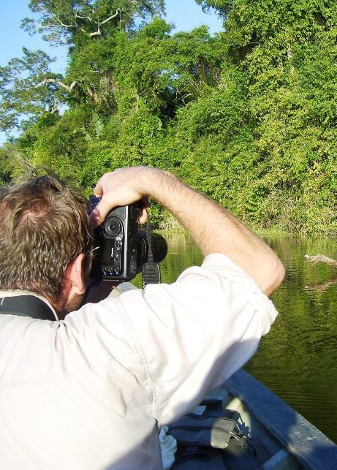
Season:
All year round
Rainy season: December to March
FEEL AND HEAR
THE AMAZONIAN JUNGLE
Content:
Natural reserves, Native communities
Puerto Maldonado is the main city of the department of Madre de Dios, and the starting point for jungle trips.
Nearby lies the Manu National Park, Tambopata National Reserve, and Bahuaja-Sonene National Park. These are some of the most pristine primary rainforests in the world, which include several oxbow lakes and clay clicks, where hundreds of birds including macaws feed on clay.
Recommended stay:
3 nights

Slide 46
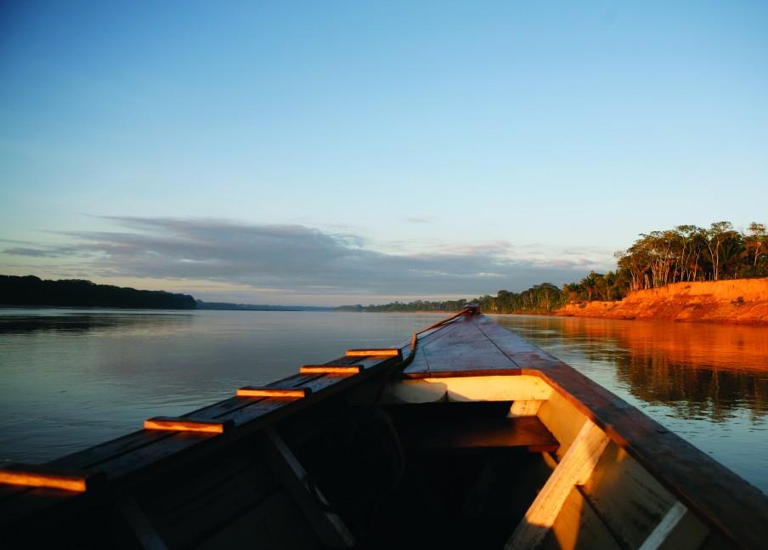
Puerto Maldonado

Slide 47
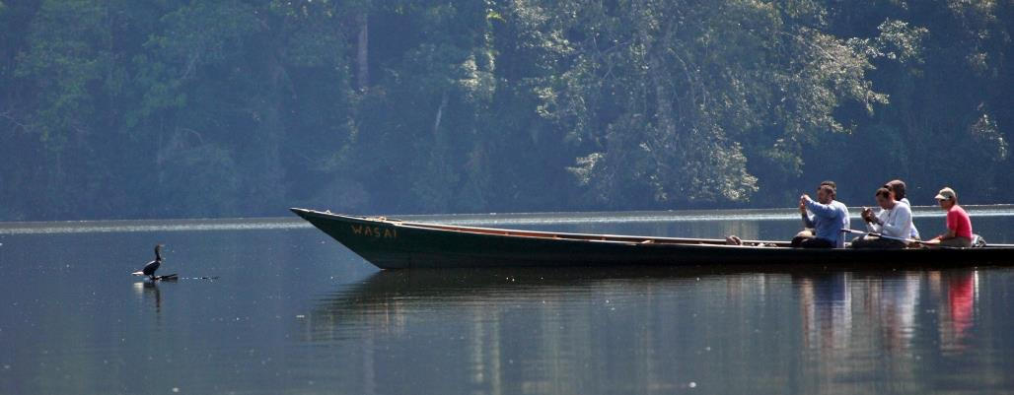
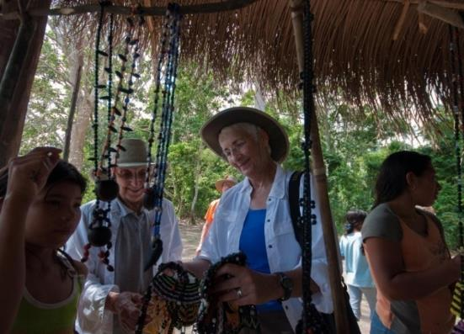
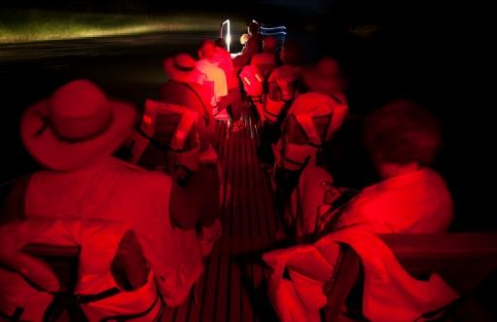
Jungle Excursions – Eco Activities

Slide 48
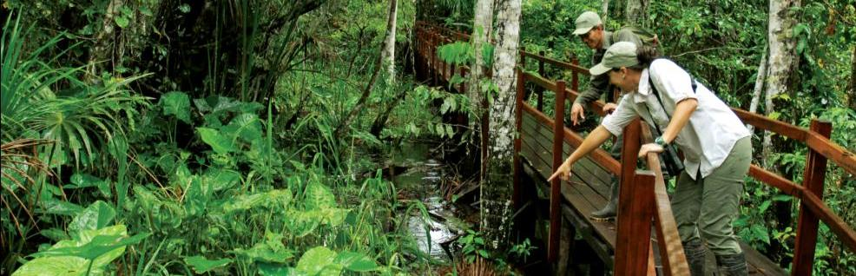
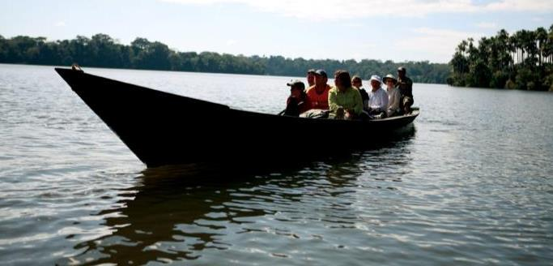

Jungle Excursions – Eco Activities

Slide 49



Giant river otter
Squirrel Monkey
White Caiman
Biodiversity

Slide 50




Scarlet Macaw
Brown Agouti
Clown Tree-frog
Ornate Snail-eater snake
Biodiversity

Slide 51

Sandoval Lake

Slide 52

Metropolitan Touring Peru
Preferred Lodges
Puerto Maldonado

Slide 53




Slide 54
Inkaterra Reserva Amazónica
Access method |  | Car ride from PEM Airport to the port and motor boat ride down to Reserva Amazonica.
Travel time |  | 10’ car ride and 45’ motor boat
Location |  | Adjacent to the lush Tambopata National Reserve
Best time to visit |  | Late March through December
Lodge Facilities | Rooms | 35 thatched roof cabañas, built on raised platforms in the style of the indigenous Ese’ Eja people.
 | Dining room | Meals are served in the main dining room. international buffet is served for breakfast; lunch and dinner are served a la carte
 | Bar | Complete bar service
 | Hammock area | yes
 | Trails | Yes, plus the Inkaterra Canopy Walkway
 | Boutique | Yes
 | Library | Yes
 | Observation towers | Yes
Guide ratio |  | Private Explorer Guides
Tour programs |  | 3d/2n; 4d/3n; 5d/4n – add nights available
Target market |  | Special interest, Honeymooners, Birdwatchers, Photographers , Families

Slide 55

Inkaterra Reserva Amazonica

Slide 56

Inkaterra Reserva Amazonica

Slide 57

Inkaterra Reserva Amazonica

Slide 58

Inkaterra Reserva Amazonica

Slide 59


Slide 60

Canopy Tree House

Slide 61

Canopy Tree House

Slide 62

Canopy Tree House

Slide 63


Slide 64
Hacienda Concepción by Inkaterra
Access method |  | Car ride from PEM Airport to the port and motor boat ride
Travel time |  | 20 minutes down the river from the town of Puerto Maldonado
Location |  | In an enchanting and serene lush setting within 819 hectares of natural rain forests that act as a buffer zone between the Tambopata National Park and the right shore of the vast Madre de Dios river.
Best time to visit |  | Late March through December
Lodge Facilities | Rooms | 8 twin rooms and 7 cabañas
 | Dining room | Nutritious buffet meals made with organic ingredients served in the main dining room.
 | Bar | Yes. Complementary Pisco sour during happy hour between 5 p.m. – 7 p.m.
 | Hammock area | No
 | Trails | Yes. Many
 | Boutique | No
 | Library | No
 | Observation towers | No
Guide ratio |  | Private Explorer Guides
Tour programs |  | 3d/2n; 4d/3n; 5d/4n – add nights available
Target market |  | Special interest, Honeymooners, Birdwatchers, Photographers , Families

Slide 65

Hacienda Concepción by Inkaterra

Slide 66

Hacienda Concepción by Inkaterra

Slide 67

Hacienda Concepción by Inkaterra

Slide 68

Hacienda Concepción by Inkaterra

Slide 69



Slide 70

Posada Amazonas
Access method |  | Bus ride from PEM Airport to the Infierno River Port and motor boat ride down to Posada Amazonas
Travel time |  | 45´by motor boat and 10' walk to the lodge
Location |  | Inside a 200 acre uninhabited private community reserve, adjacent to the Tambopata National Reserve
Best time to visit |  | Late March through December
Lodge Facilities | Rooms | 30 double bedrooms with a private bathroom with hot water only. Rooms and bathrooms are separated by drapes
 | Dining room | Self serve three course meals served in the main dining room.
 | Bar | Yes
 | Hammock area | No
 | Trails | Yes. Many
 | Boutique | Yes
 | Library | No
 | Observation towers | Yes, Canopy Tower
Guide ratio |  | 10 pax per 1 guide
Tour programs |  | 3d/2n; 4d/3n; 5d/4n – add nights available
Target market |  | Special interest, Honeymooners, Birdwatchers, Photographers , Families

Slide 71

Posada Amazonas

Slide 72

Posada Amazonas

Slide 73

Posada Amazonas

Slide 74

Posada Amazonas

Slide 75



Slide 76
Refugio Amazonas
Access method |  | Bus ride from PEM Airport to the Infierno River Port and motor boat ride down to Refugio Amazonas
Travel time |  | 2 hr 30´by motor boat and 10' walk to the lodge
Location |  | Adjacent to Tambopata National Reserve
Best time to visit |  | Late March through December
Lodge Facilities | Rooms | 32 Rooms with Private Bathroom with cold water only. Rooms and bathrooms are separated by drapes
 | Dining room | The dining room is a huge open building with a loft on the second story for an eye level view of the surrounding rainforest canopy
 | Bar | No
 | Hammock area | No
 | Trails | Yes, plus a children rainforest trail
 | Boutique | Yes
 | Library | No
 | Observation towers | Yes, Canopy Tower
Guide ratio |  | 10 pax per 1 guide
Tour programs |  | 3d/2n; 4d/3n; 5d/4n – add nights available
Target market |  | Special interest, Honeymooners, Birdwatchers, Photographers , Families

Slide 77

Refugio Amazonas

Slide 78

Refugio Amazonas

Slide 79



Slide 80
Tambopata Research Center
Access method |  | Bus ride from PEM Airport to the Infierno River Port and motor boat ride down to TRC
Travel time |  | 7 Hours (4 Hours from Refugio Amazonas)
Location |  | Inside the Tambopata National Reserve
Best time to visit |  | Late March through December
Lodge Facilities | Rooms | 18 small rooms with shared bathroom. Bedrooms are separated from one another by light cane fencing, with drapes instead of doors. Bedrooms open out onto the surrounding rainforest, allowing guests to enjoy this unique ecosystem
 | Dining room | Self-serve three course meals served in the main dining room.
 | Bar | No
 | Hammock area | No
 | Trails | Yes
 | Boutique | No
 | Library | Yes
 | Observation towers | Yes
Guide ratio |  | 6 pax per 1 guide
Tour programs |  | Minimum stay: 4 nights (two of them at Refugio Amazonas)
Target market |  | Special interest, Birdwatchers, Photographers

Slide 81

Tambopata Research Center

Slide 82

Tambopata Research Center

Slide 83

Tambopata Research Center

Slide 84

Tambopata Research Center

Slide 85

Amazon Cruises - Iquitos
4 days / 3 nights extention

Slide 86

Altitude:
104 m.a.s.l / 341 feet
Climate:
Hot and rainy all year long
Maximum: 31°C (88°F)
Minimum: 21°C (70°F)
The dry season ( July-November) and the flood season (December – July) feature particular differences in the flora & fauna
Access Route
By air:
Daily flights from Lima to: Puerto Maldonado (90min)

Slide 87

Swimming - Amazon River

Slide 88

Visits to communities

Slide 89

Pirana Fishing

Slide 90

Amazon River Cruises

Slide 91

Always go to an expert!
Small team = Personalized service
Local company with over 5 decades of expertise in operation
We pay 10 or 12% commission*
Toll Free 1-888-458-8567 (from US & Canada)
One-stop-shop for all Peru related services as well as for multi-country (with Ecuador and Colombia!)

Slide 92

We specialize in tailor-made programs for the most demanding guests and we always propose engaging, authentic and unforgettable experiences.
We provide extremely competitive rates (net or gross)
Our quotations to you will always include any promotions launched by hotels or cruises.
We can provide itemized quotations to make things easier for you
We keep you informed of relevant developments and product updates in Peru
Payments can be directed to our US-based bank account or via major credit cards
We offer open webinars about Peru to our clients and we can set-up tailored webinars on any subject you choose, exclusively for you.
We provide you with plenty marketing support, including high resolution pictures, videos, presentations, among others.
Lake Titikaka

Slide 93



General enquiries: info@metropolitan-touring.com.pe
Toll Free 1-888-458-8567 (from US & Canada) / Phone: +(51 1) 715 5515
For more details, comments and bookings, please contact us:
Mariela Chiara
Sales Leader USA, Canada & Latin America
mchiara@metropolitan-touring.com.pe
Skype: Mariela.chiara
Carla Acosta
Exclusive Service Desk for Travel Agents
cacosta@metropolitan-touring.com.pe
Skype: Carla-mtp_1
Marisol Matos
Exclusive Service Desk for Travel Agents
mmatos@metropolitan-touring.com.pe
Skype: marisolmatos-mtp

Slide 94

Thank you!
For questions please use the control panel located at the right hand side of your computer

