Slide 1
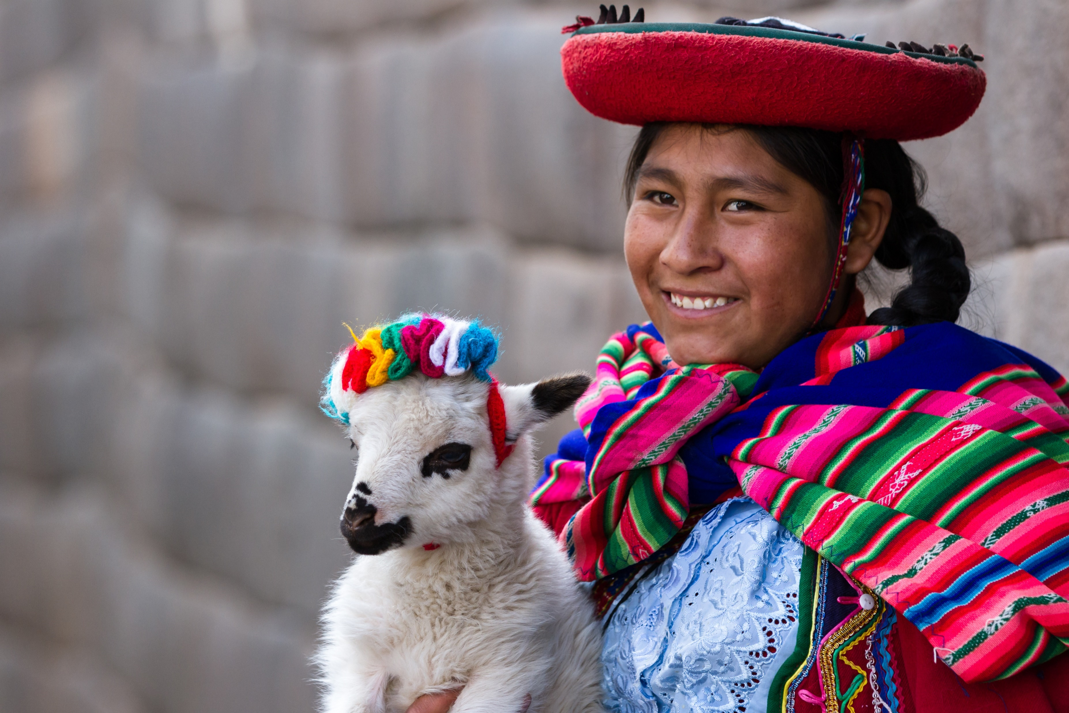

Slide 3
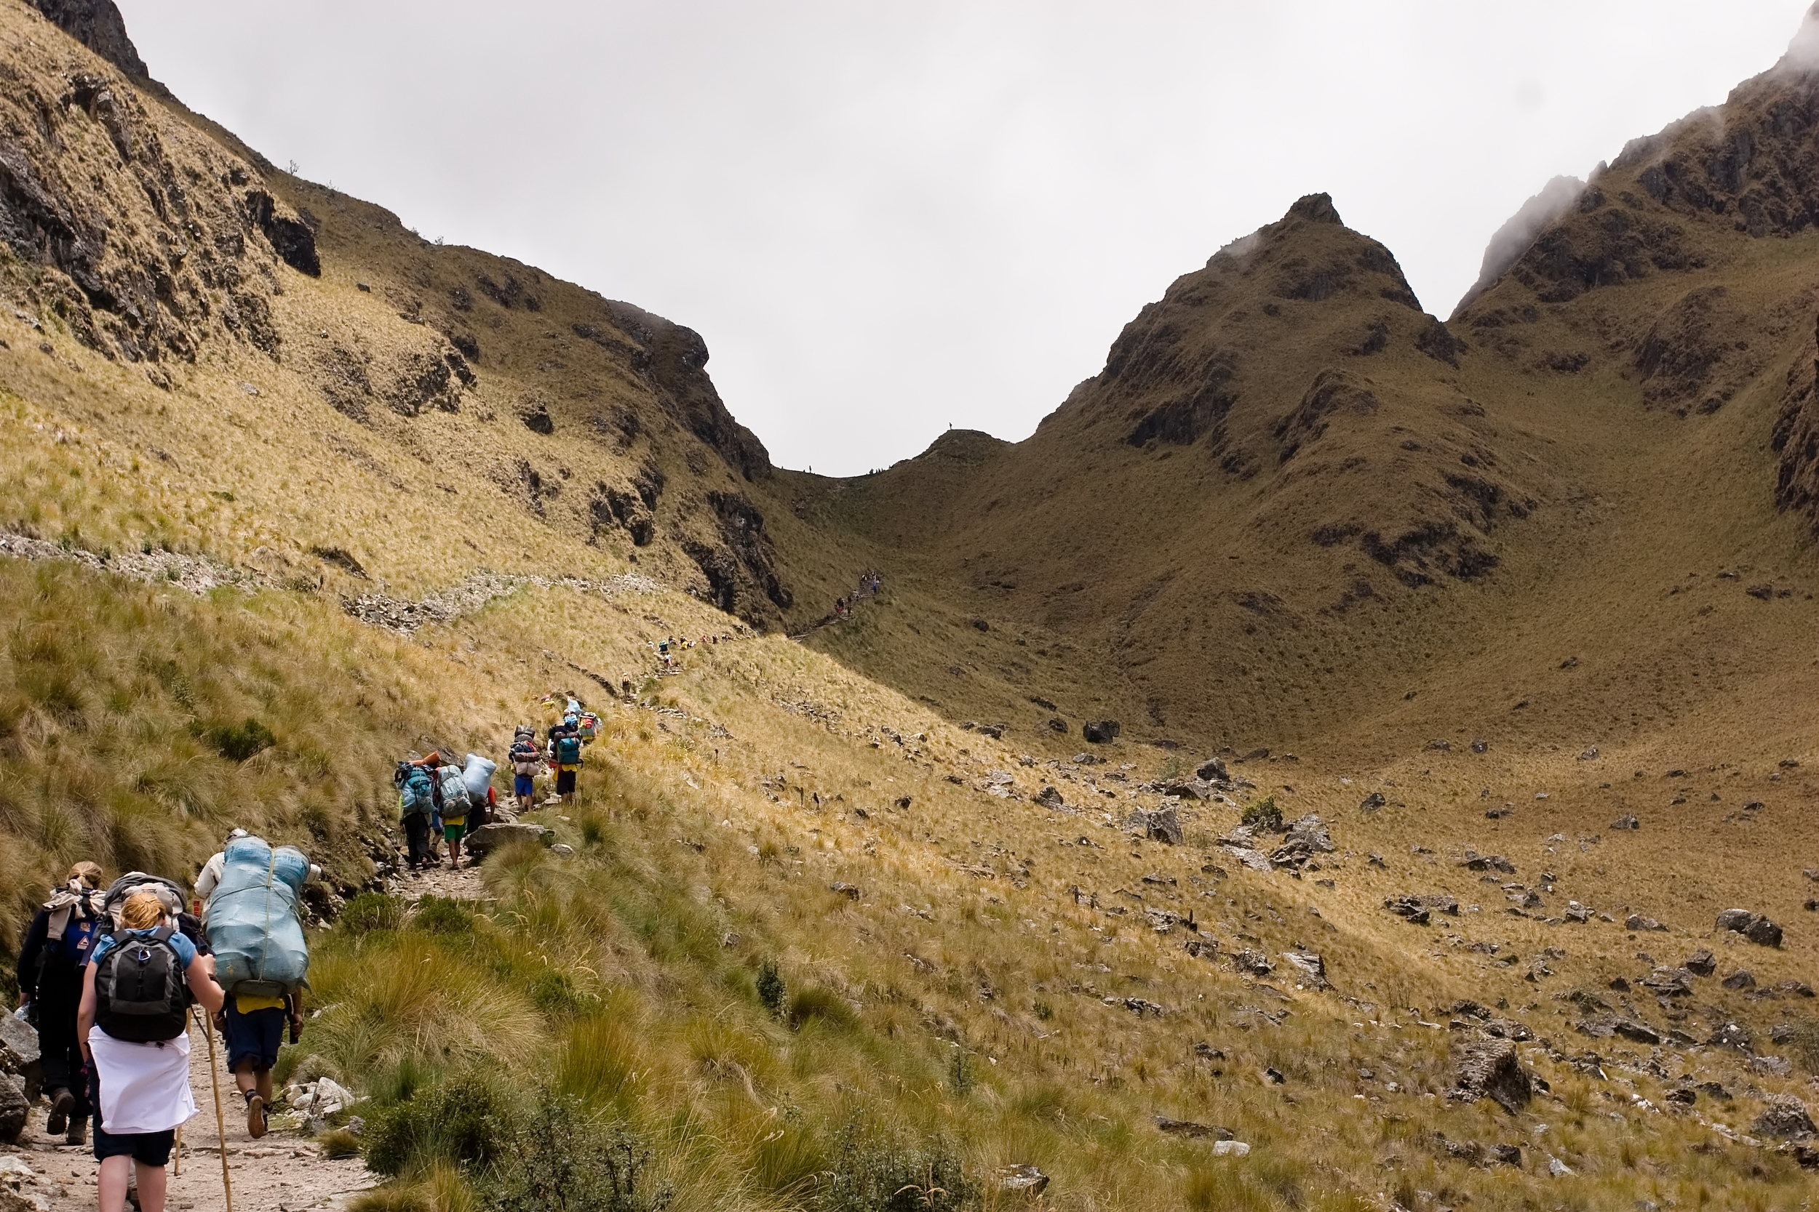
Inca Trail & Salkantay

Slide 5
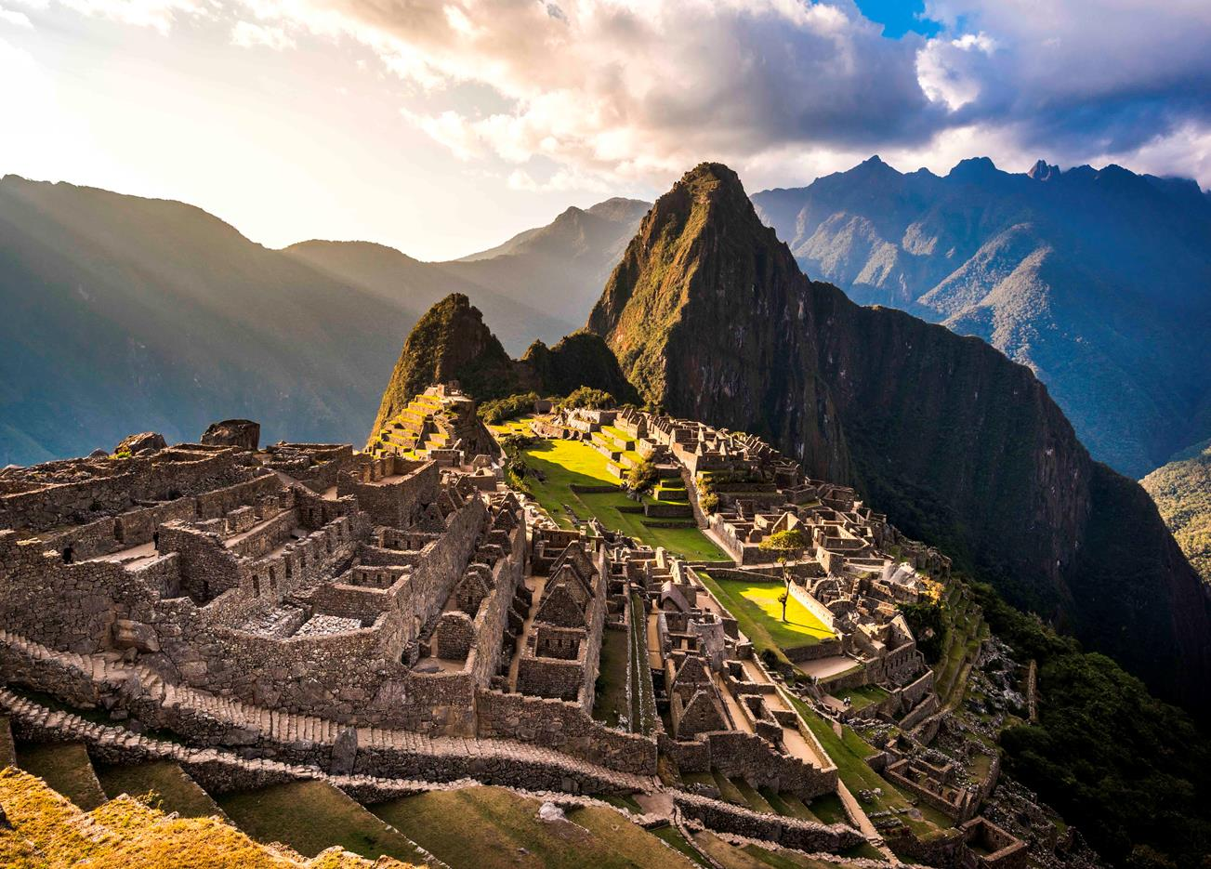

Slide 6
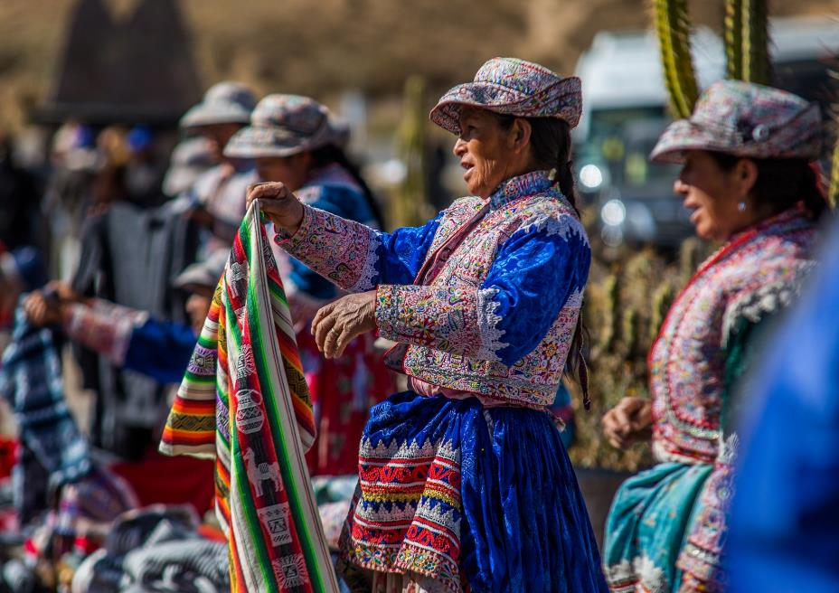

Slide 7
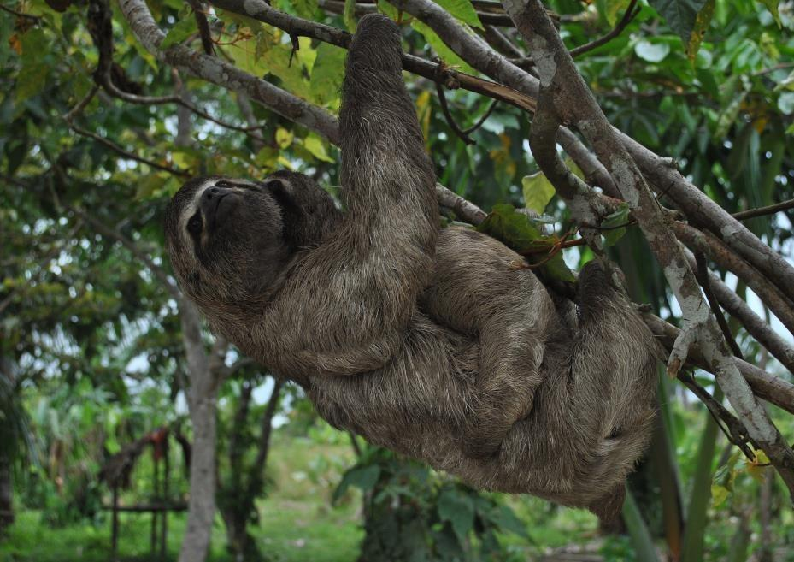

Slide 8
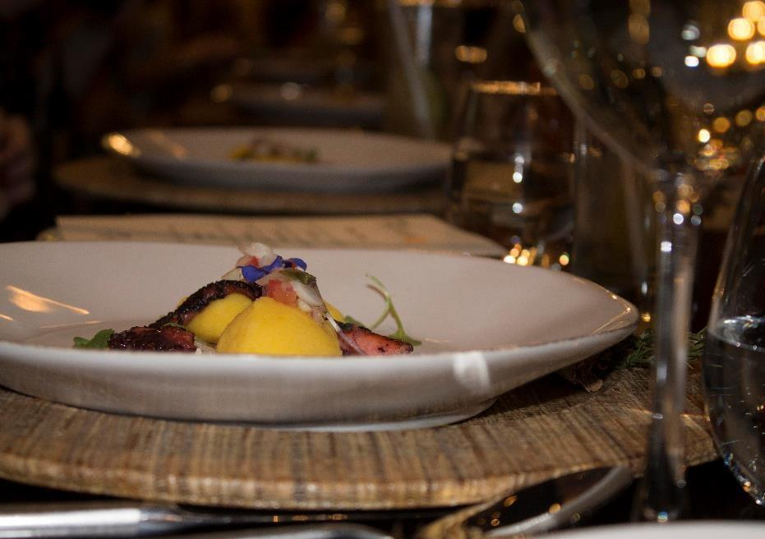

Slide 9
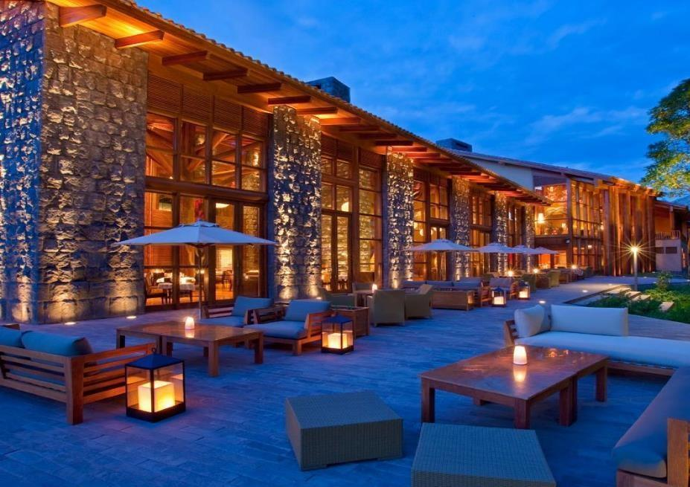

Slide 10
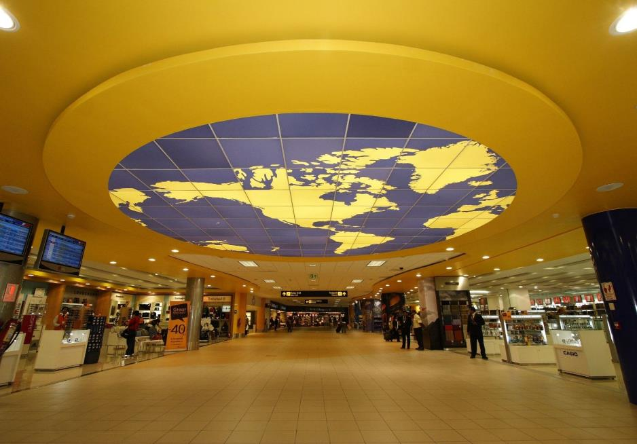

Slide 11
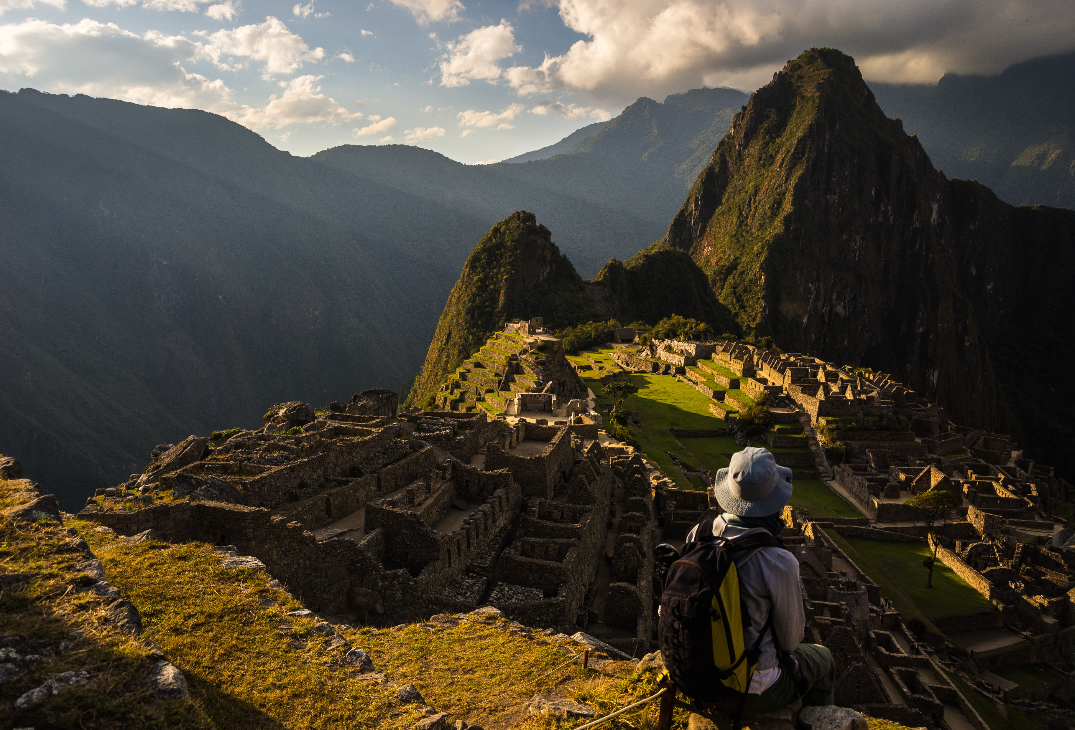
Index:
Inca Trail Express (2d-1n)
Equipment
Inca Trail (4d-3n)
Contact
Salkantay Trek(5d-4n)

Slide 12
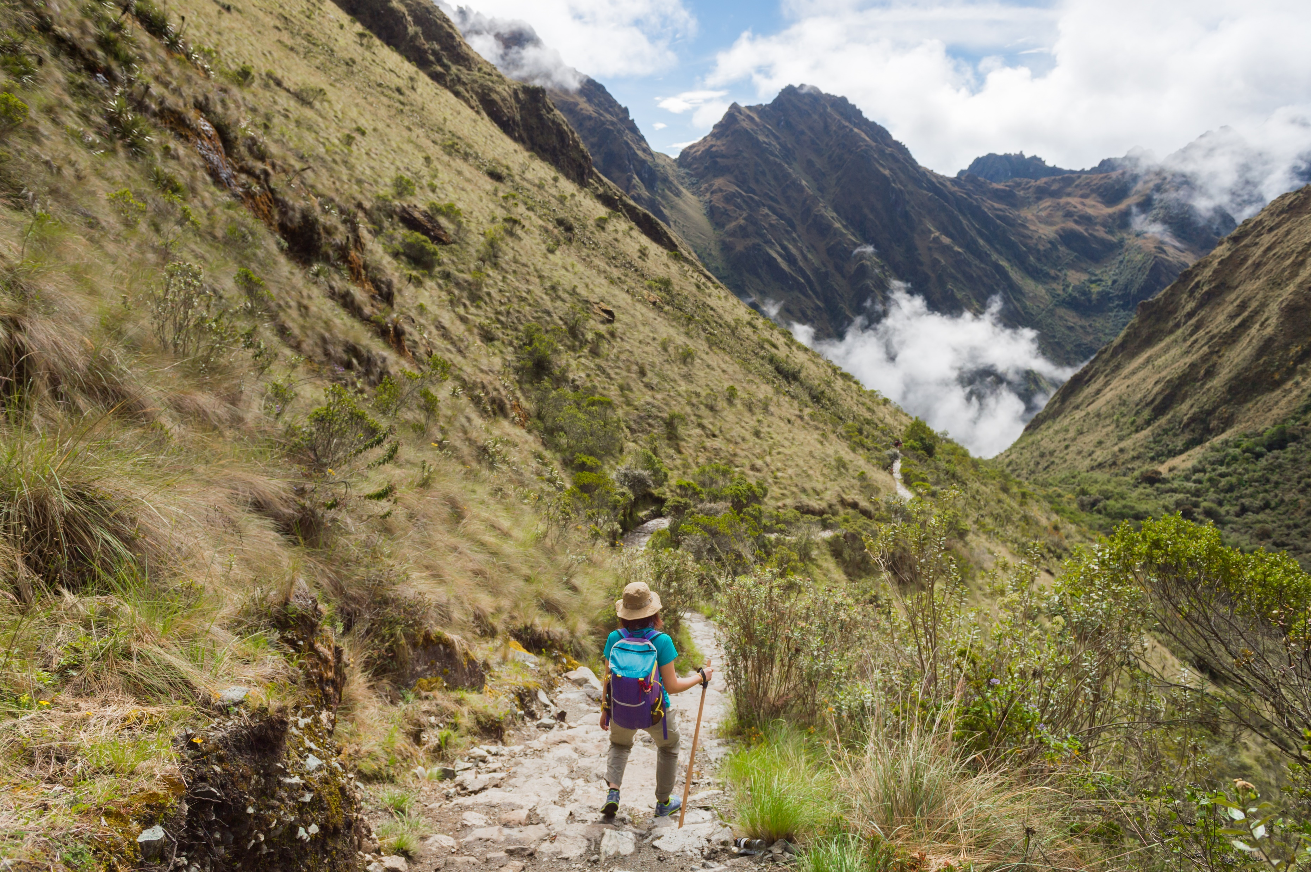
Inca Trail Express
The well-preserved final stretch of the Inca Trail starting at Chachabamba (km 104) on the railroad, up to Wiñaywayna and a stunning descent to Machu Picchu, first day hiking into the citadel through Intipunku, the door of the Sun. Next day early guided visit of Machu Picchu and train back to Cusco after lunch.

Slide 13
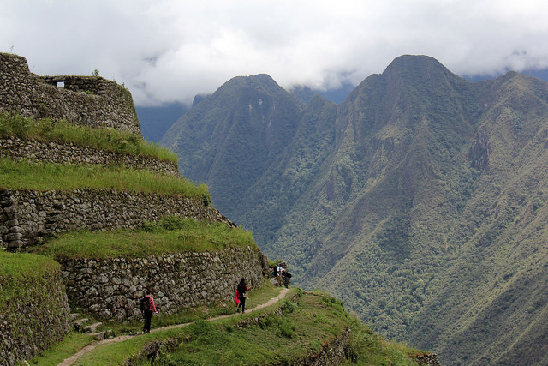
Inca Trail 2 Days/ 1 Night

Slide 14
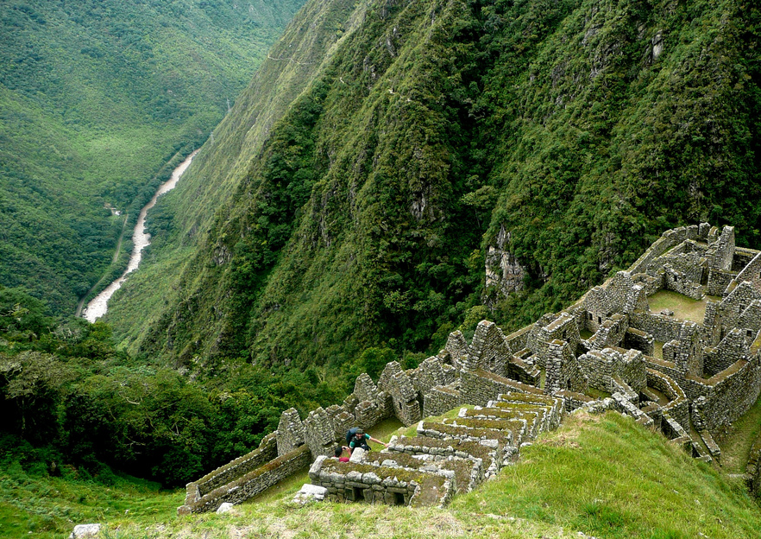
Wiñaywayna
(8858 F.A.S.L)

Slide 15
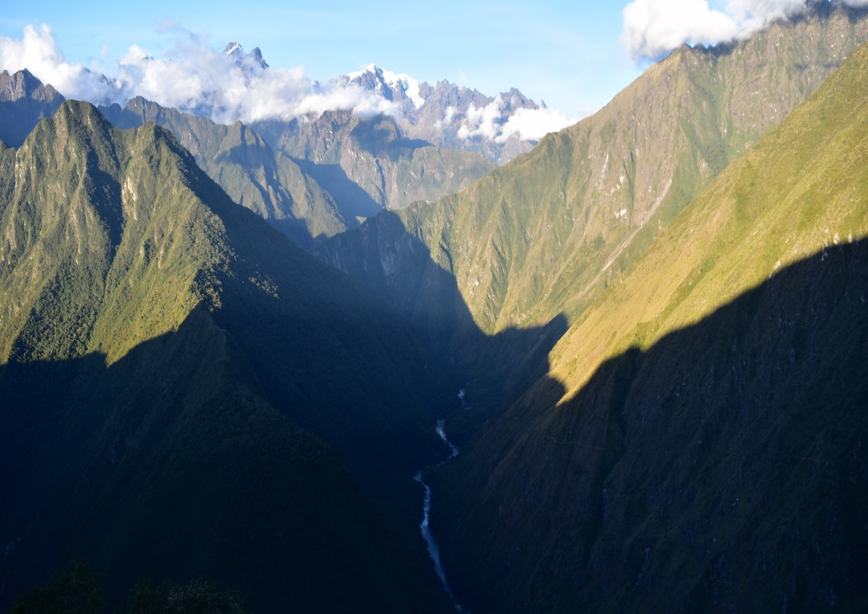
Includes:
Orientation meeting (previous to departure date).
Private transportation Cusco / Ollanta train station / Cusco
Inca Trail entrance fee
English Professional bilingual guide, additional cost for other languages
1 assistant guide for groups over 9 passengers
Day 1: Box lunch
Day 1: Bus ticket to Machu Picchu – Aguas Calientes
Day 1: Vistadome 301 train service: Ollantaytambo – Km 104 - Aguas Calientes (7:05/8:27 h.)
Day 2: Bus ticket to Aguas Calientes – Machupicchu – Aguas Calientes
Day 2: Guided tour of Machu Picchu
Wiñaywayna

Slide 16
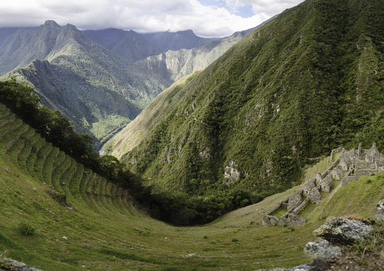
Not Included:
Porter requested in advance (max. 10 kilograms)
Dinner and lunch in Aguas Calientes.
Hotels Aguas Calientes
Tips and extra expenses
Extra services not mentioned
Entrance to Huaynapicchu requested in advance
Wiñaywayna

Slide 17
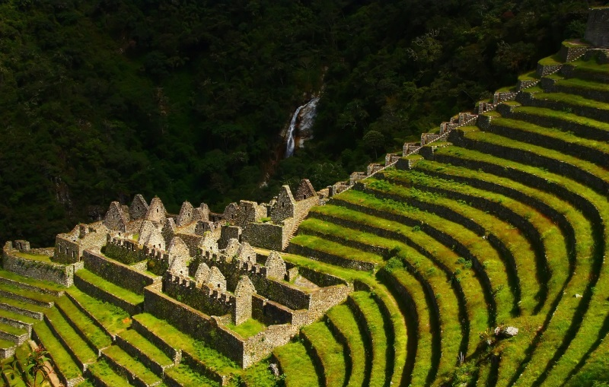
Wiñaywayna

Slide 18
Map

Slide 19
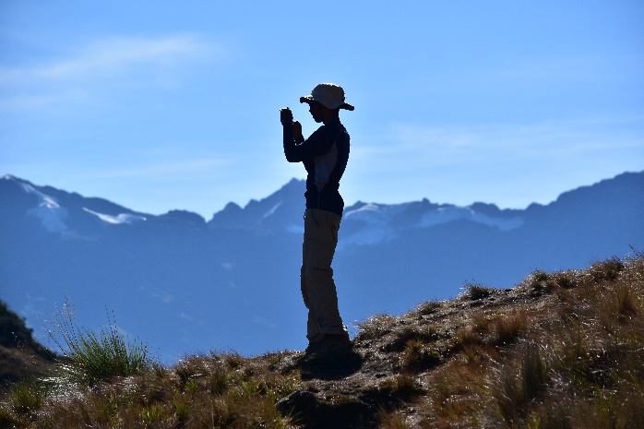
Inca Trail
4 Days/ 3 Nights
The Inca Trail to Machu Picchu is rated among the best trekking trips in the world because of the exquisite beauty of its natural surroundings. It includes different ecological areas from high deserts to the Andean tropical rain-forest. Following this ancient Inca Trail, we will be walking past mysterious archaeological sites, half covered by the jungle overgrowth that looks like you are discovering them for the first time, and finally arriving to the lost city of the Incas: Machu Picchu. Our journey is conducted by experienced guides that will make your trip pleasant and safe. Our service includes native "Quechua" porters for your luggage and we will provide delicious meals during the trip

Slide 20
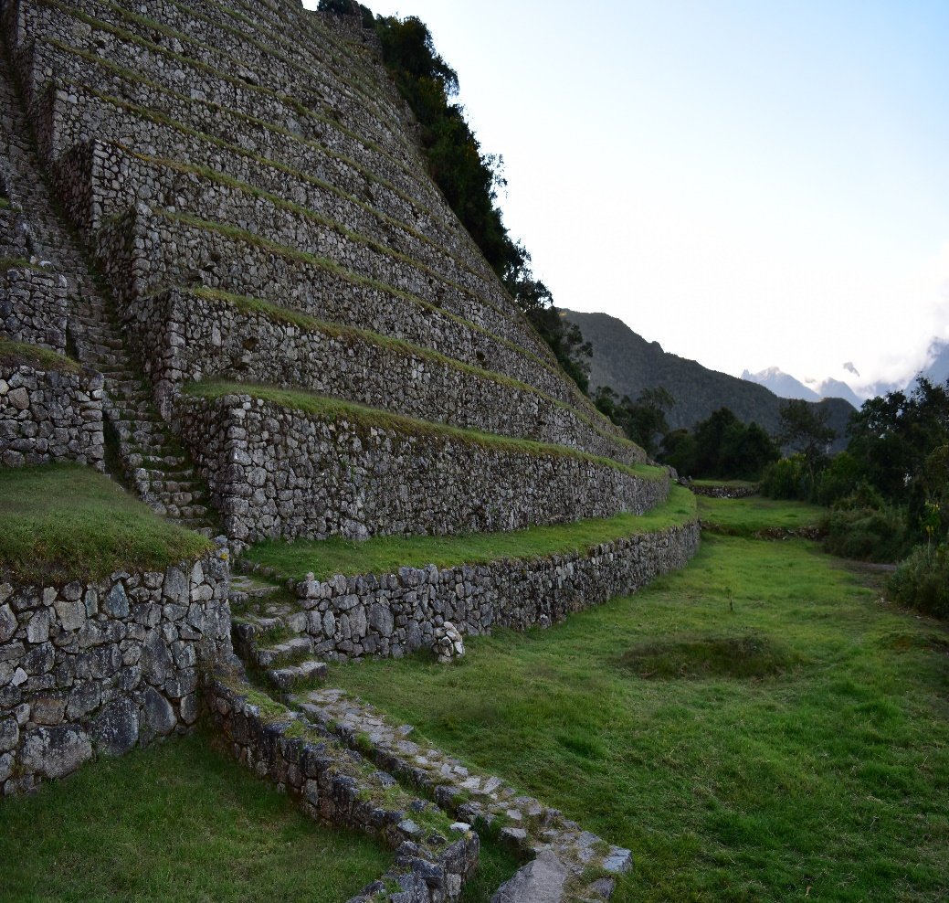
Includes:
Private transportation from your hotel to KM 82
Inca Trail entrance fee
Private traportation from Ollantaytambo train station to your hotel
All balanced meals during the trek, from lunch on day 1 to boxed lunch on day 4
Vistadome train service from Aguas Calientes to Ollantaytambo for clients and guide
All common camping gear: 3 men mountain tent for 2 people, inflatable sleeping mattress, kitchen dishes, kitchen tent, dining tent, toilet tent, table and chairs
Cook & assistant Cook
Porters for the whole camping equipment including 7 kilograms for passenger’s personal luggage (duffle bag with clothes, sleeping bag and personal items). Porters will place campsite before passenger’s arrival to campground.
First-aid kit with oxygen bottle
Sanitation care (disinfected dishes, filtered water, etc).
English Professional bilingual guide, additional cost for other languages
Assistant guide for groups over 9 people
Bus ticket from Machu Picchu to Aguas Calientes on day 4

Slide 21
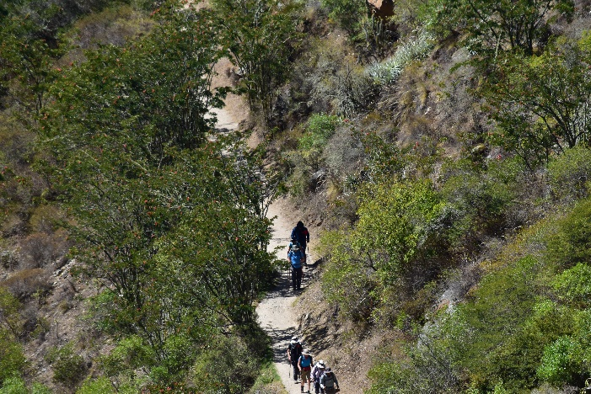
Not Included:
Sleeping bag and walking poles
Tips and extra expenses
Meals in Aguas Calientes

Slide 22
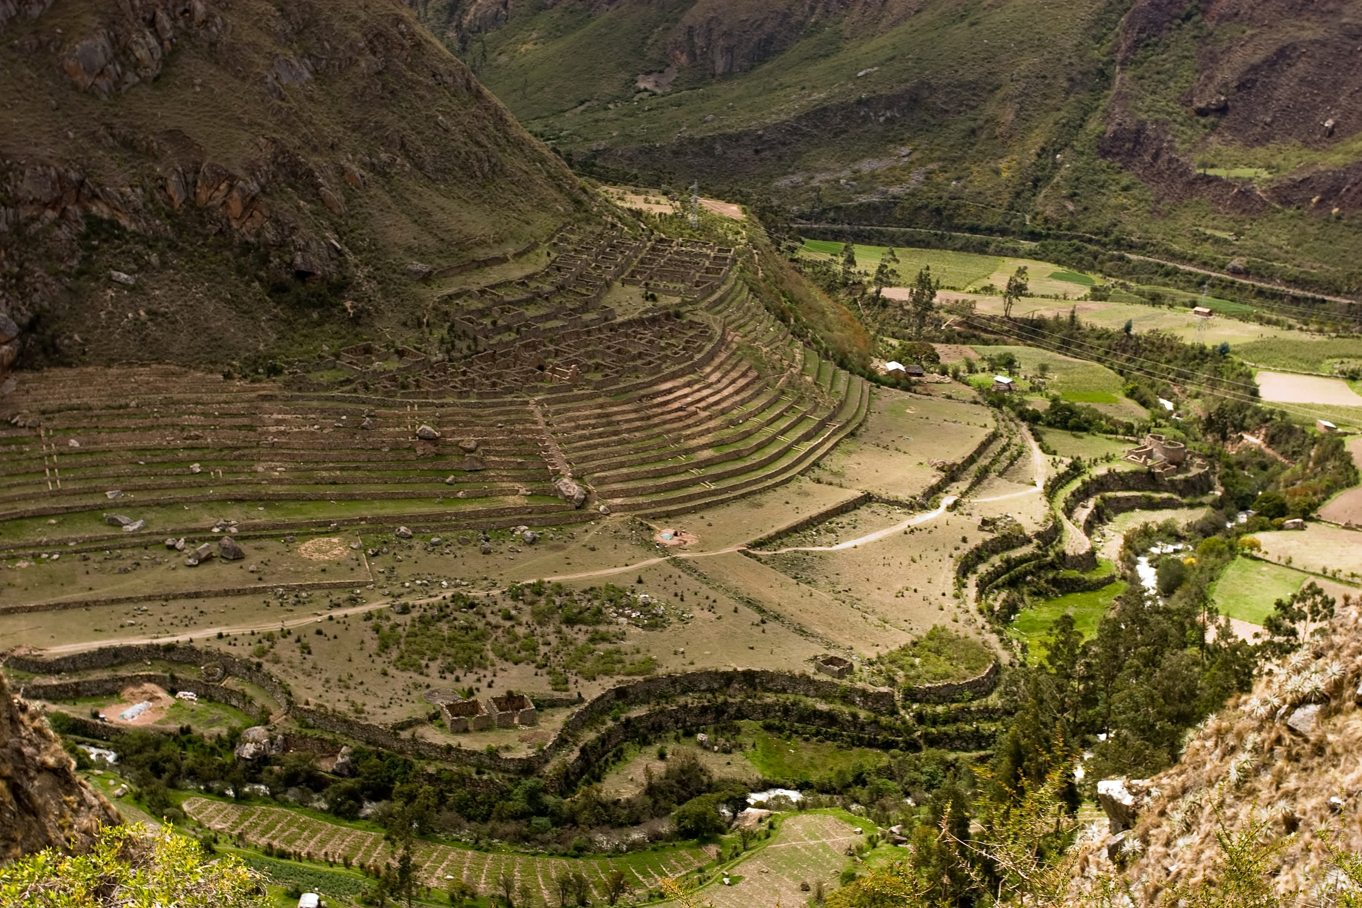
Day 1: Huayllabamba
Huayllabamba

Slide 23
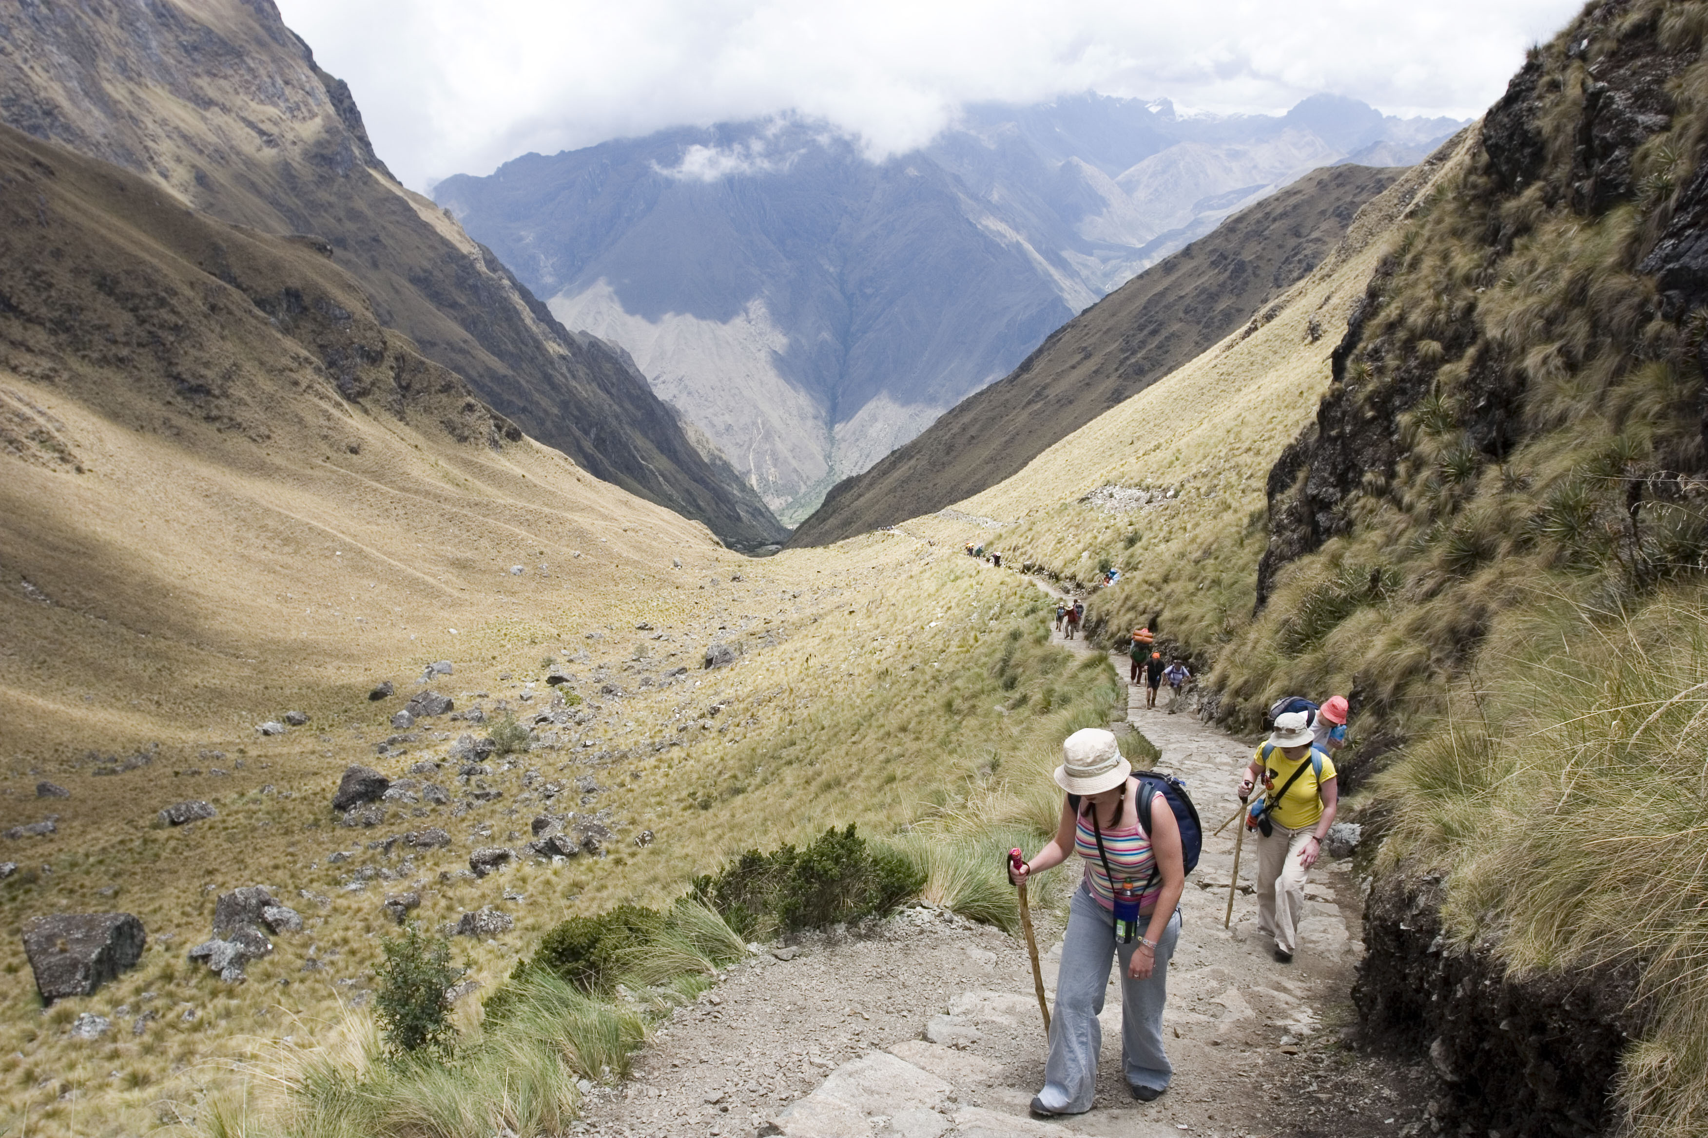
Day 2: Warmiwahuañusca Pass
Warmiwahuañusca Pass

Slide 24
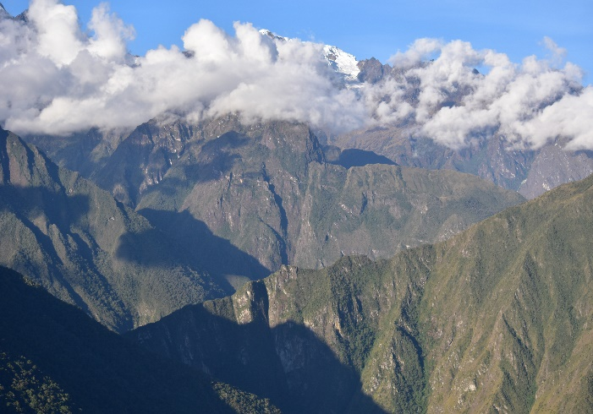
Day 3: Pacaymayo

Slide 25
Day 4: Phuyupatamarca
Phuyupatamarca

Slide 26
Map

Slide 27
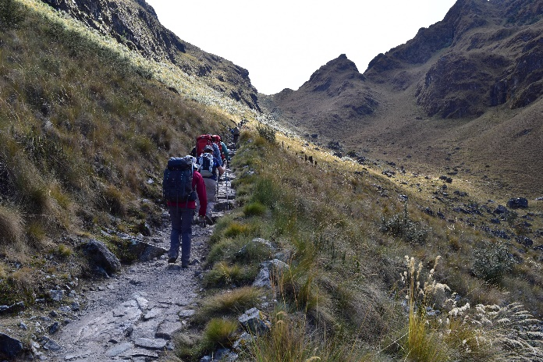
Salkantay Trek 5 Days
5 Days/ 4 Nights
Located less than fifty miles northwest of Cusco city by the Cordillera Vilcabamba and rising to 6271 meters above sea level (20574 ft) Salkantay Mountain is an outstanding glacier-capped summit worshipped for thousands of years by ancient Peruvians. The name Salkantay is a Quechua means "Wild or Savage Mountain". This trek offer a variety of ecological floors from high Andean platoons to cloud forest that we call “the eyebrow of the jungle”

Slide 28
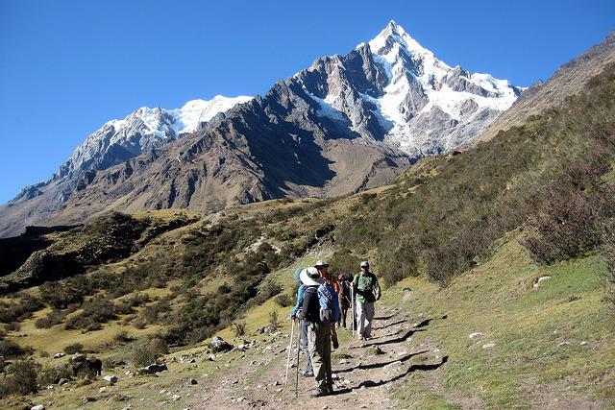
Includes:
Orientation briefing in Cusco/Sacred Valley (previous to departure date)
English Professional bilingual guide, additional cost for other languages
Transfer Hotel - Mollepata & Ollanta train station - Hotel
All balance meals during the trekking (5 days/4 nights), including snacks (from lunch on day 1 to lunch on day 4)
All common camping gear: 3 men mountain tent for 2 people, inflatable mattress, kitchen dishes, kitchen tent, dinner tent, toilet tent, table, chairs
Cook, kitchen crew and commissary gear with all meals included as described
Horse and mules for the whole equipment and luggage (7 kilograms per client, including the sleeping bag weight)
First-aid kit with oxygen
Short wave radios (for staff )
Machu Picchu entrance fee (5th day)
Bus up and down to Machu Picchu (5th day).
Sanitation care (disinfected dishes, filtered water, etc).
Environment care (all the garbage is going back to Cusco, portable toilet treatment).
Train Expedition from Hidroelectrica to Aguas Calientes 4th day
Train Vistadome from Machu Picchu to Cusco.

Slide 29
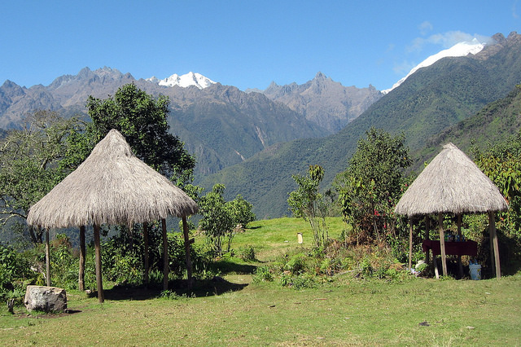
Not Included:
Entrance fee to Huaynapicchu Mountain (required in advance)
Sleeping bag
Meals in Aguas Calientes
Extra services not mentioned in the program
Tips and extras

Slide 30
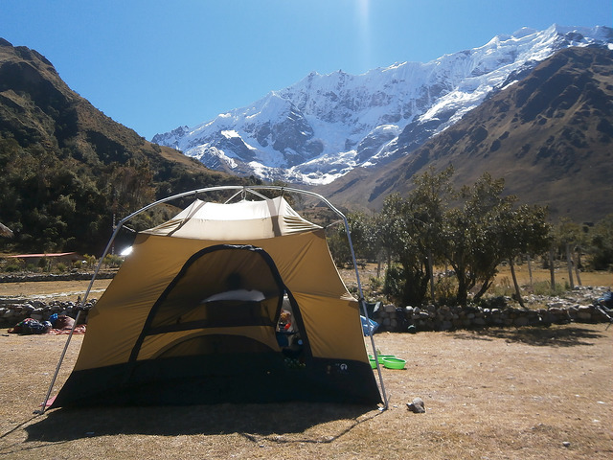
Day 1: Soraypampa
Soraypampa

Slide 31
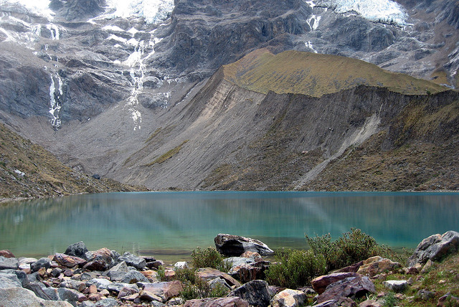
Day 2: Huacramachay
Huacramachay

Slide 32
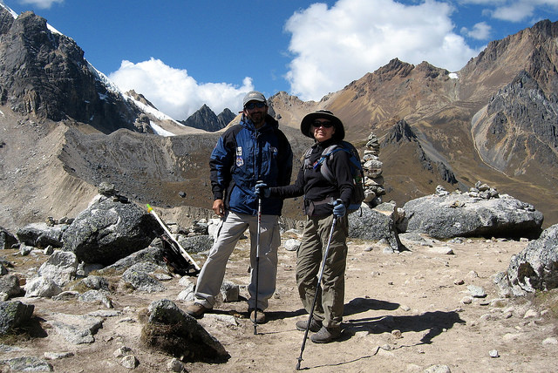
Day 3: Wiñaypoko
Wiñaypoko

Slide 33
Day 4: Llactapata
Llactapata

Slide 34
Day 5: Machu Picchu
Machu Picchu

Slide 35
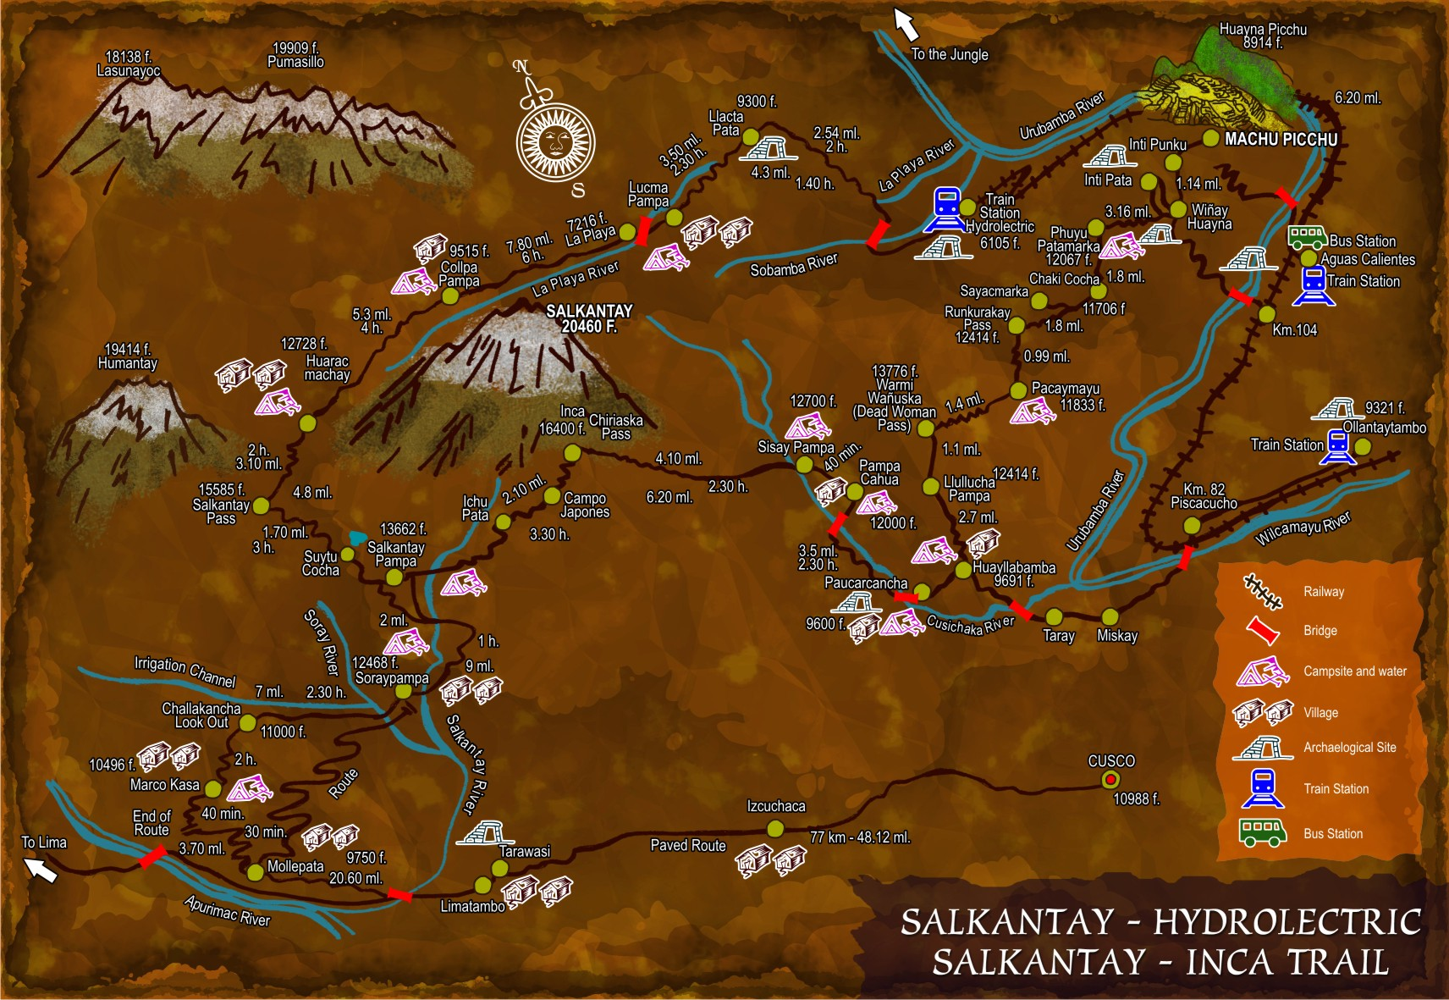
Map

Slide 36
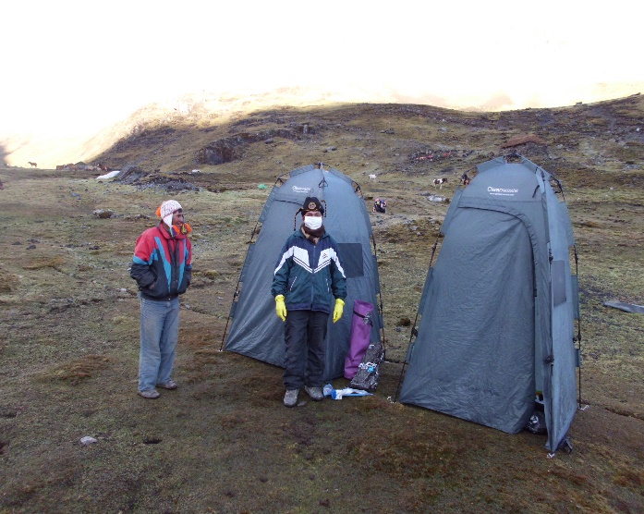
Equipment

Slide 37
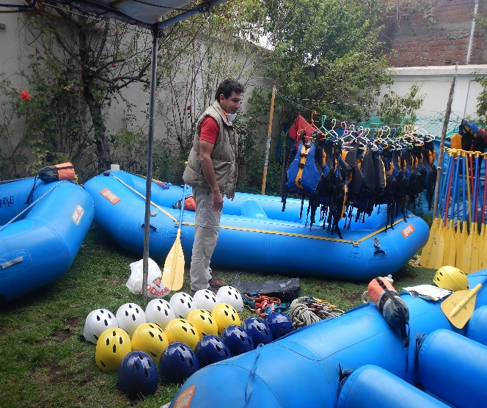
Equipment

Slide 38
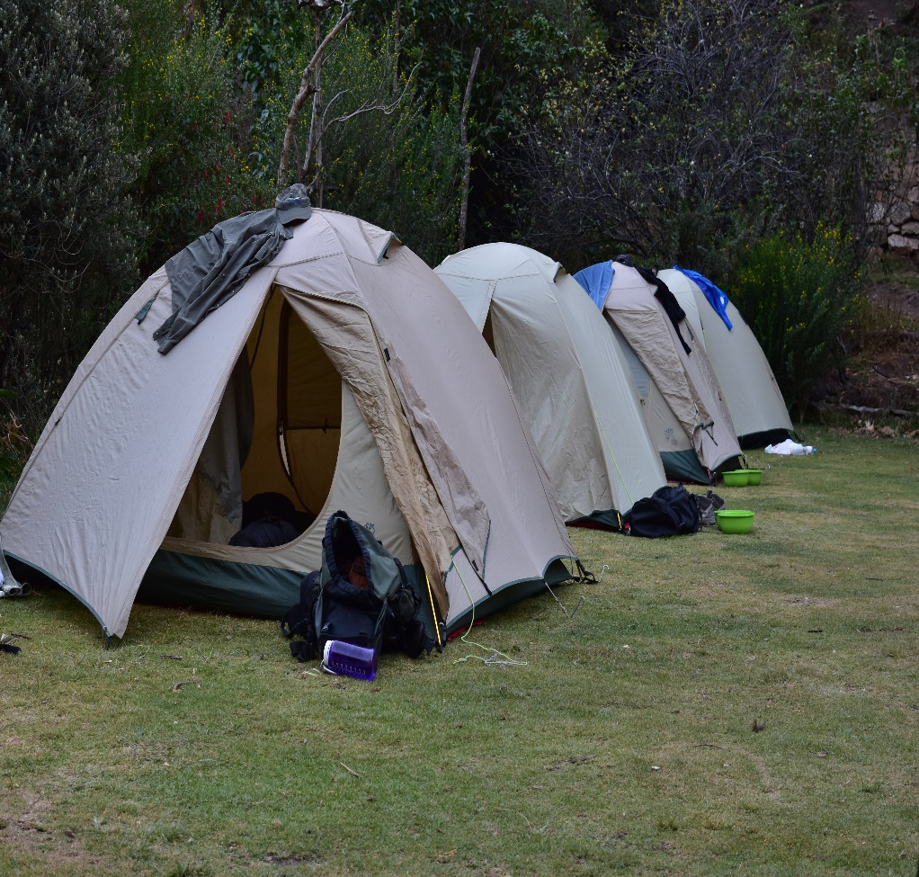
Sleeping Tents

Slide 39
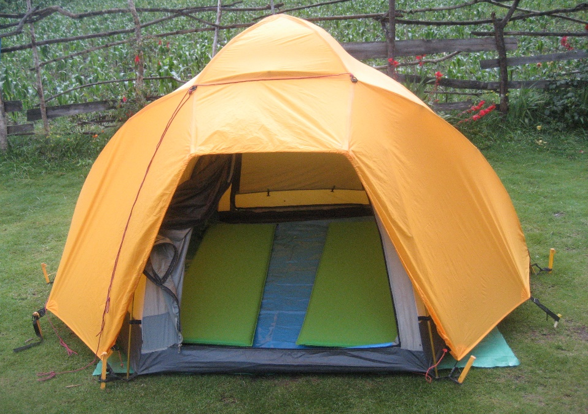
Sleeping Tents

Slide 40
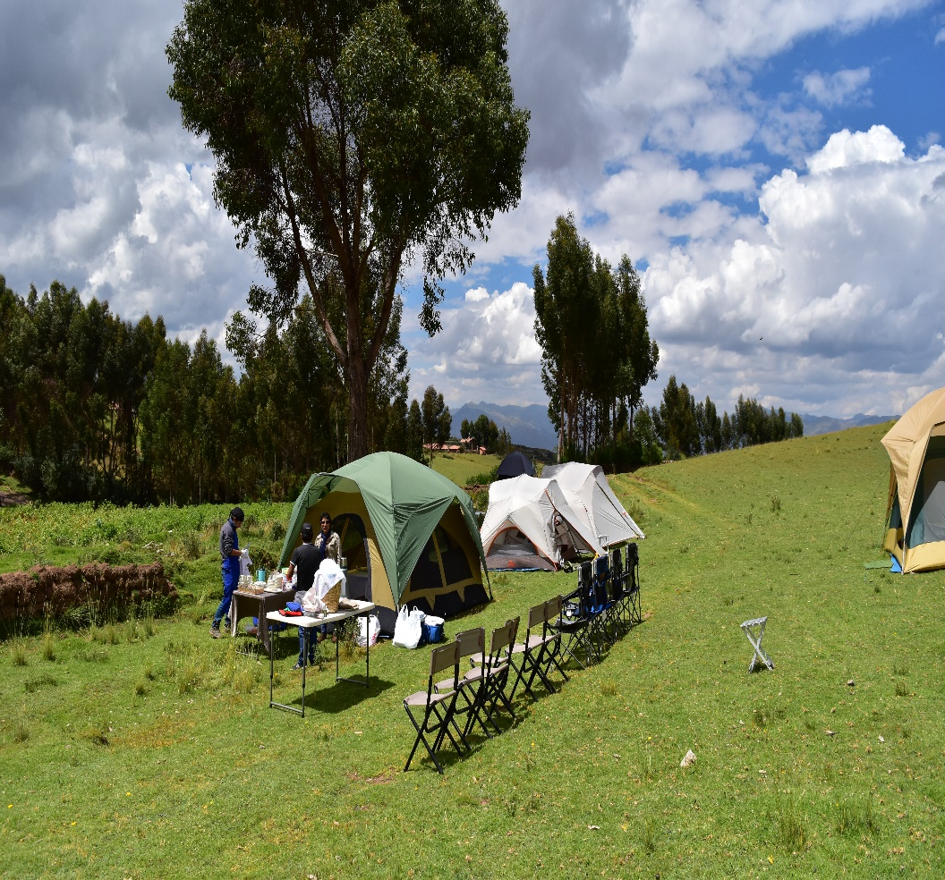
Dinning Tents

Slide 41
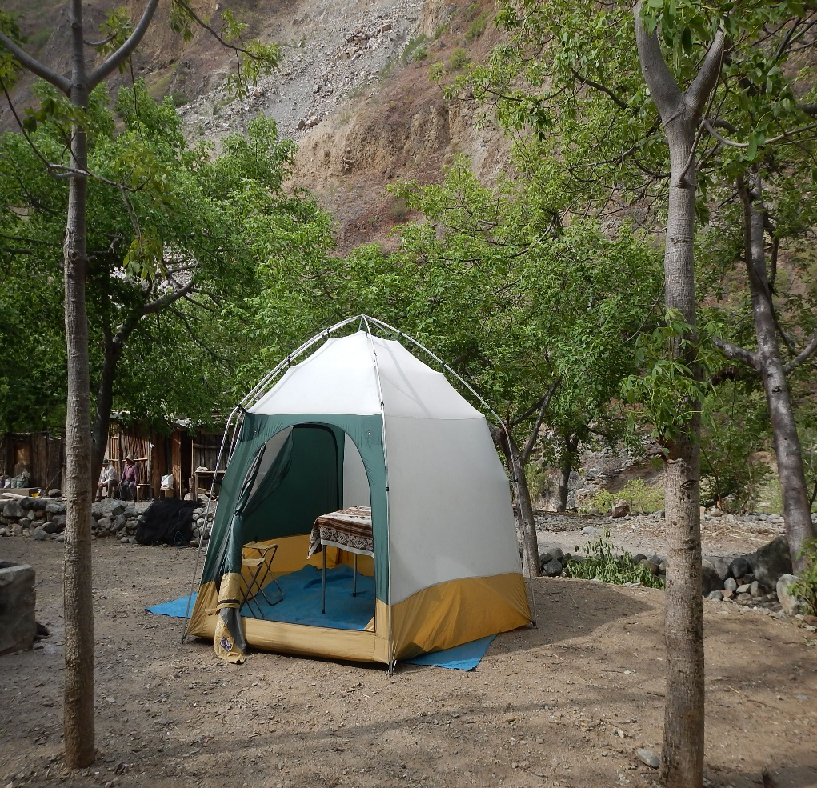
Dinning Tents

Slide 42
Dinning Tents

Slide 43
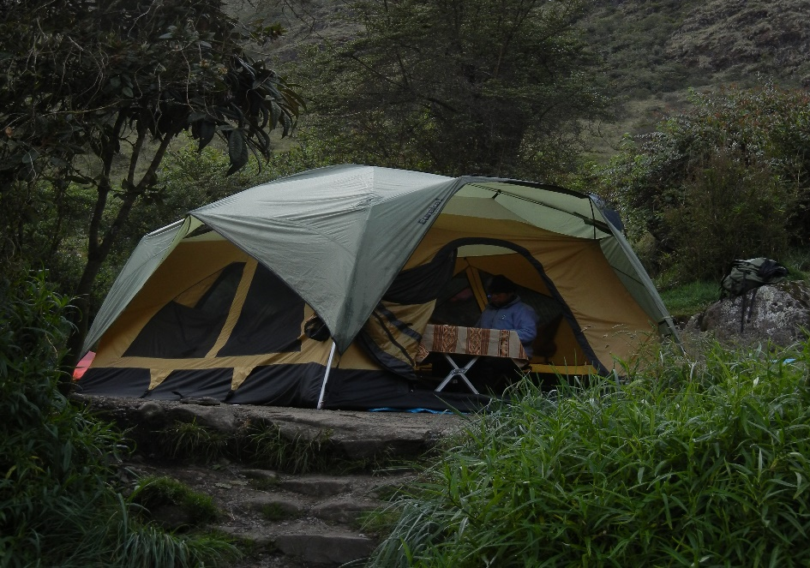
Dinning Tents

Slide 44
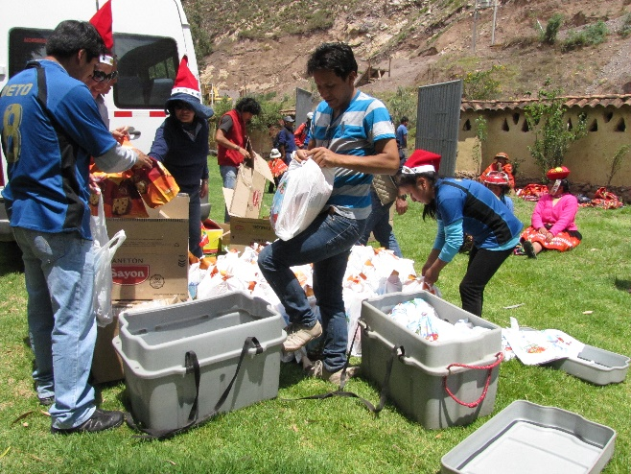
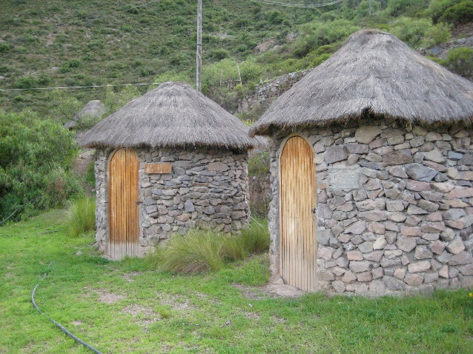
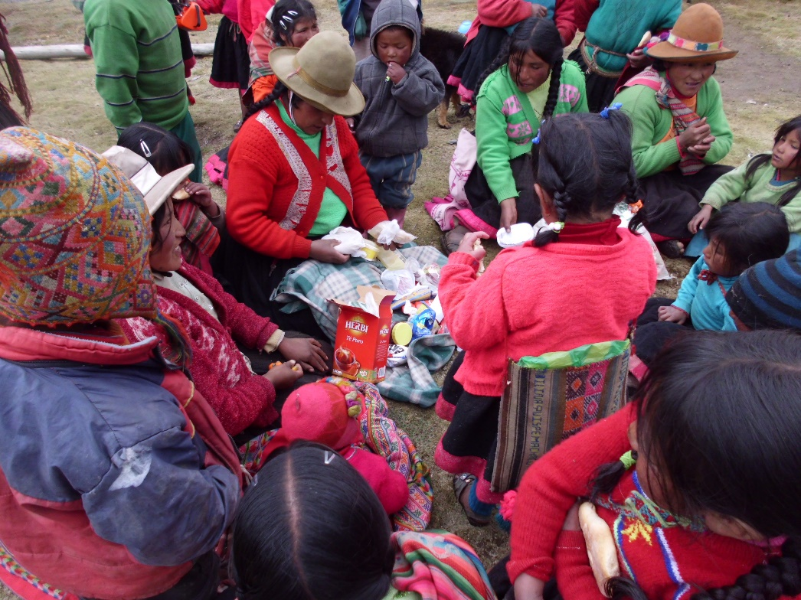
Our Benefits:
RESPONSIBLE TOURISM
Environmental responsibility
Social responsibility

Slide 45
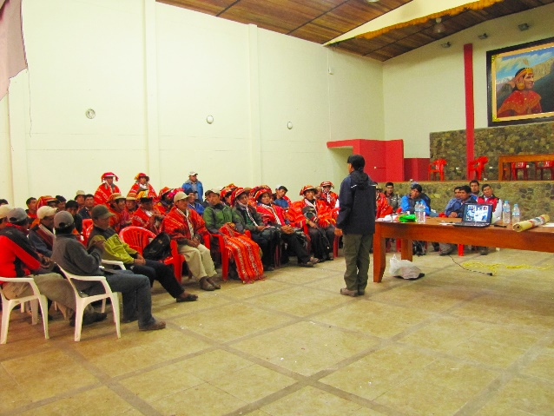
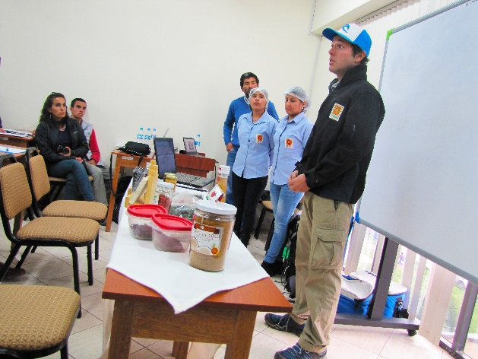
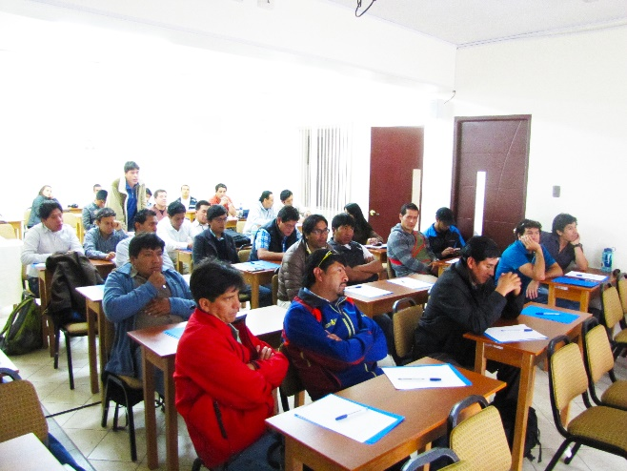
EMPOWERMENT, TRAINING AND COACHING
Guides
Chefs
Porters
Office Staff
Muleteer
Drivers
Others

Slide 46
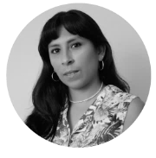
General enquiries: Info@metropolitan-touring.com.pe
Phone: +(51 1) 715 5515
For more details, comments and bookings, please contact us:
Mariela Chiara
Sales Leader USA, Canada & Latin America
mchiara@metropolitan-touring.com.pe
Skype: Mariela.chiara
Karen Yesquen
Account Excutive
kyesquen@metropolitan-touring.com.pe
Skype: Karen-mtp

Slide 47
Thank You!
For bookings and further information
please contact your Sales Expert
info@metropolitan-touring.com.pe

