Slide 1
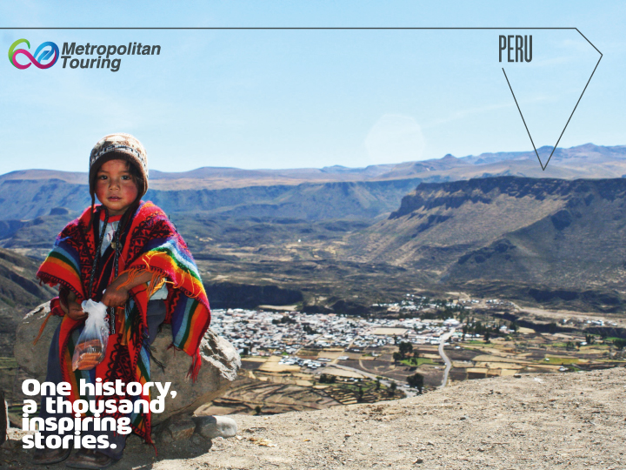

Slide 2
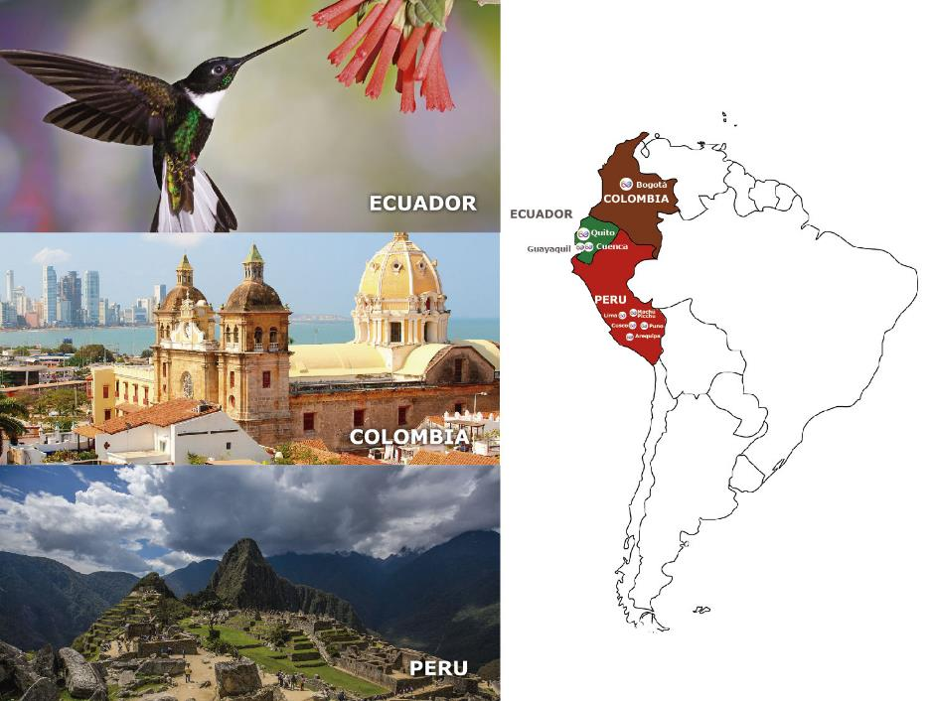

Slide 3
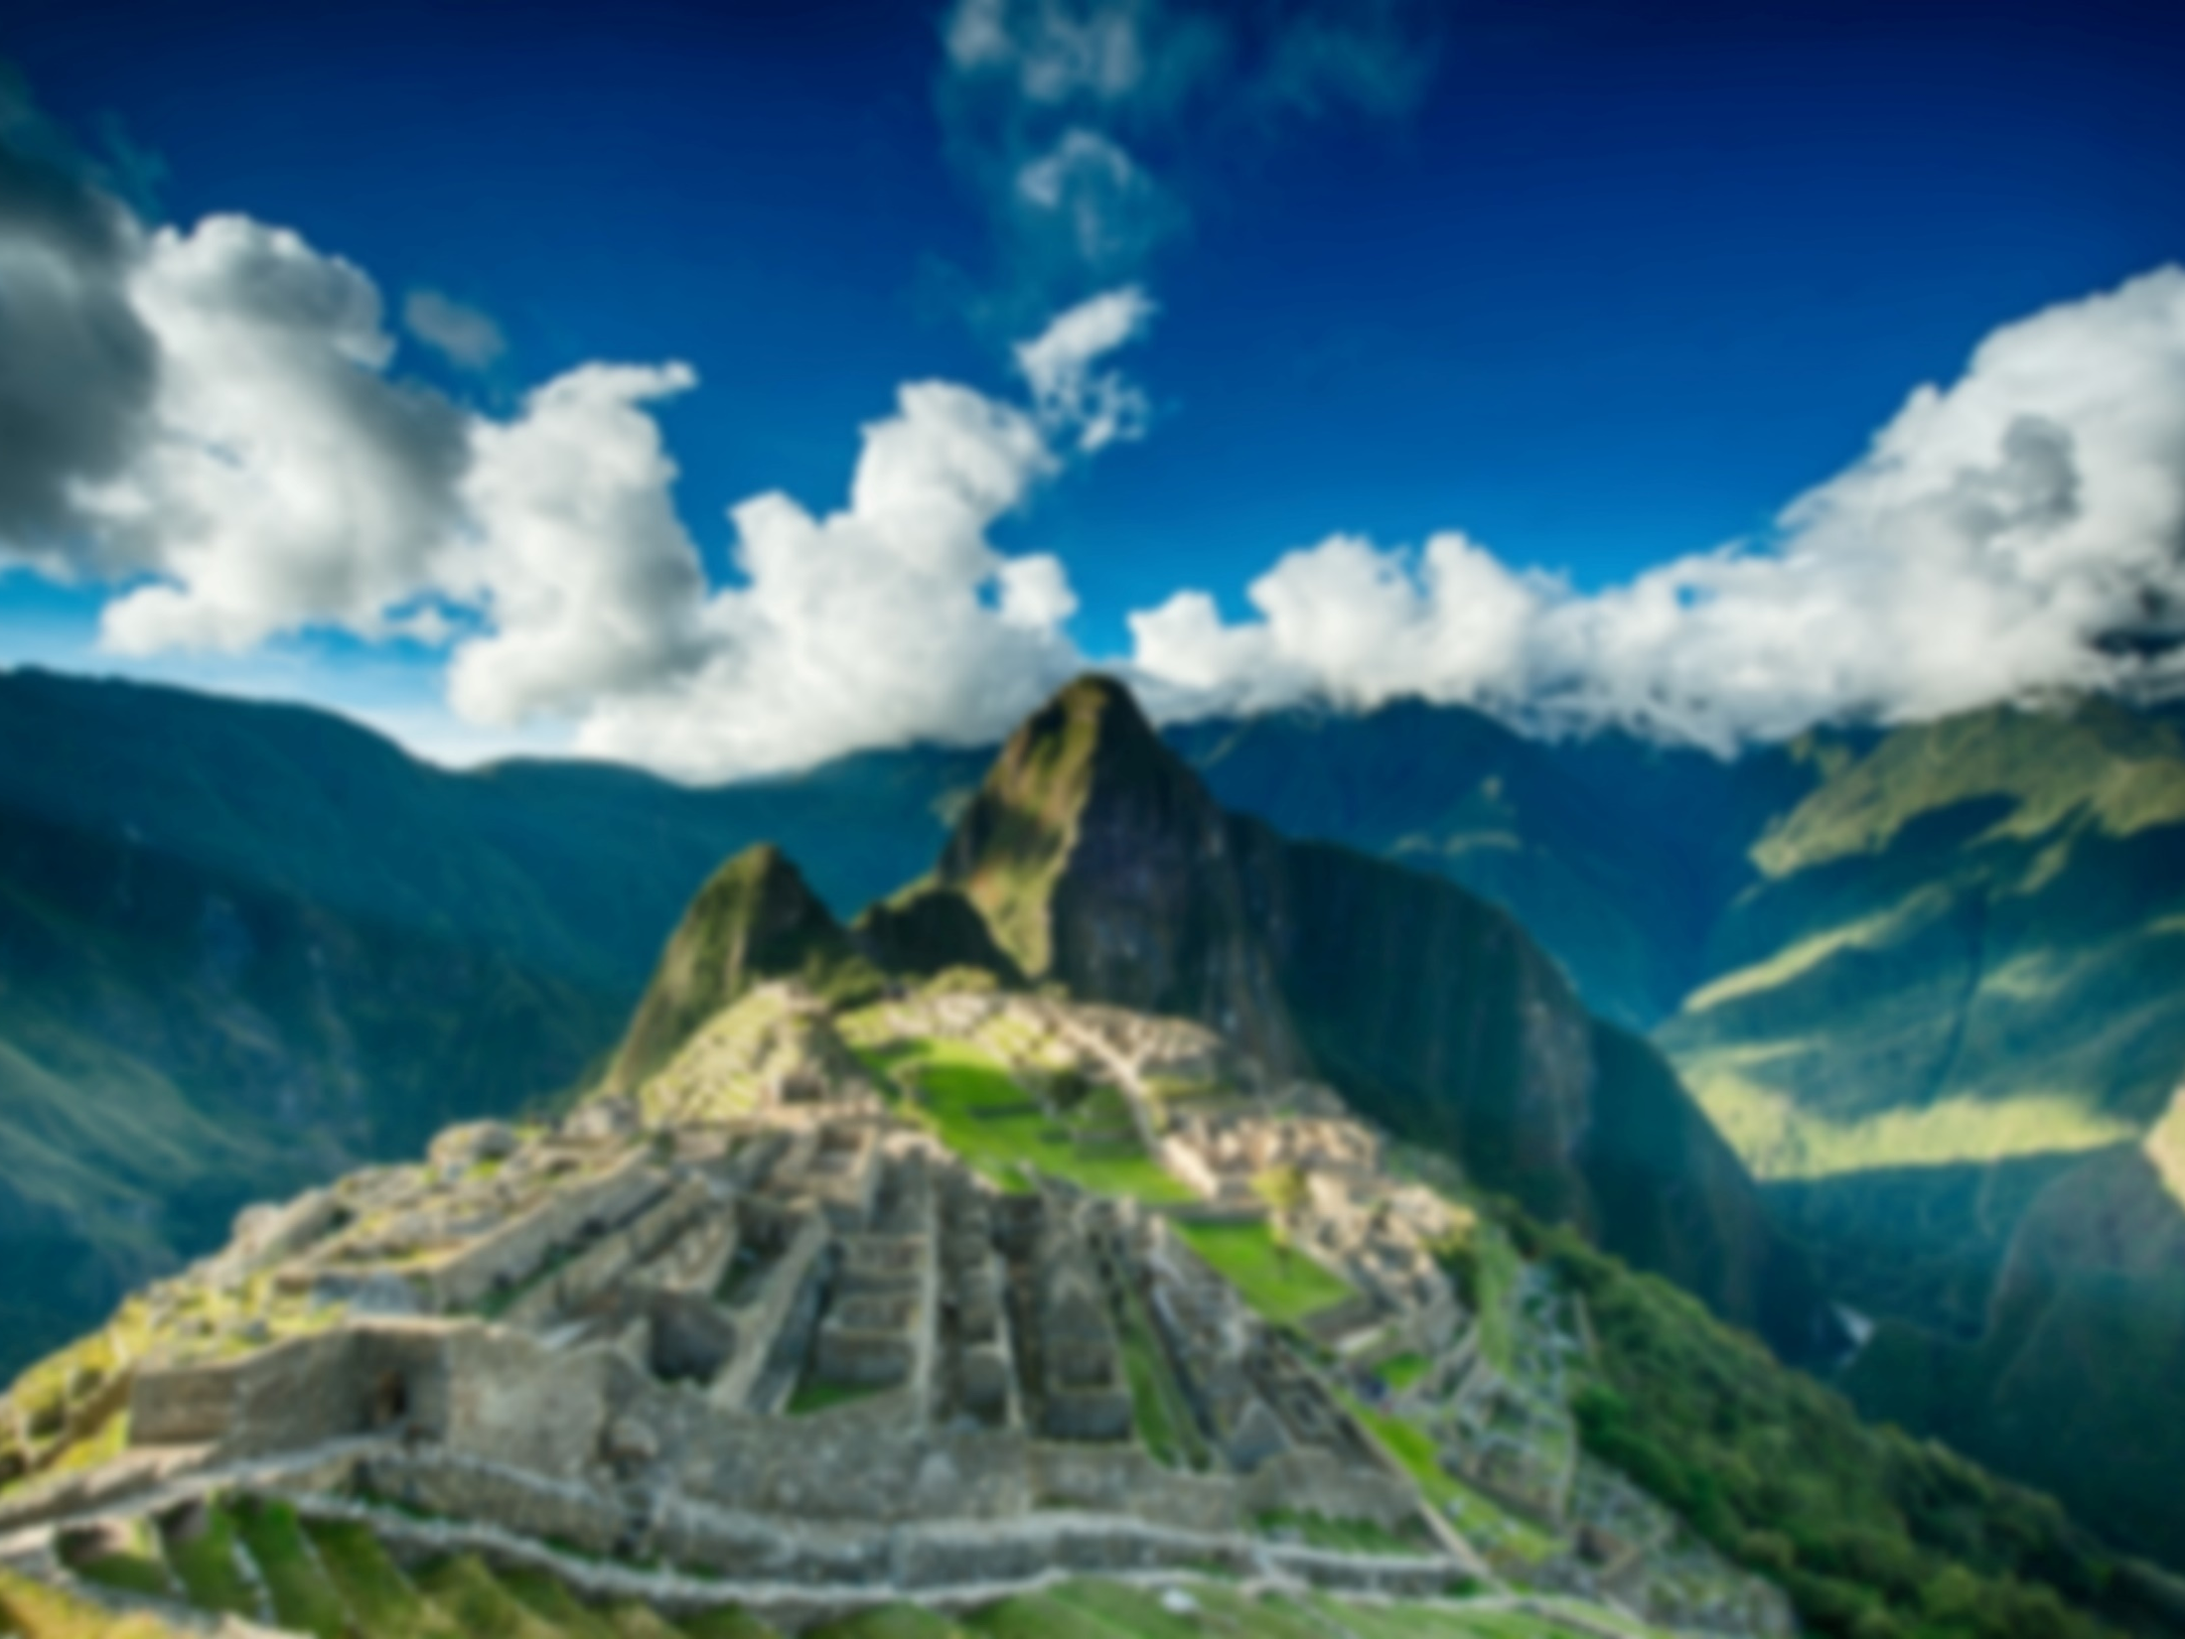
Peru: An Intense Discovery

Slide 4
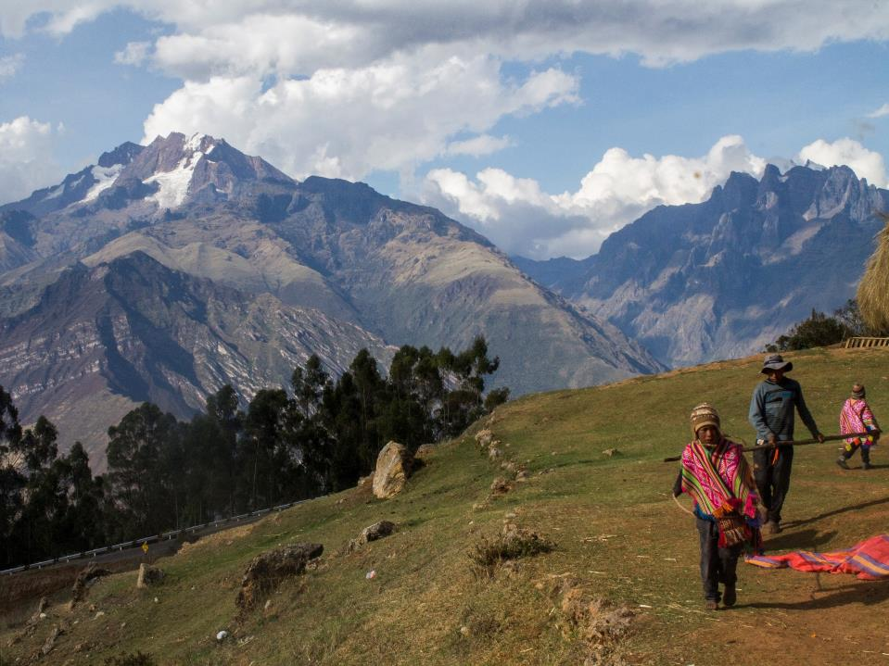
Why Peru

Slide 5
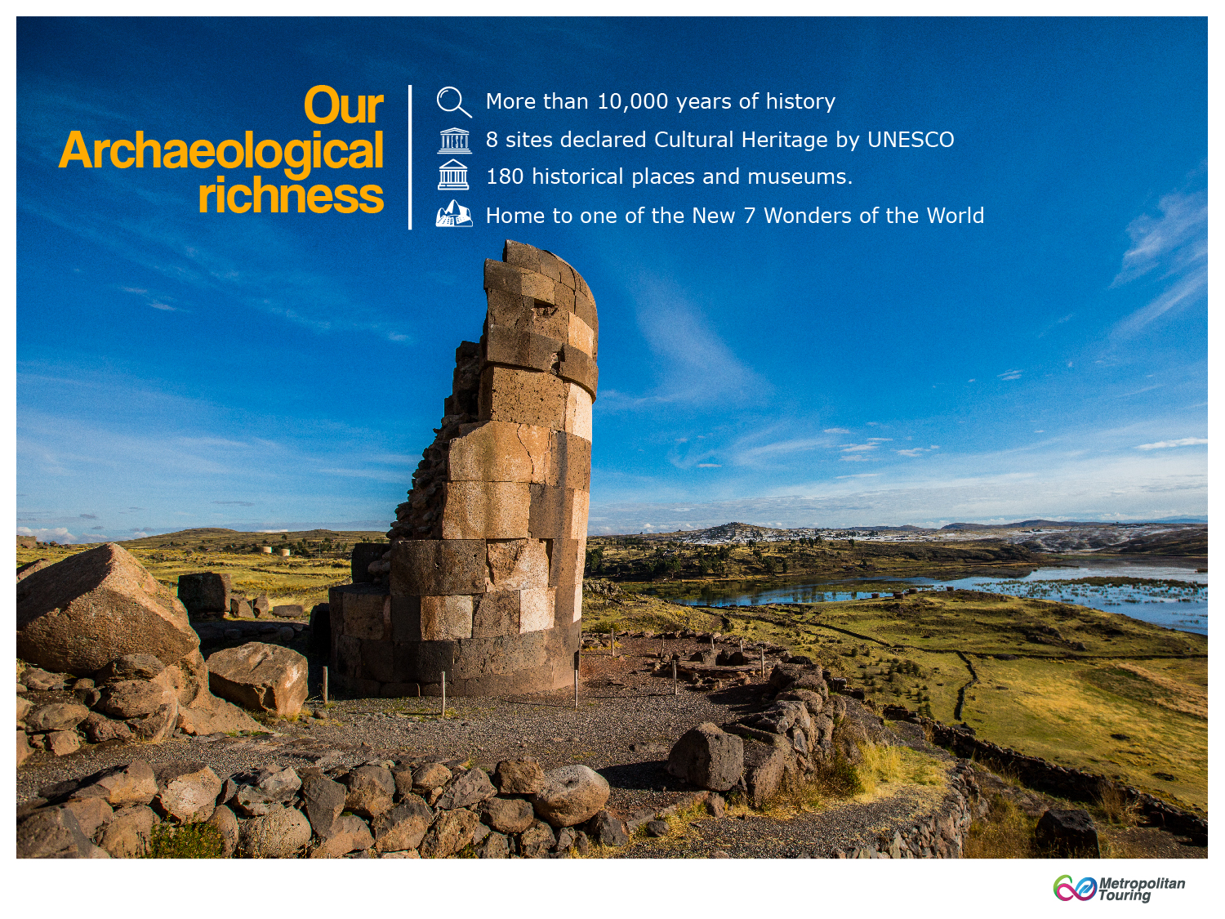

Slide 6
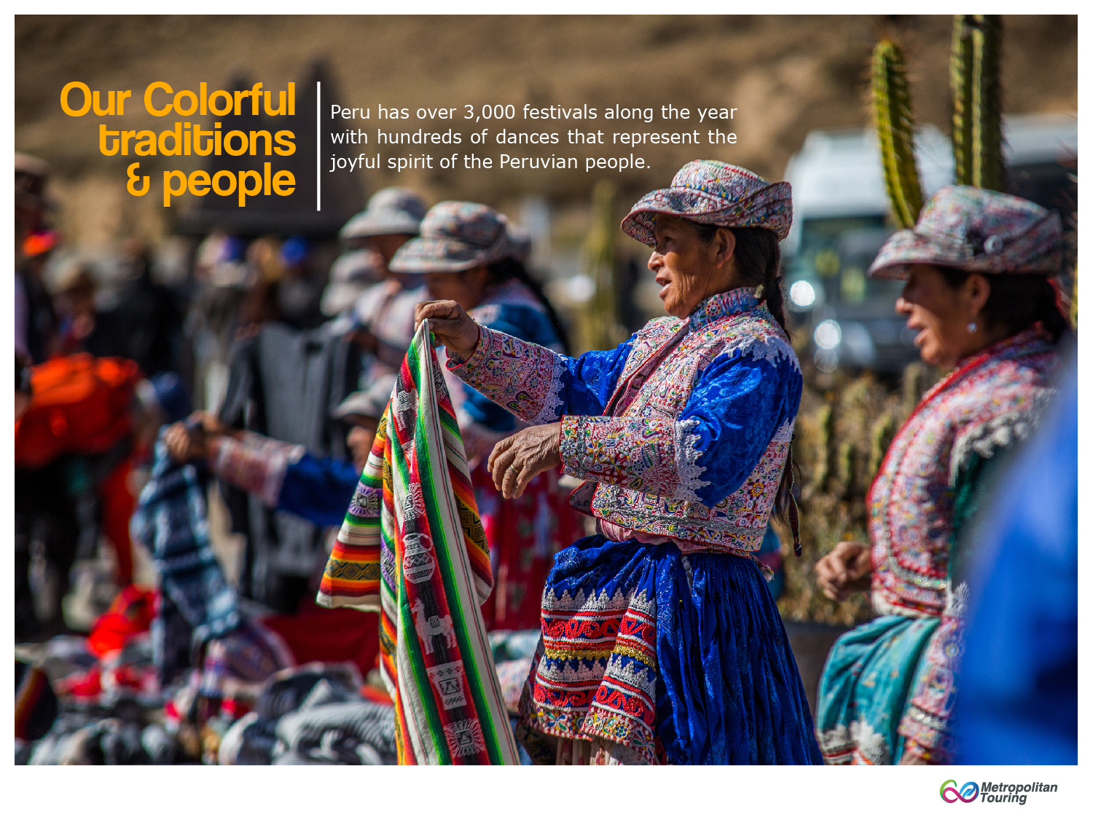

Slide 7
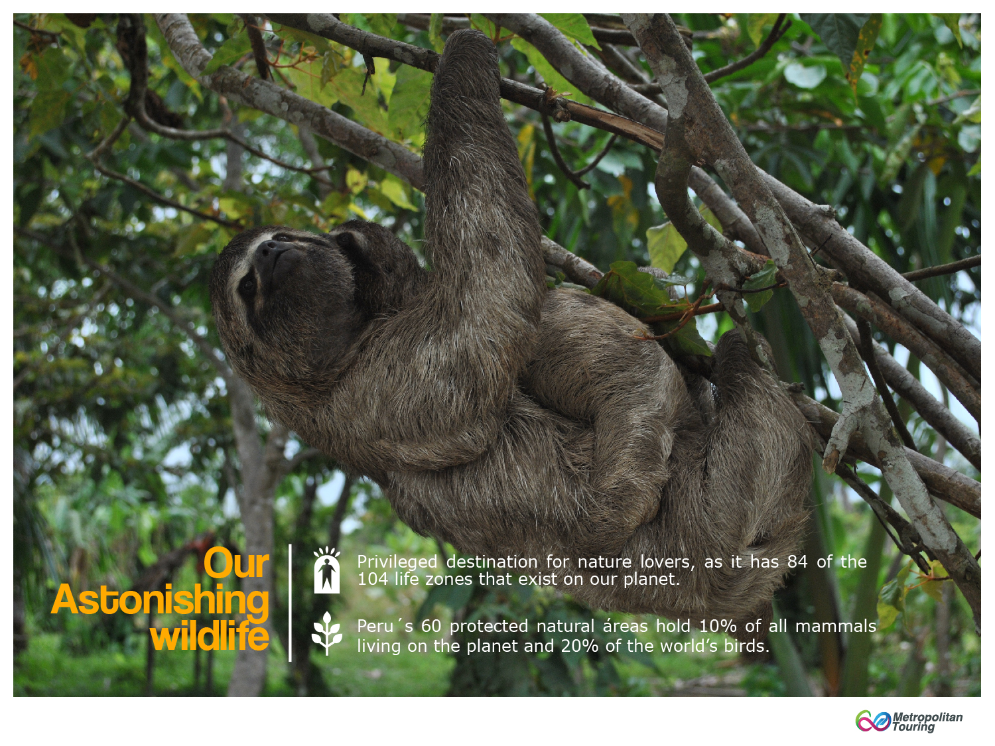

Slide 8
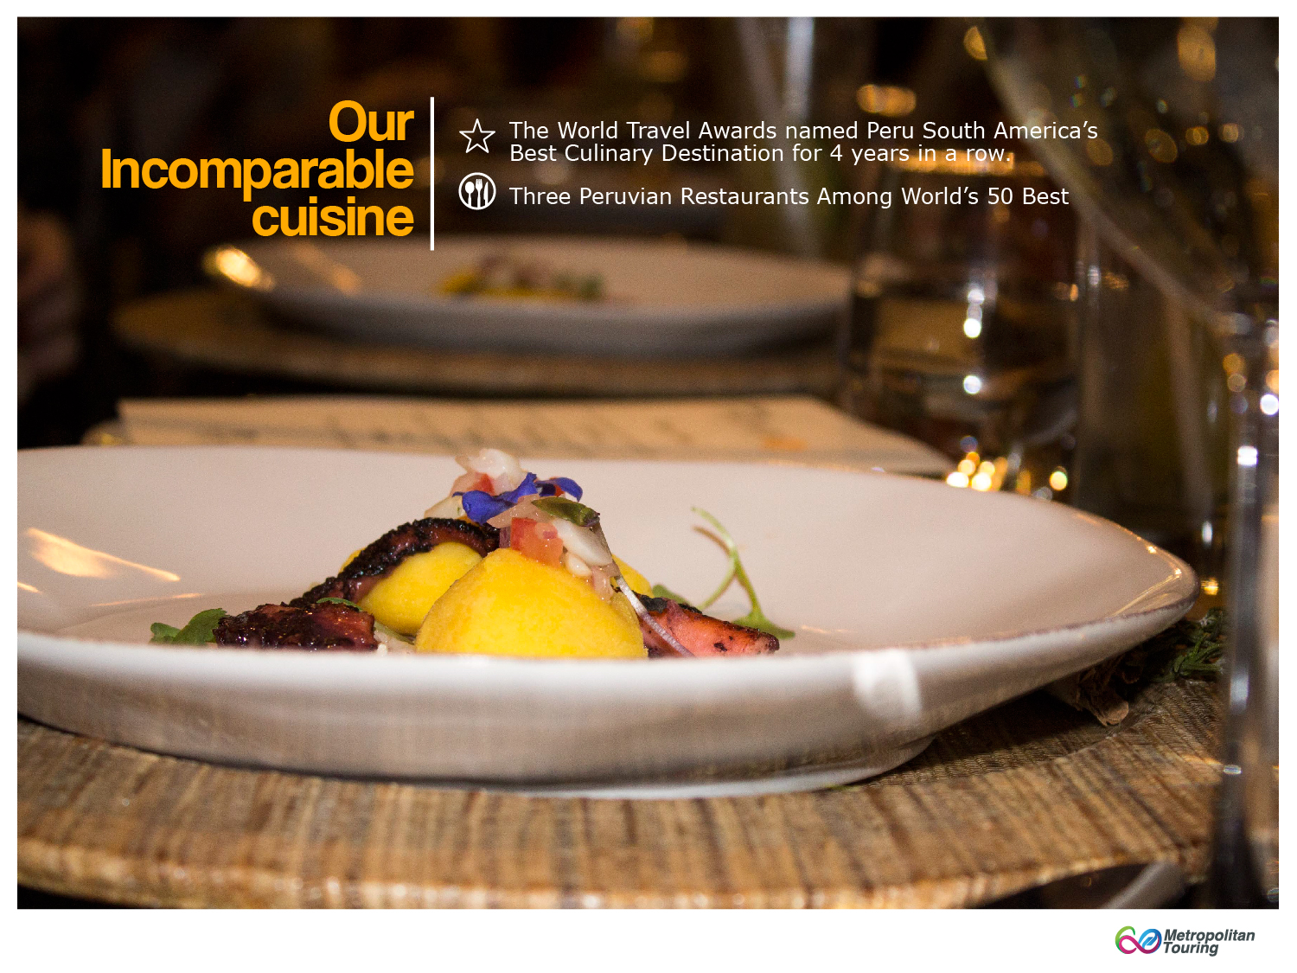

Slide 9
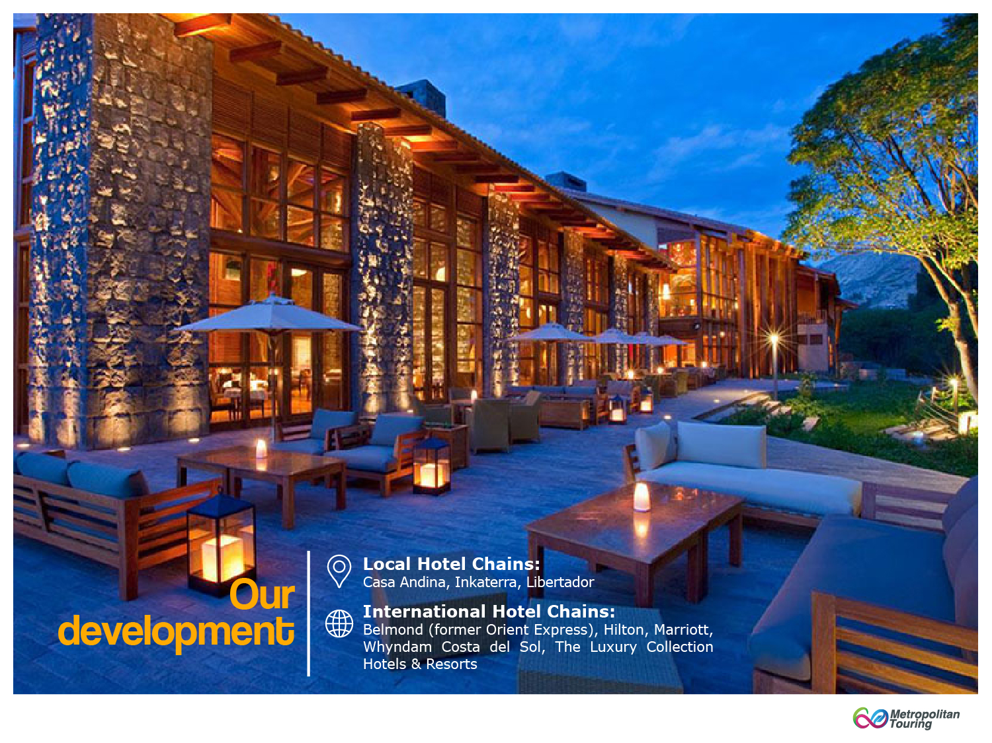

Slide 10
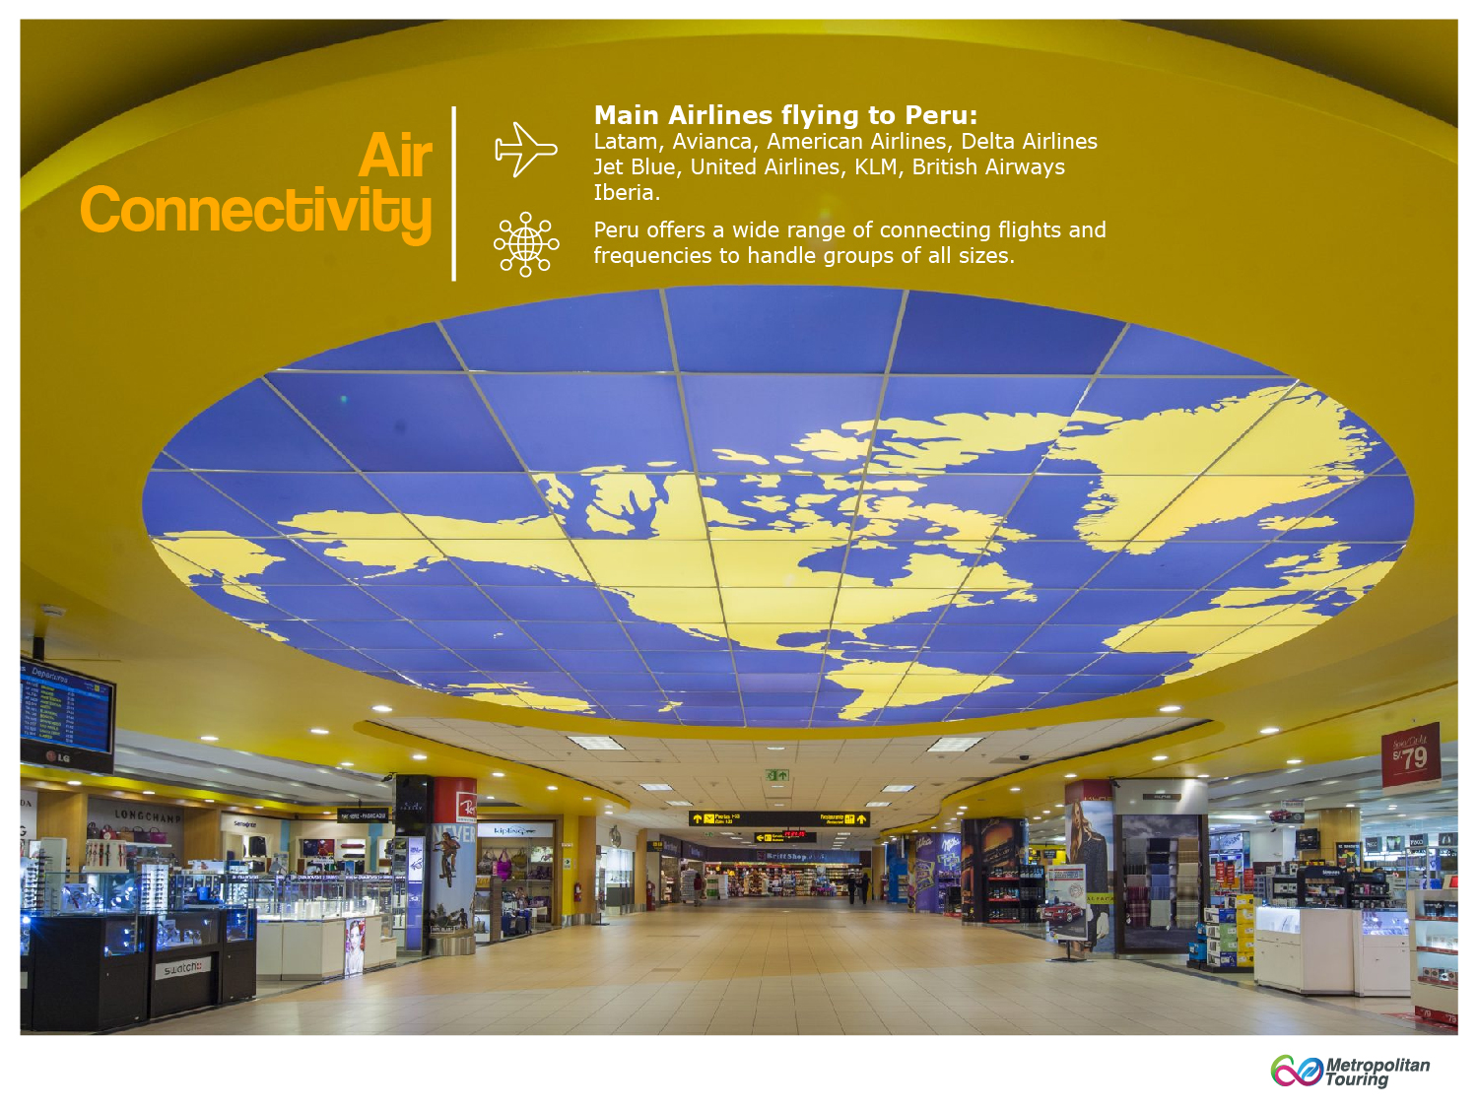

Slide 11
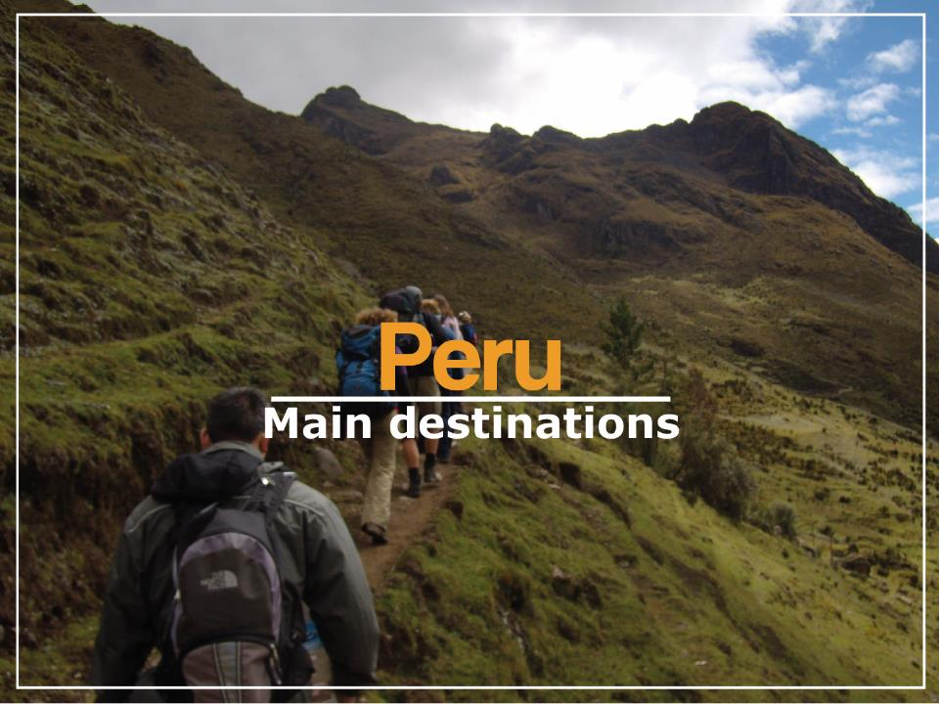

Slide 12
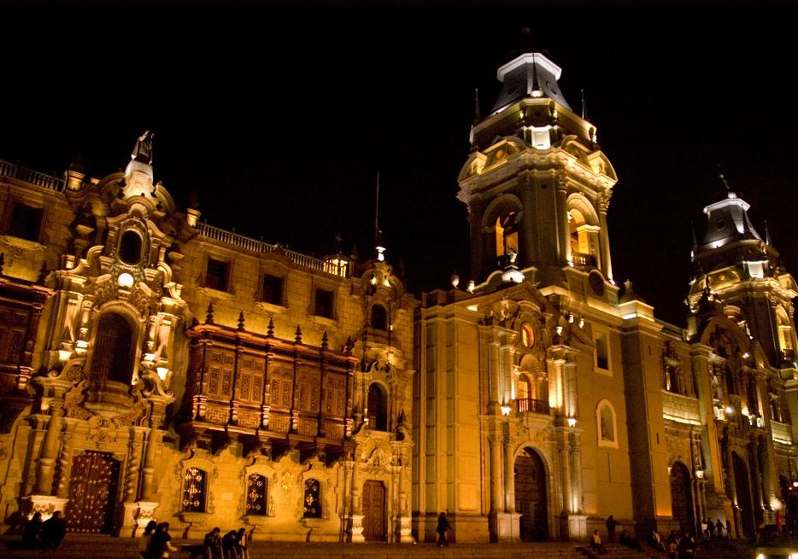
Lima
The Gateway to Peru

Slide 13
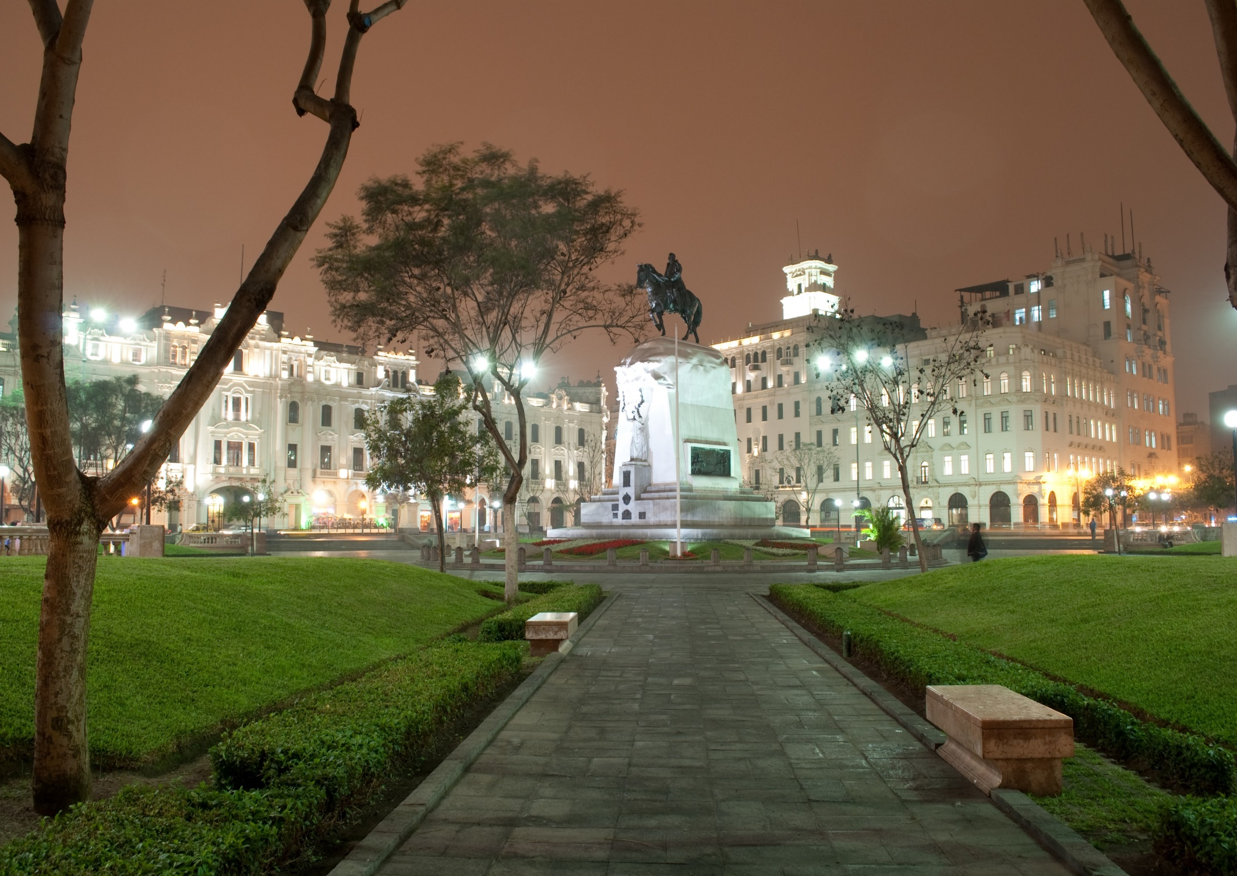
Capital of the Country and the gateway to the rest of Peru
Declared a World Cultural Heritage Site by the UNESCO due to its breathtaking colonial architecture
House of the best Pre-Hispanic Museum in South America – Larco Museum
Exquisite Gastronomy and Cultural exhibitions
Lima is a modern metropolis with infrastructure ideal for conventions and meetings
San Martin Plaza

Slide 14
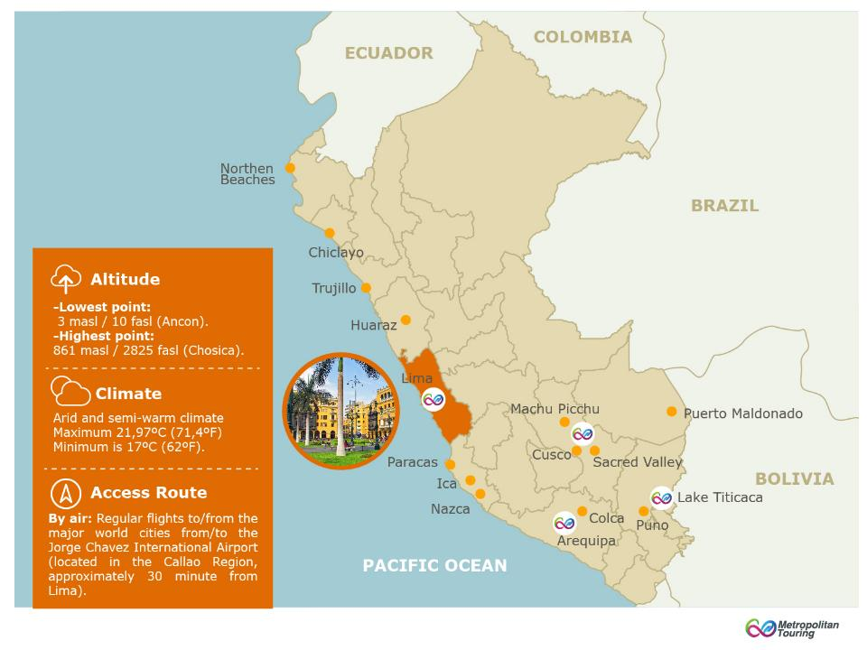

Slide 15
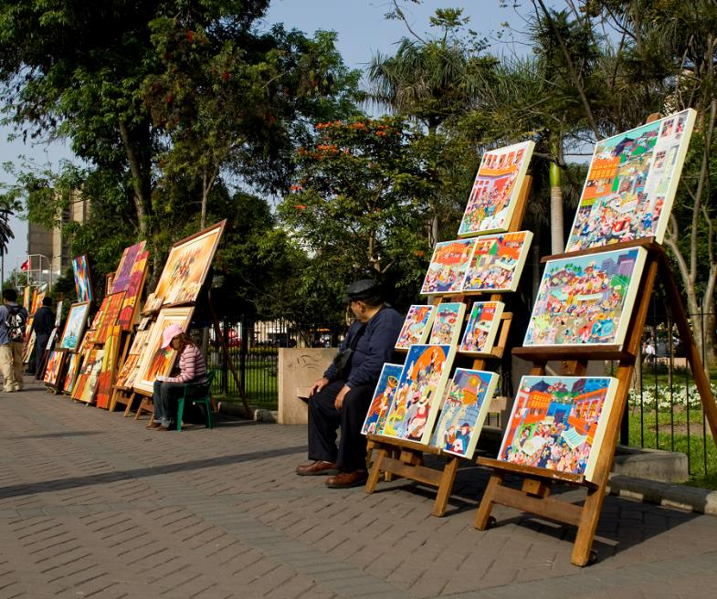


ENJOY
BEAUTIFUL
LIMA

Slide 16
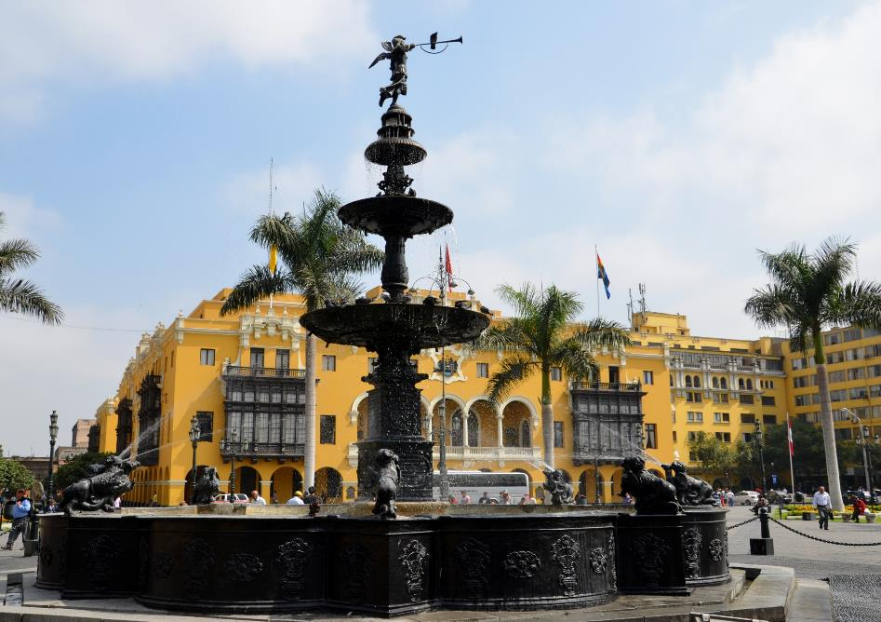
Main Square

Slide 17
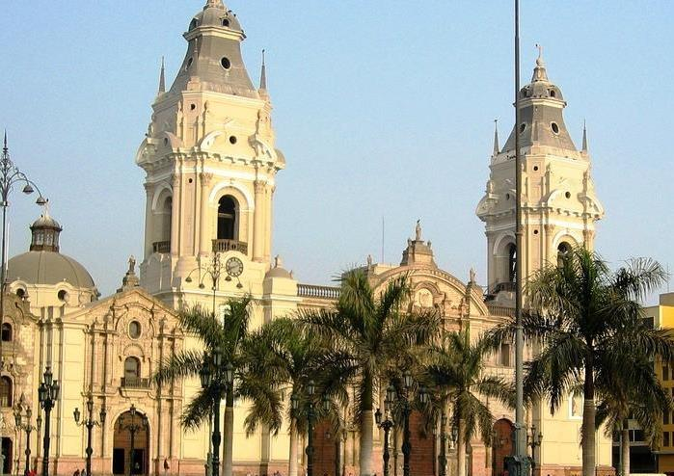
Cathedral of Lima

Slide 18
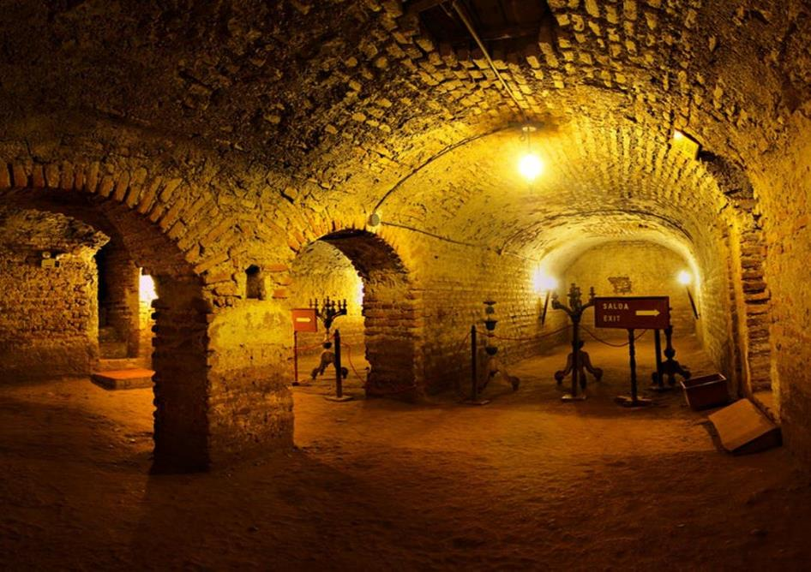
San Francisco Catacombs

Slide 19
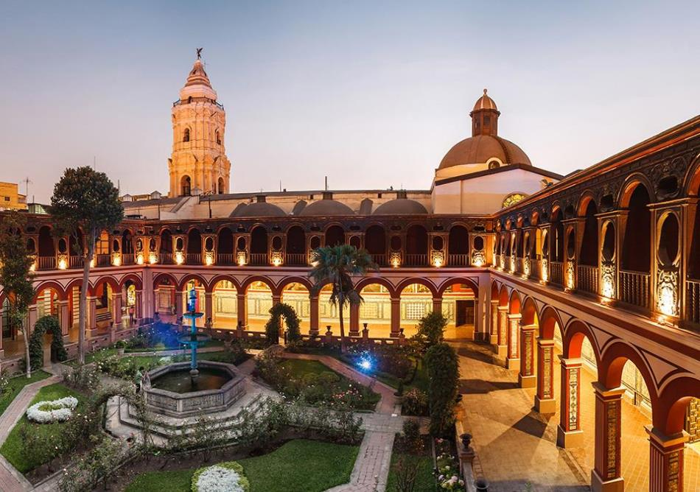
Santo Domingo Convent

Slide 20
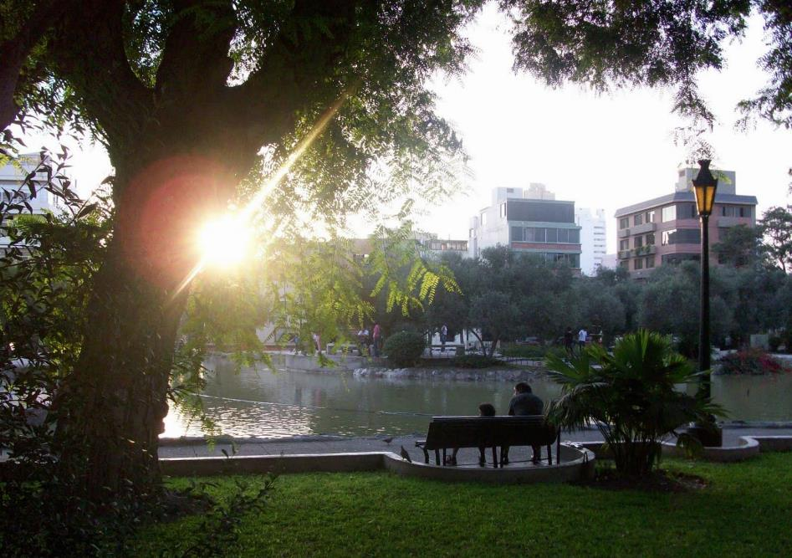
El Olivar Park – San Isidro District

Slide 21
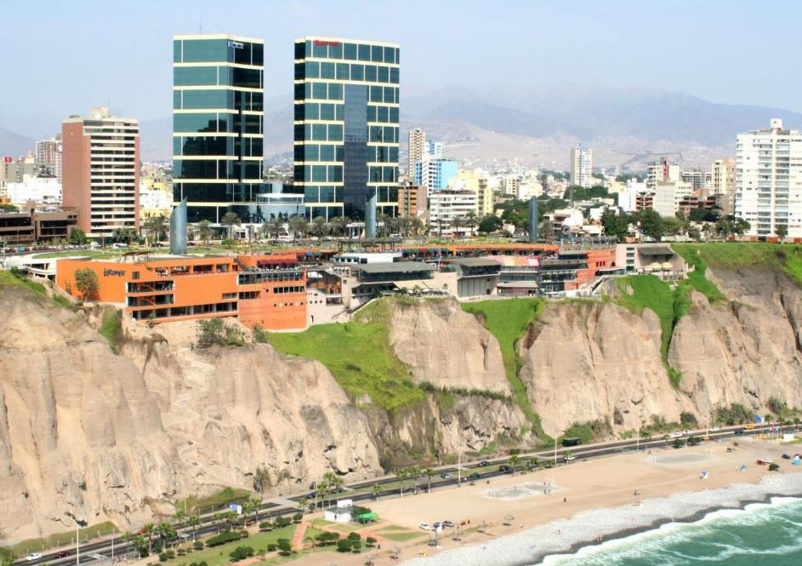
Larcomar Shopping Mall – Miraflores District

Slide 22
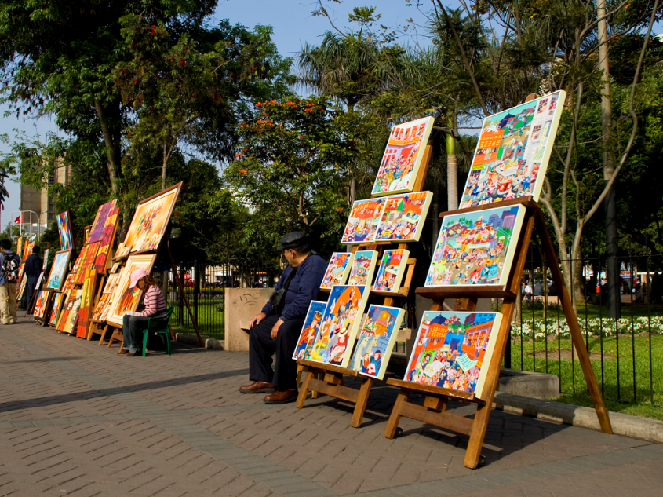
Kennedy Park - Miraflores District

Slide 23
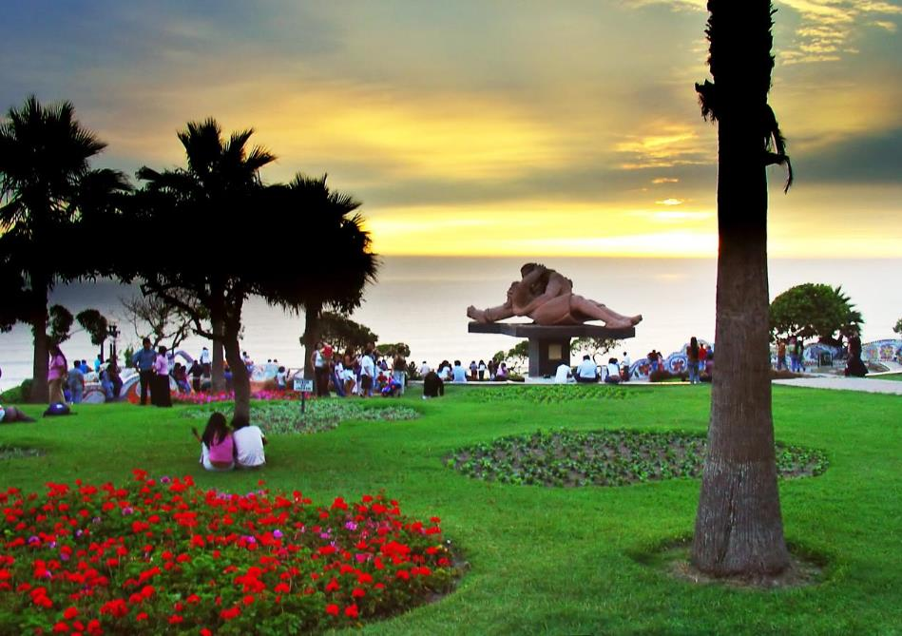
Love Park – Miraflores District

Slide 24
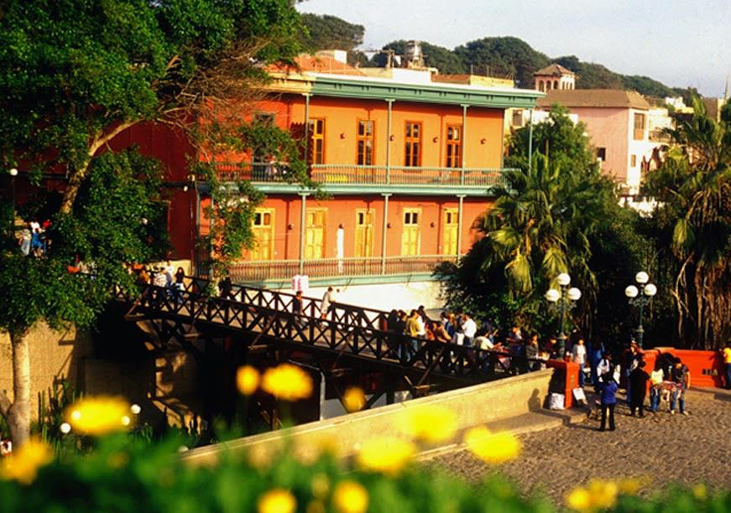
Barranco District

Slide 25
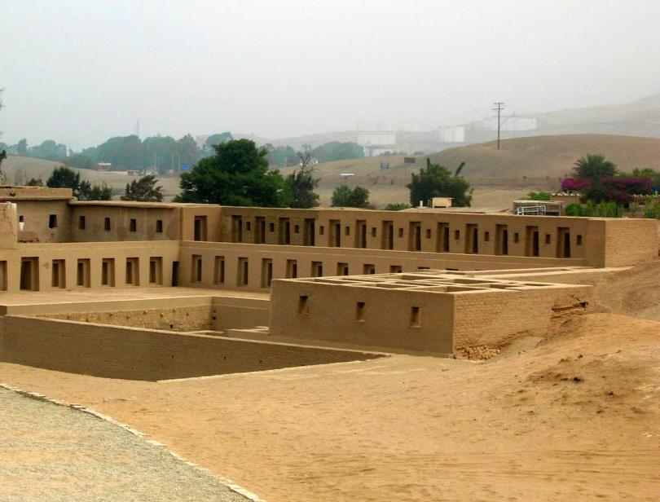
Pachacamac Ruins

Slide 26
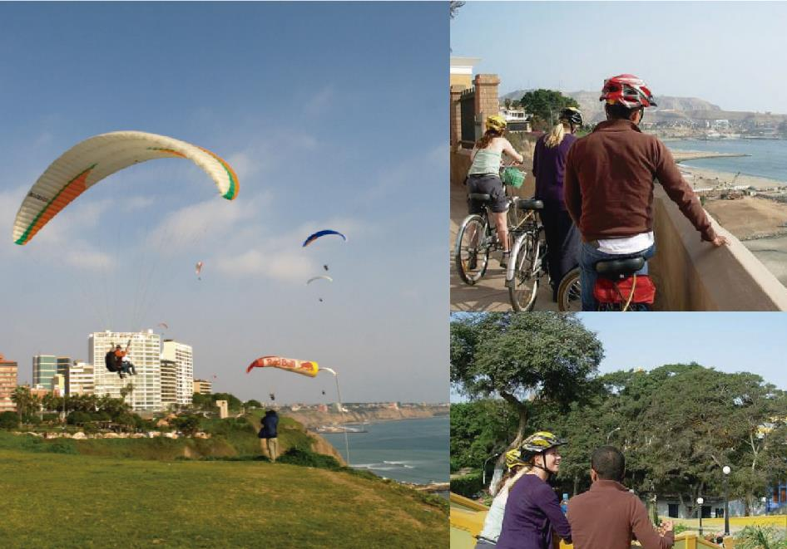
Outdoor Activities

Slide 27
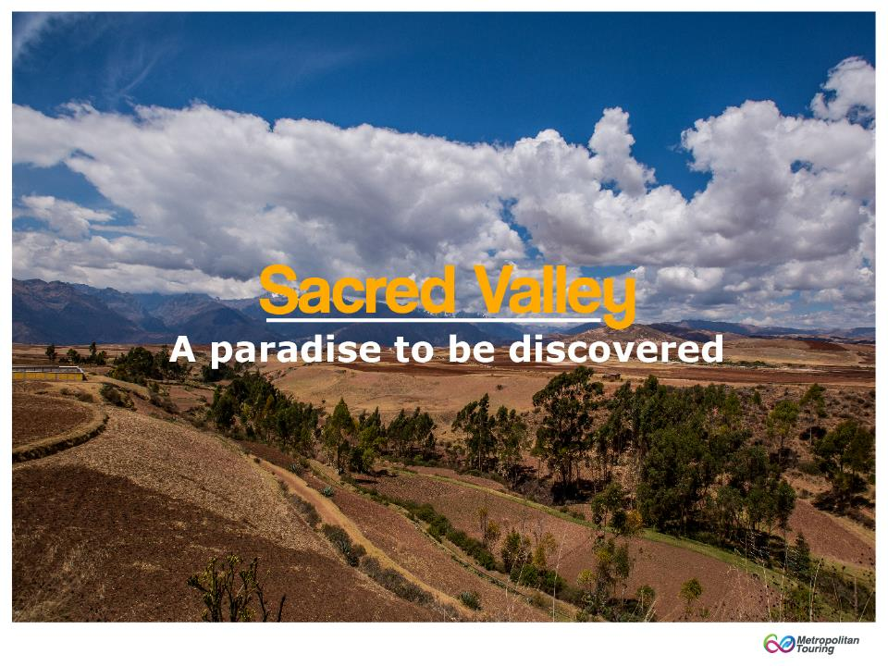

Slide 28
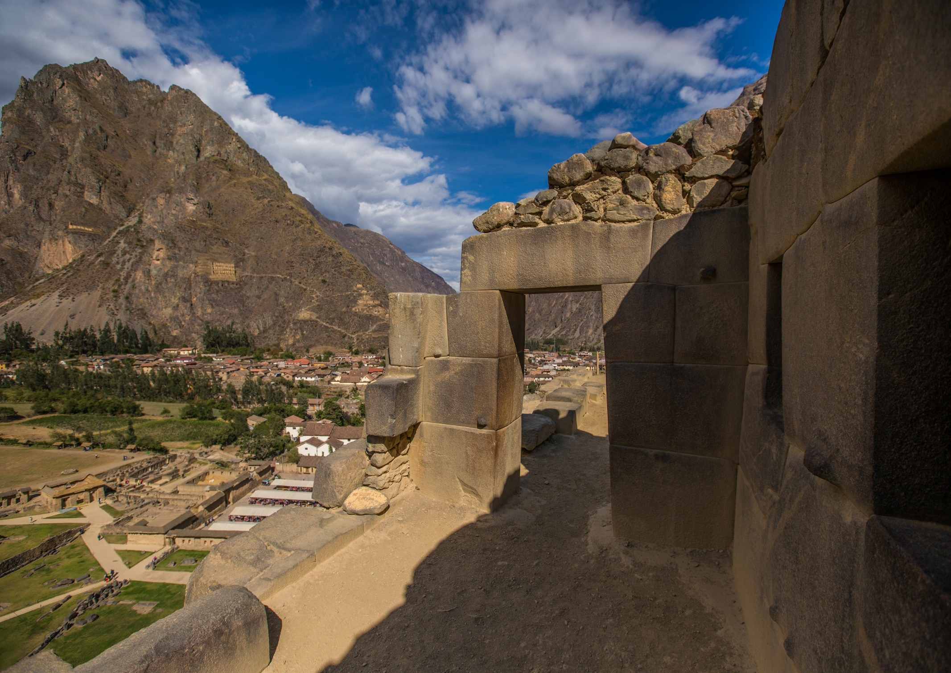
The Sacred Valley of the Incas (Urubamba Valley) is home of picturesque communities, impressive terraces and several important archaeological sites
In Inca times, the valley was the breadbasket of the Empire
It’s still important for agriculture, as farmers plant the same fields they did in Inca times with the same crops
Ollantaytambo

Slide 29
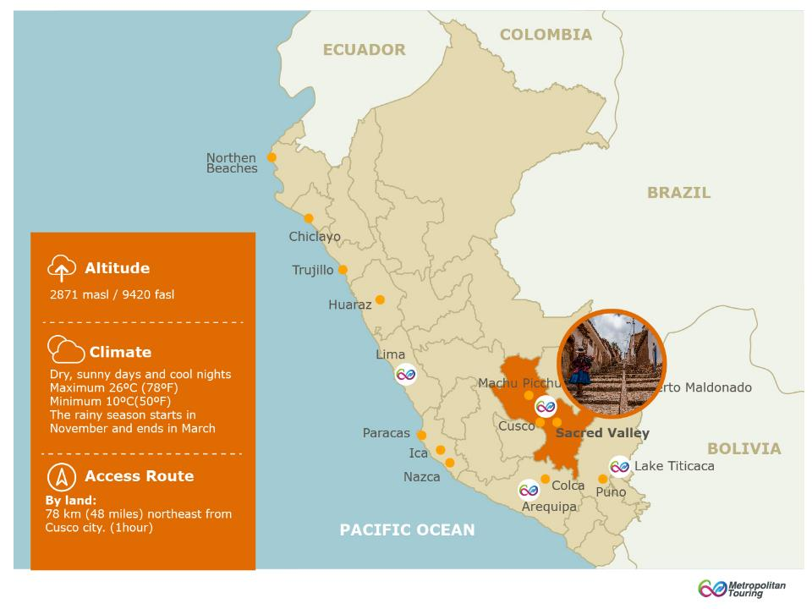

Slide 30
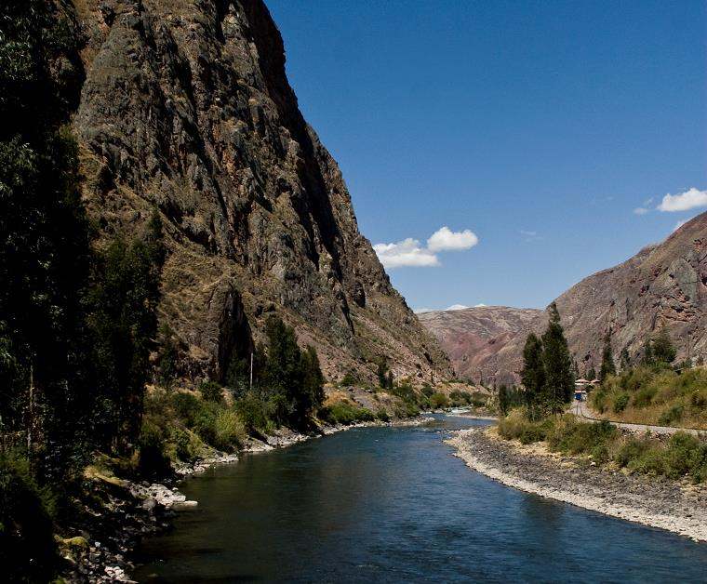


DISCOVER
THE SACRED
VALLEY

Slide 31
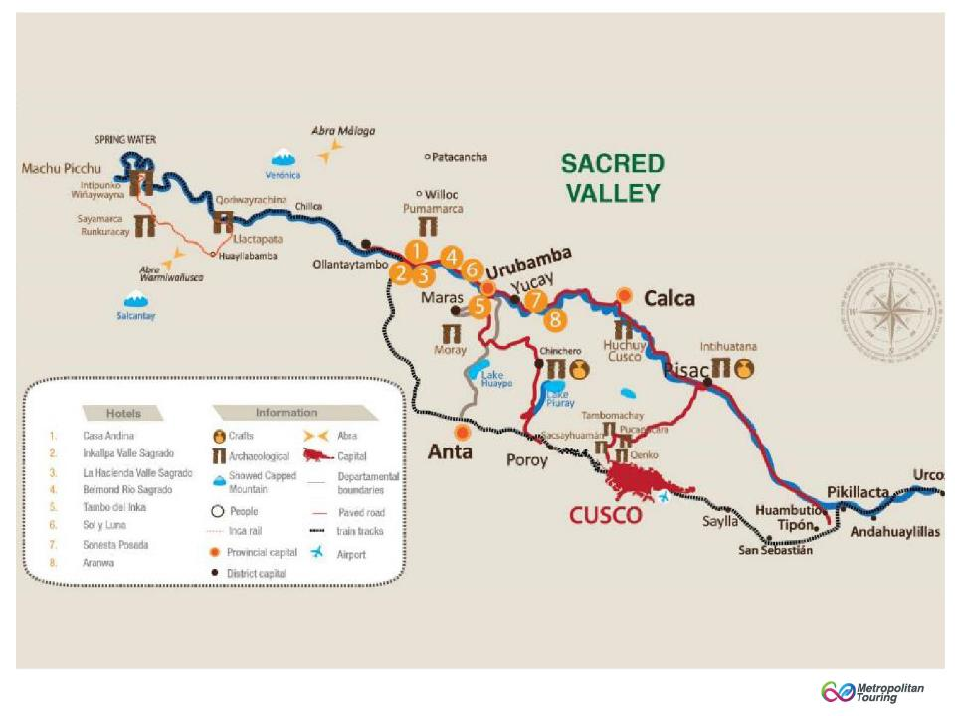
Map of the Sacred Valley

Slide 32
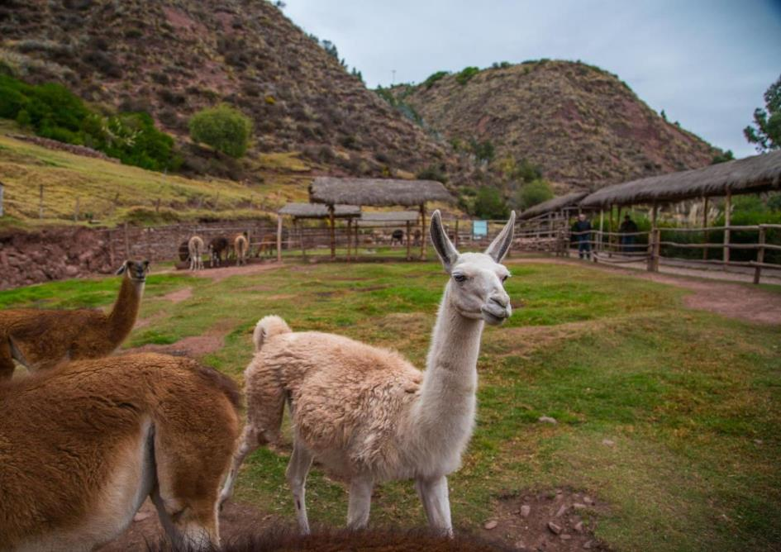
Awanacancha Textile Center
Notes:
32

Slide 33
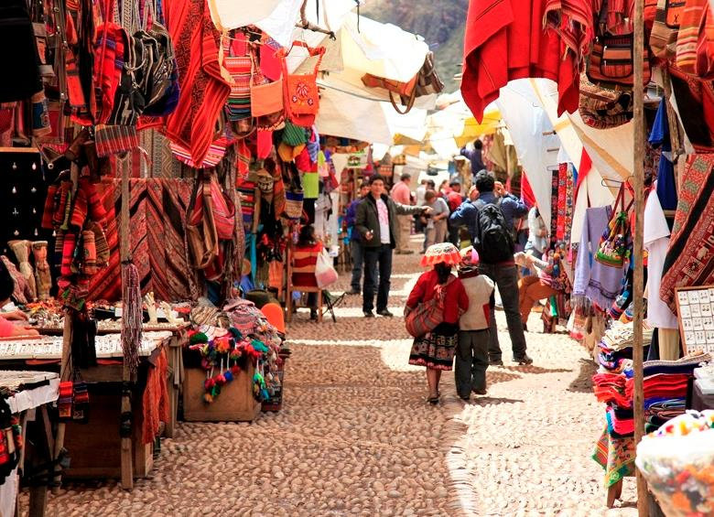
Pisac Market

Slide 34
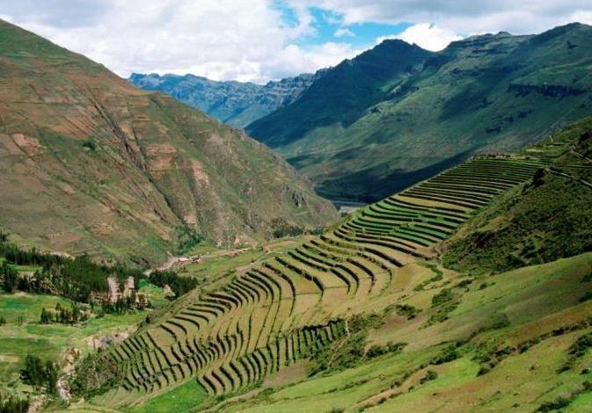
Pisac Ruins
Notes:
34

Slide 35
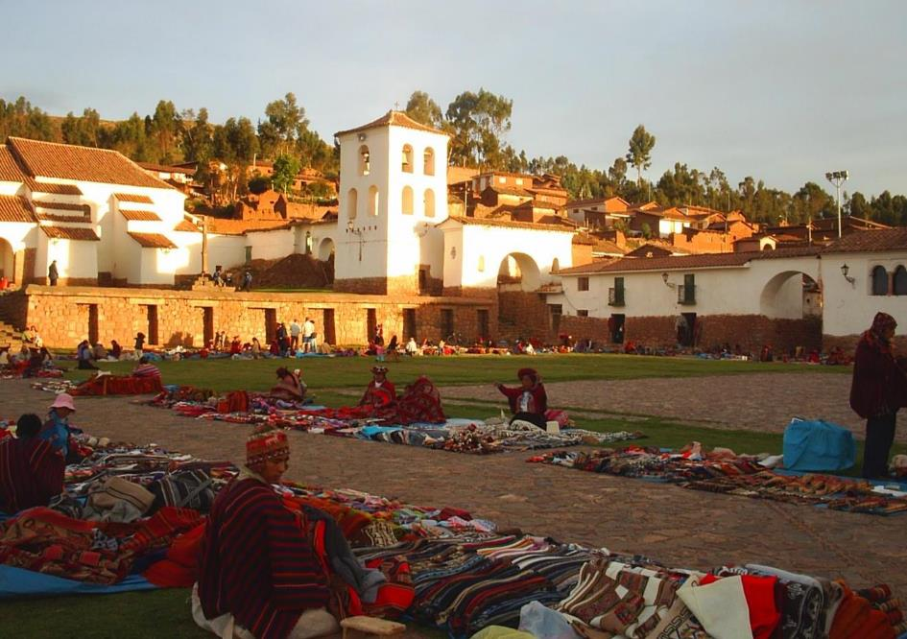
Chinchero Town

Slide 36
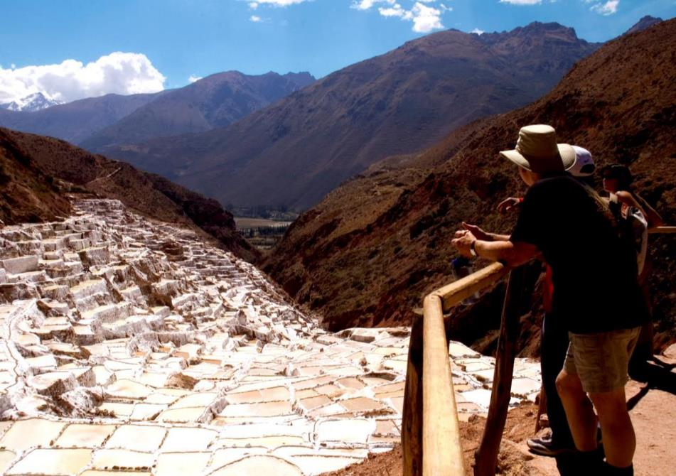
Maras Saltpans
Notes:
36

Slide 37
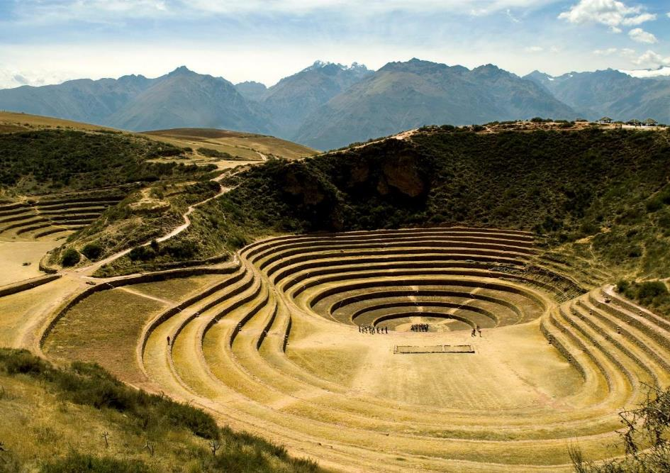
Moray Terraces
Notes:
37

Slide 38
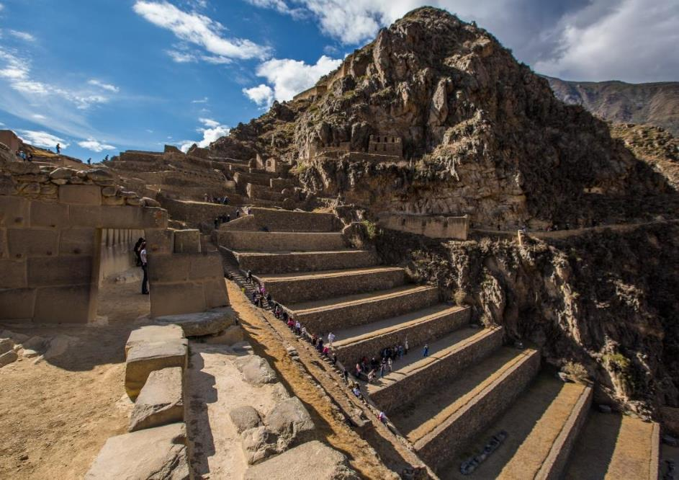
Ollantaytambo Fortress

Slide 39
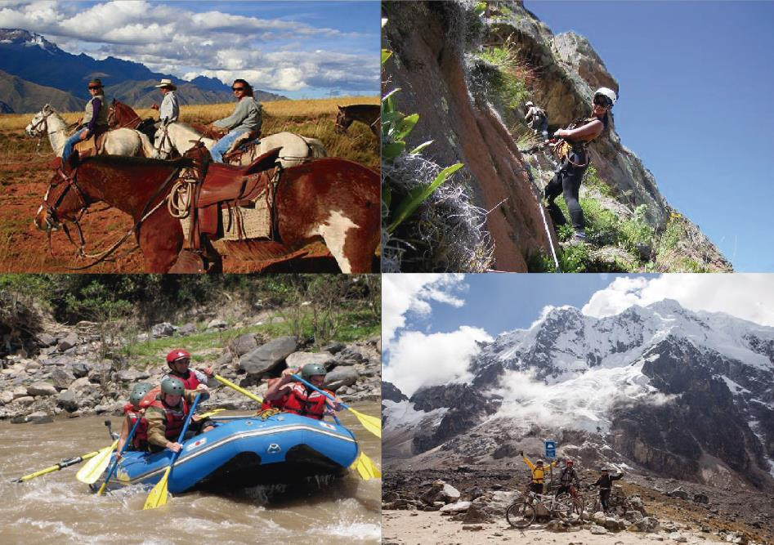
Soft Adventure Activities

Slide 40
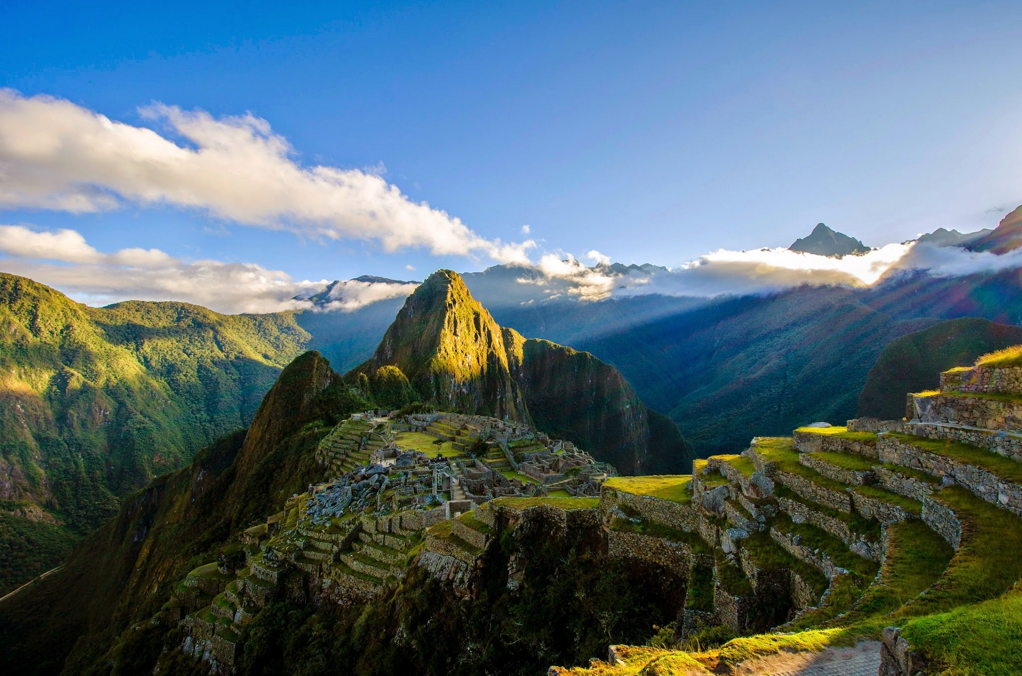
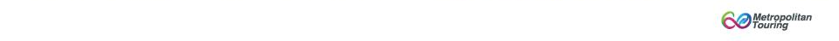
Machu Picchu
The Inca royalty sanctuary

Slide 41
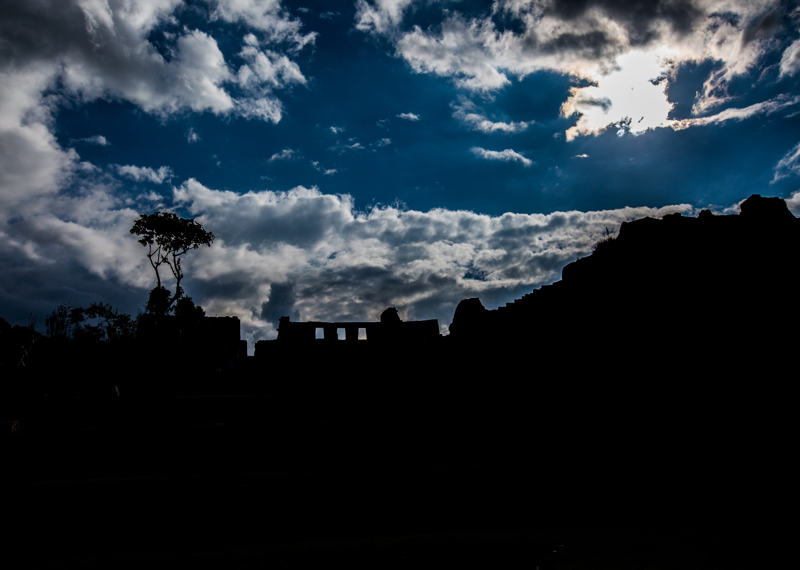
The lost city of the Incas
A mystic place of worship, a spot for star-gazing, and the private hacienda of the Inca Pachacutec
A real jewel in architecture and engineering
Named one of the New Seven Wonders of the World in 2007
Another Perspective of Machu Picchu

Slide 42
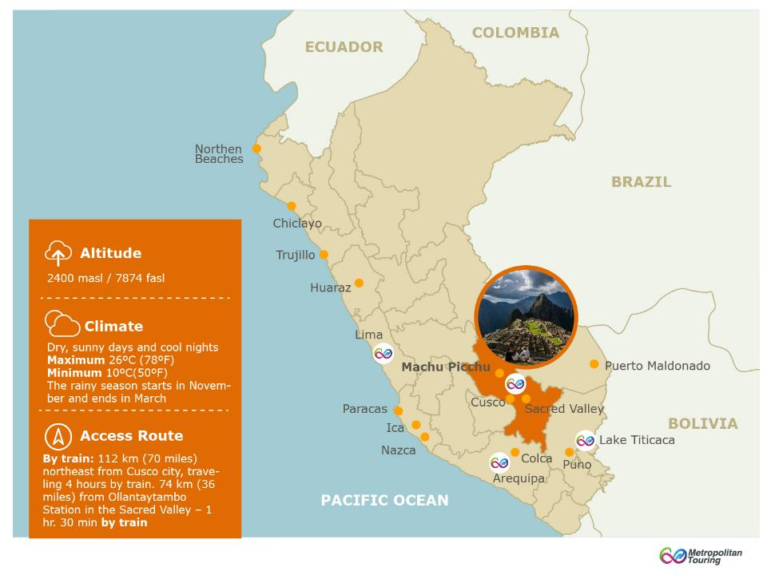

Slide 43
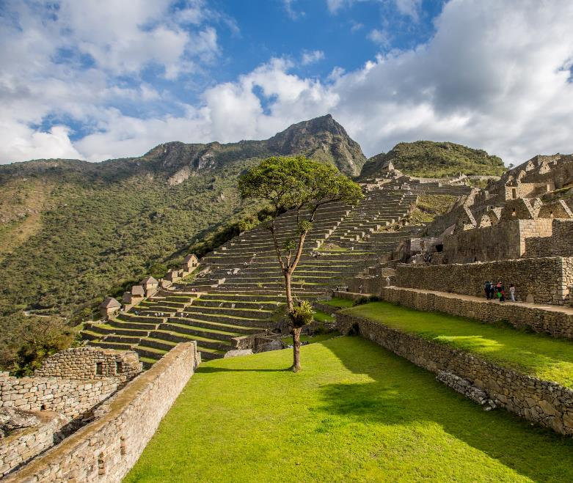


MACHU
PICCHU
NEW SEVEN
WONDER
Content
Archaeology,
Adventure, Nature
Notes:
Revisar Grading que otras ciudades no tienen

Slide 44
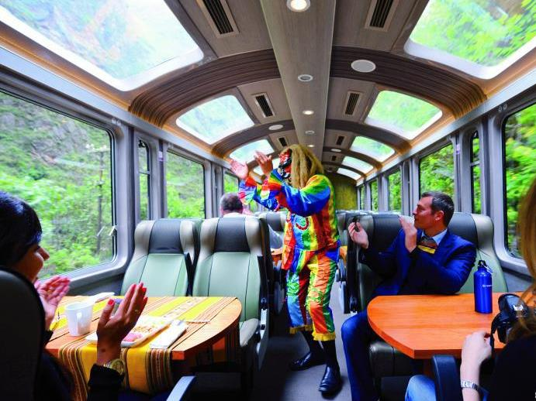
Train to Machu Picchu

Slide 45
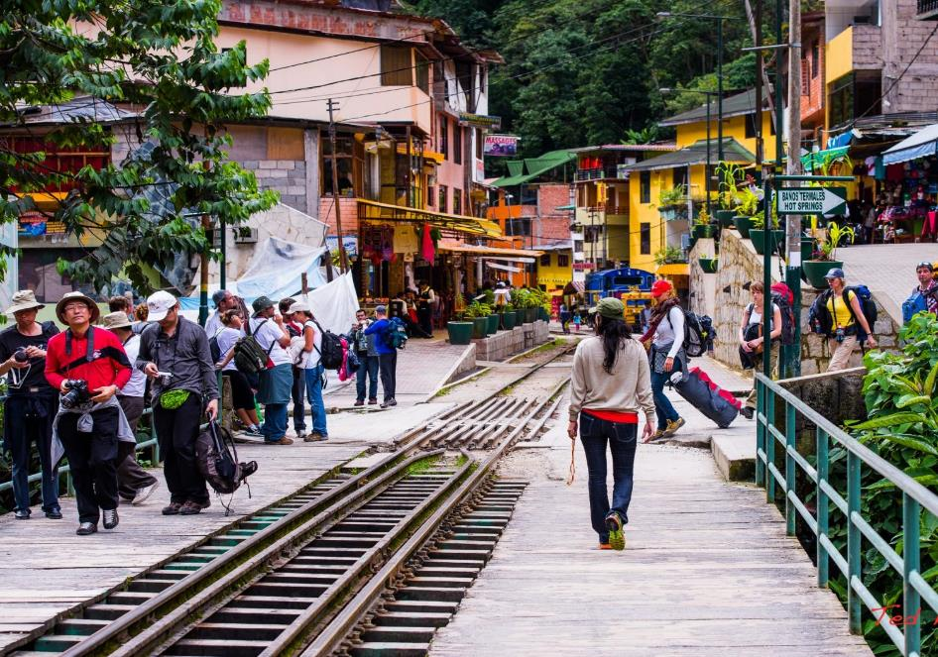
Aguas Calientes Town

Slide 46
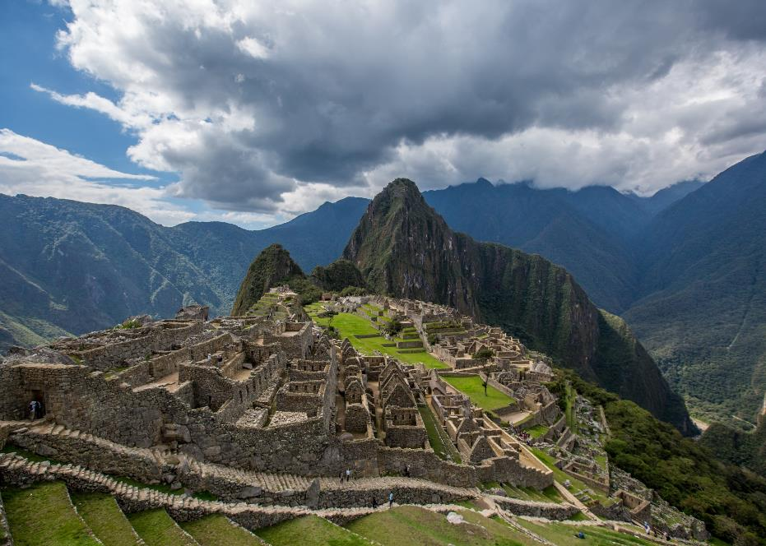
Machu Picchu Citadel

Slide 47
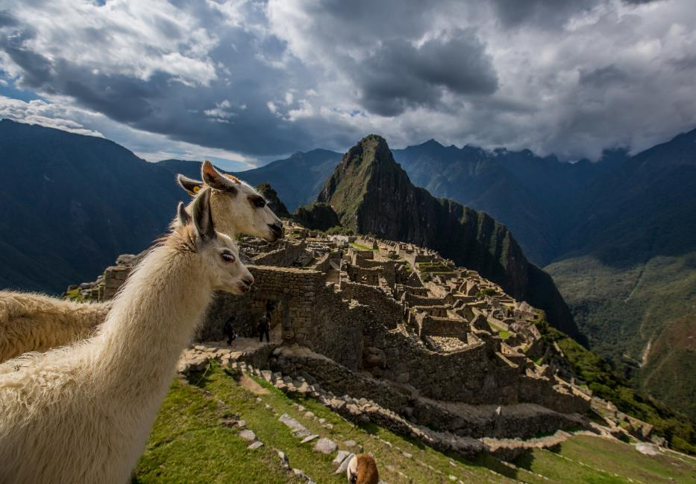
Machu Picchu Citadel

Slide 48
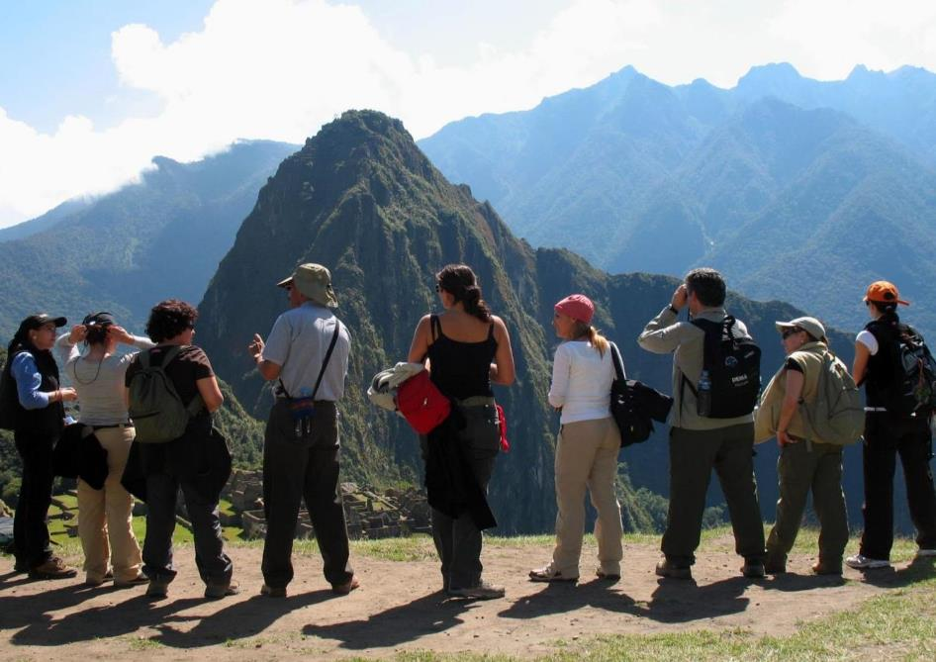
Machu Picchu Citadel

Slide 49
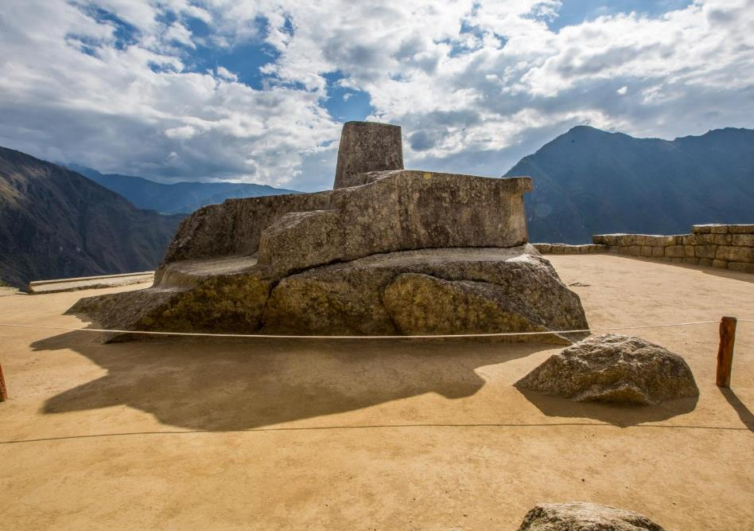
Sun Dial - Machu Picchu Citadel

Slide 50

Machu Picchu Citadel

Slide 51

Machu Picchu Citadel

Slide 52

Machu Picchu Citadel

Slide 53

Machu Picchu Citadel

Slide 54


Slide 55


The capital of the Inca Empire
It gathers impressive archaeology, cultural fusion, and mystical sites
Cusco is today a very cosmopolitan city
the gateway to the Sacred Valley of the Incas and Machu Picchu

Slide 56


Slide 57


CUSCO,
HISTORICAL
CENTER

Slide 58

Cusco Main Square

Slide 59

Cusco Cobblestone Streets

Slide 60

Hatun Rumiyoc Street – 12 angle stone

Slide 61

Koricancha Temple & Santo Domingo Convent

Slide 62

San Blas District

Slide 63

Sacsayhuaman Fortress

Slide 64

Cusco Surrounding Ruins

Slide 65

Overnight Aguas Calientes
Notes:
Revisar: Day 5 , overnight

Slide 66

Other Peru
Destinations
Notes:
Revisar titulo,interlineado

Slide 67

Puno & Lake Titicaca
The Culture’s cradle
3 days / 2 nights extension
Notes:
Revisar titulus de cada extension, poner dias/noches

Slide 68

Uros Floating Islands

Slide 69

Taquile Island

Slide 70

Sillustani Tombs

Slide 71

Arequipa & Colca Canyon
City of contrasts
4 days / 3 nights extension

Slide 72

Arequipa Main Square

Slide 73
Santa Catalina Convent

Slide 74

Yanque Town

Slide 75

Andean Condor – Colca Canyon

Slide 76

Paracas & Nazca
Treasures and mysteries
3 days / 2 nights extension

Slide 77


Candelabro - Paracas

Slide 78

Ballestas Islands

Slide 79

Paracas National Reserve

Slide 80

Luxury navigation

Slide 81

Adventure in the dessert

Slide 82

Puerto Maldonado
Feel and hear the Amazon jungle
3 days / 2 nights extension

Slide 83

Sandoval Lake – Tambopata National Reserve

Slide 84

Jungle Excursions

Slide 85

Amazon Cruises - Iquitos
Unique & meaningful experiences
4 days /3 nights extension

Slide 86

Swimming in dark lakes

Slide 87

Swimming in dark lakes

Slide 88

Visits to communities

Slide 89

Piraña Fishing

Slide 90

Amazon River Cruises

Slide 91

Chachapoyas
Warriors of the clouds
4 days / 3 nights extension

Slide 92

Gocta Water Fall

Slide 93


Gocta Water Fall

Slide 94

Kuelap Fortress

Slide 95

Kuelap Fortress

Slide 96

Kuelap Fortress

Slide 97


Slide 98




Slide 99

We specialize in tailor-made programs for the most demanding guests and we always propose engaging, authentic and unforgettable experiences.
We provide extremely competitive rates (net or gross)
Our quotations to you will always include any promotions launched by hotels or cruises.
We can provide itemized quotations to make things easier for you
We keep you informed of relevant developments and product updates in Peru
Payments can be directed to our US-based bank account or via major credit cards
We offer open webinars about Peru to our clients and we can set-up tailored webinars on any subject you choose, exclusively for you.
We provide you with plenty marketing support, including high resolution pictures, videos, presentations, among others.
Lake Titikaka

Slide 100

Always go to an expert!
Small team = Personalized service
Local company with over 5 decades of expertise in operation
We pay 10 or 12% commission*
Toll Free 1-888-458-8567
(from US & Canada)
One-stop-shop for all Peru related services as well as for multi-country (with Ecuador and Colombia!)

Slide 101



General enquiries: info@metropolitan-touring.com.pe
Toll Free 1-888-458-8567 (from US & Canada) / Phone: +(51 1) 715 5515
For more details, comments and bookings, please contact us:
Mariela Chiara
Sales Leader USA, Canada & Latin America
mchiara@metropolitan-touring.com.pe
Skype: Mariela.chiara
Carla Acosta
Exclusive Service Desk for Travel Agents
cacosta@metropolitan-touring.com.pe
Skype: Carla-mtp_1
Marisol Matos
Exclusive Service Desk for Travel Agents
mmatos@metropolitan-touring.com.pe
Skype: marisolmatos-mtp

Slide 102

Thank you!
For questions please use the control panel located at the right hand side of your computer.
For more details, comments and bookings, please contact us.

