Slide 1
Traveller name
Travel Dates

Slide 2
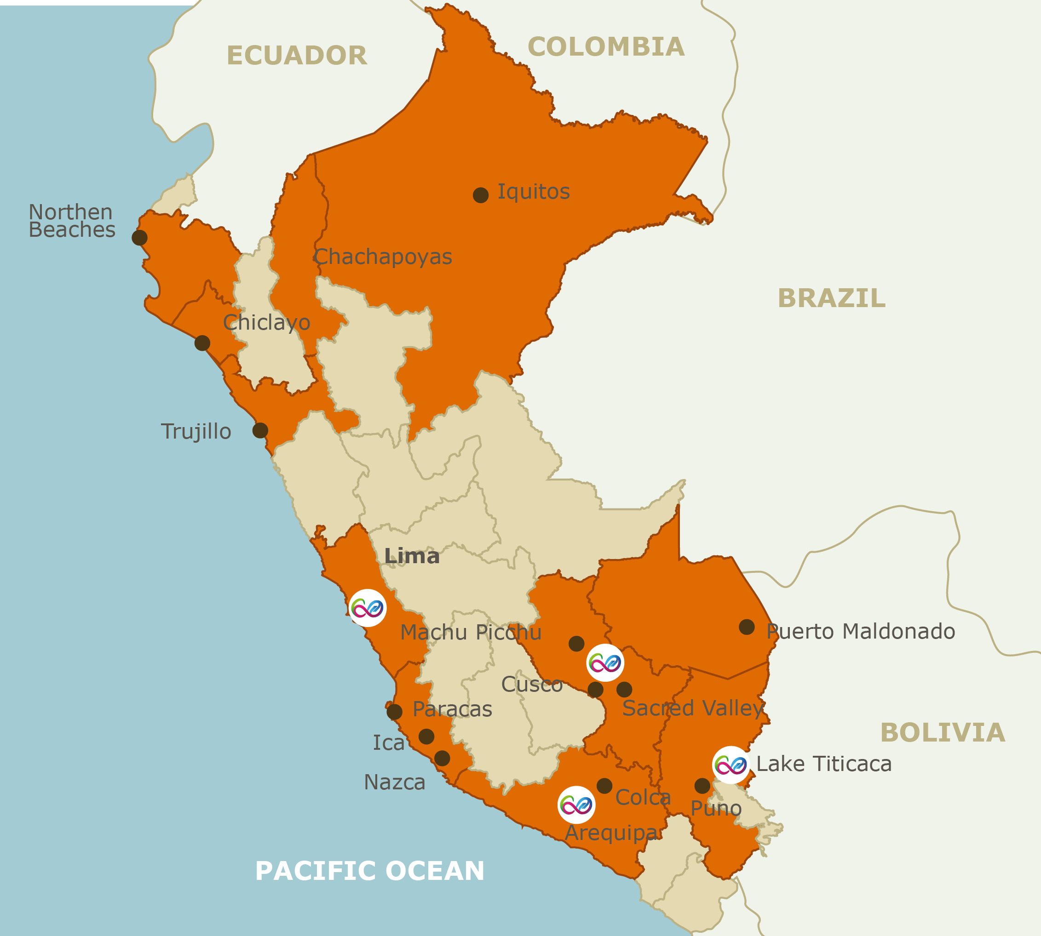
Peru, An Intense Discovery
A traveller’s Paradise. It’s one of the 12 mega-diverse countries in the world. Peru is a land of mystery and constant discovery, with countless archaeological sites and the most varied and unforgettable landscapes. Meet the people, experience the adventure, live the traditions, delight your palate, encounter the past, embrace the nature, feel the mystery … Discover the intensity of Peru
Premium Restaurants for all tastes
Beautiful moments to capture
Mega-diverse country

Slide 3
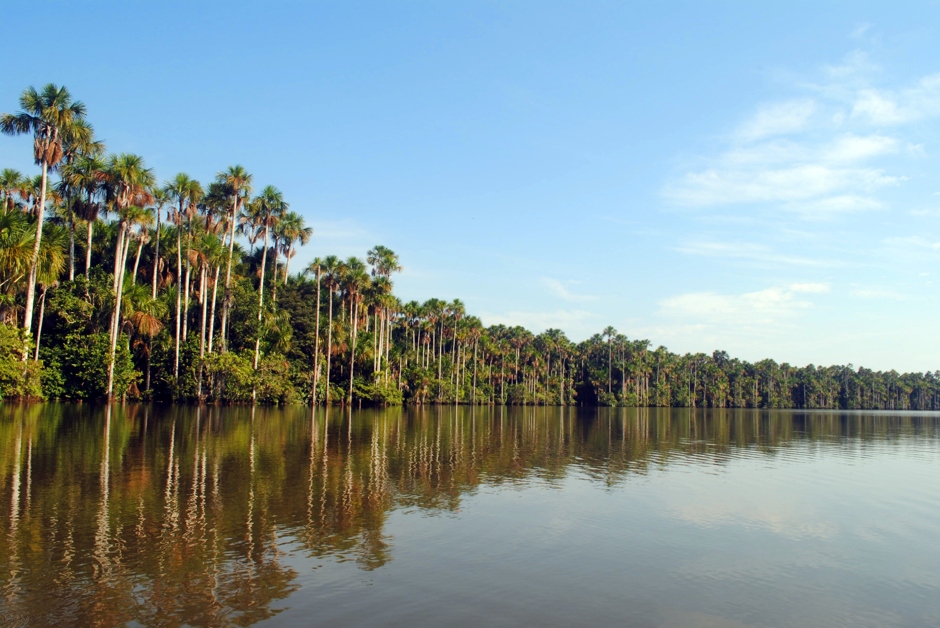
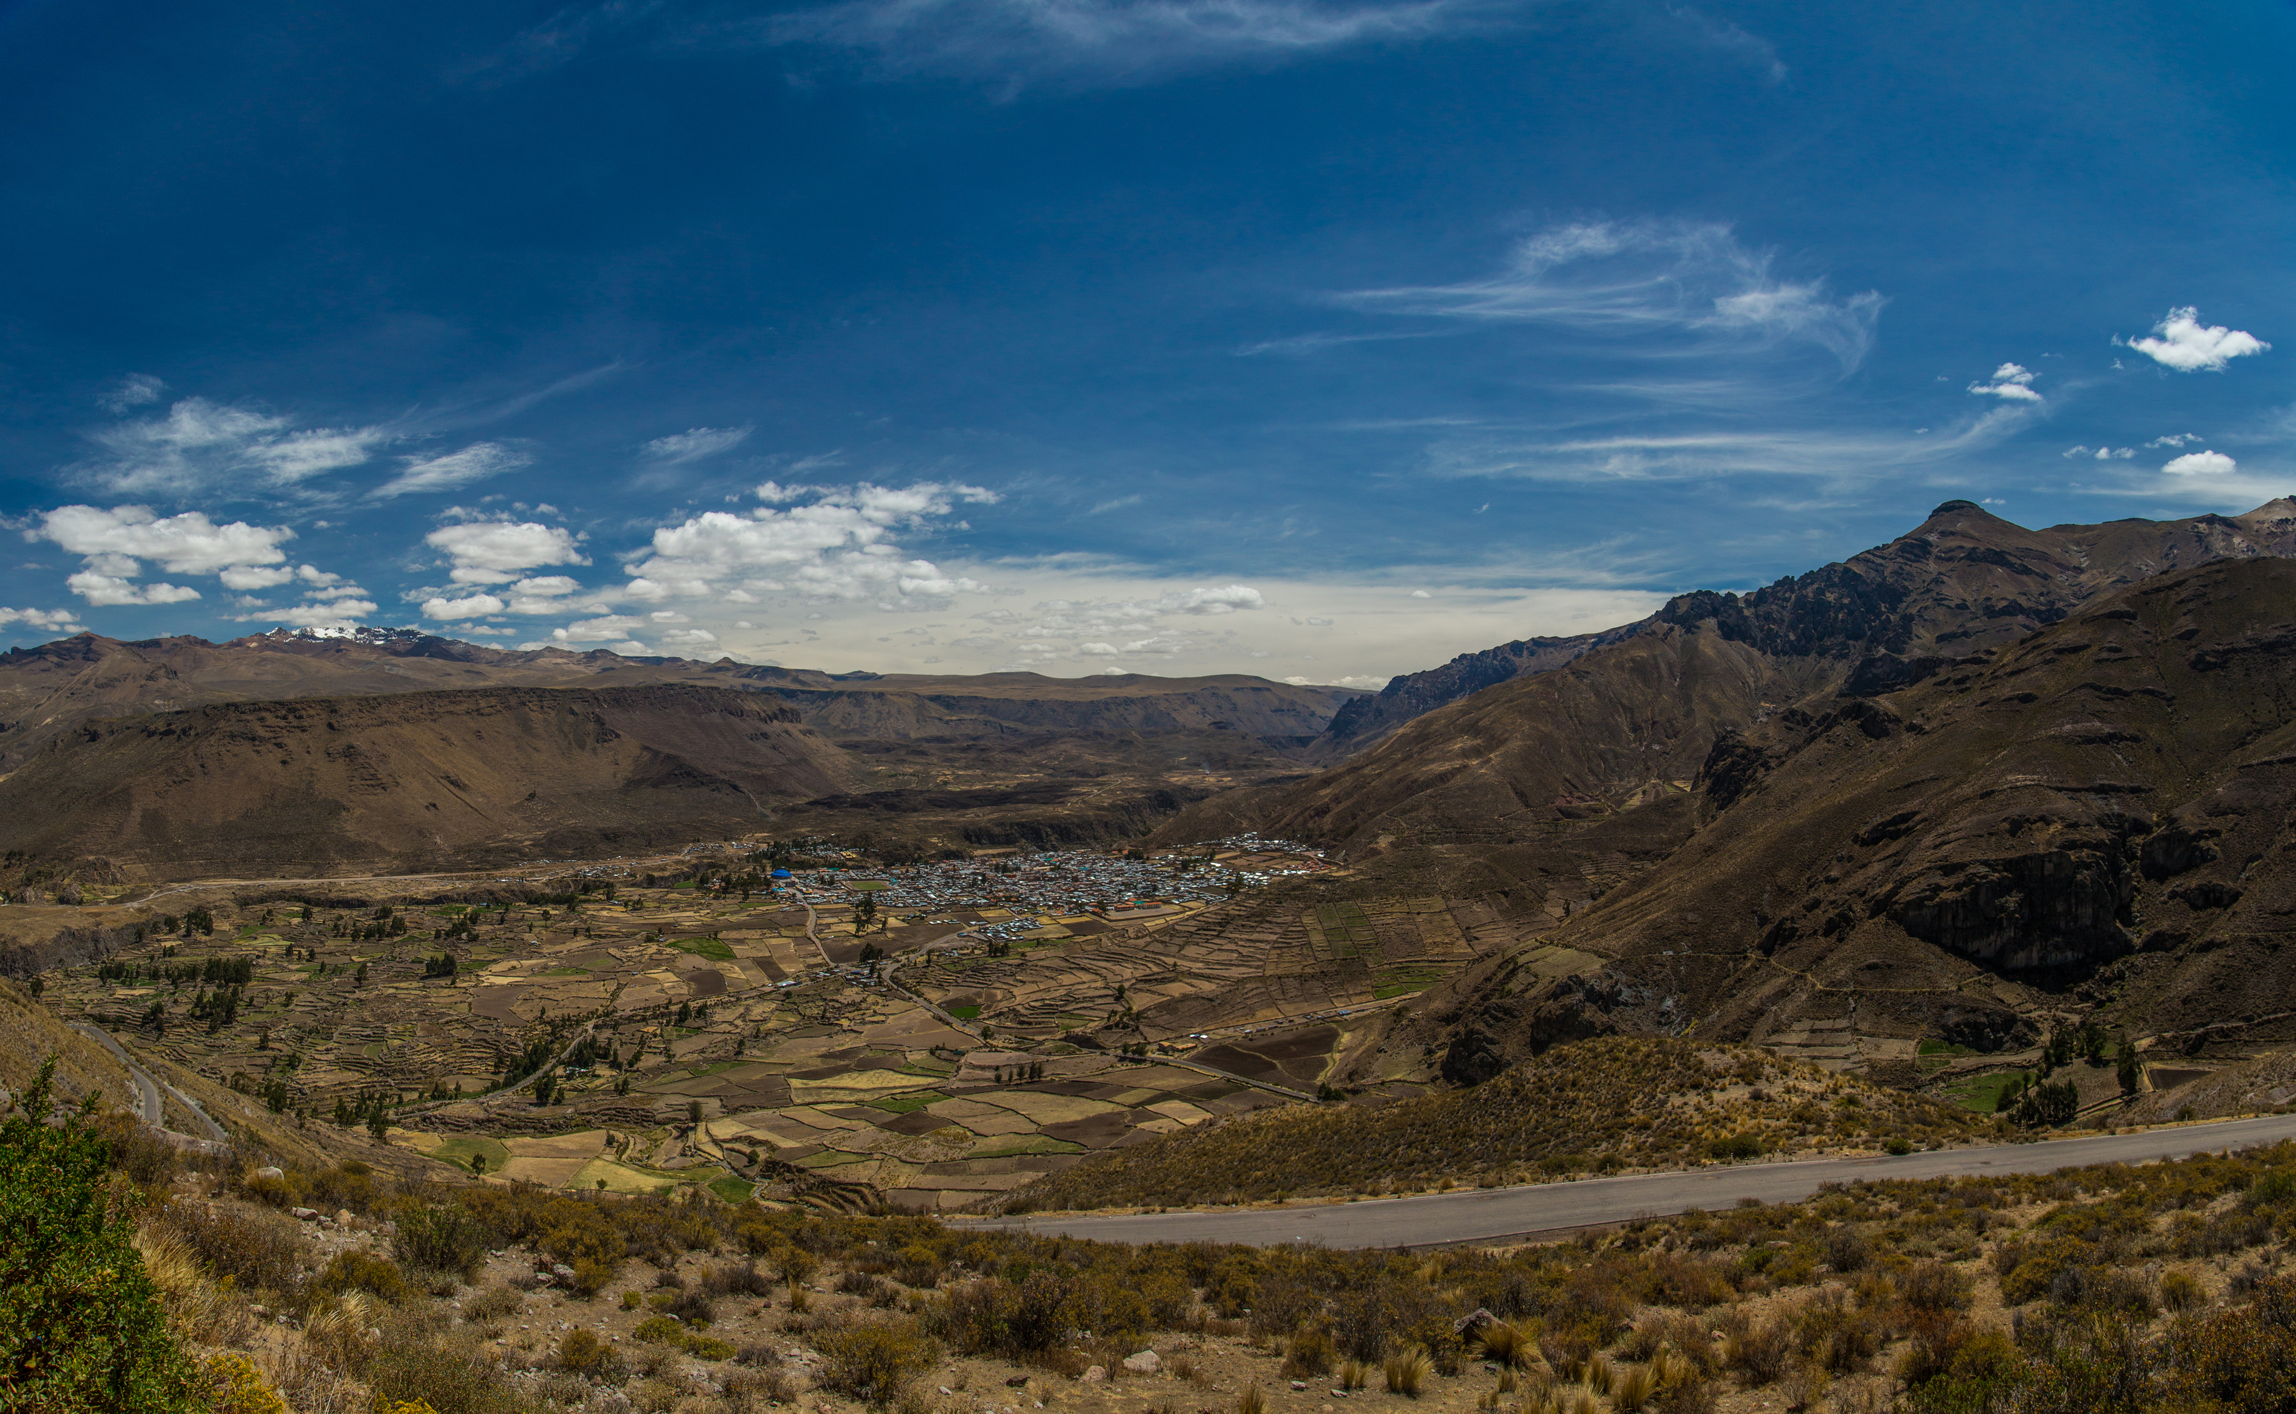
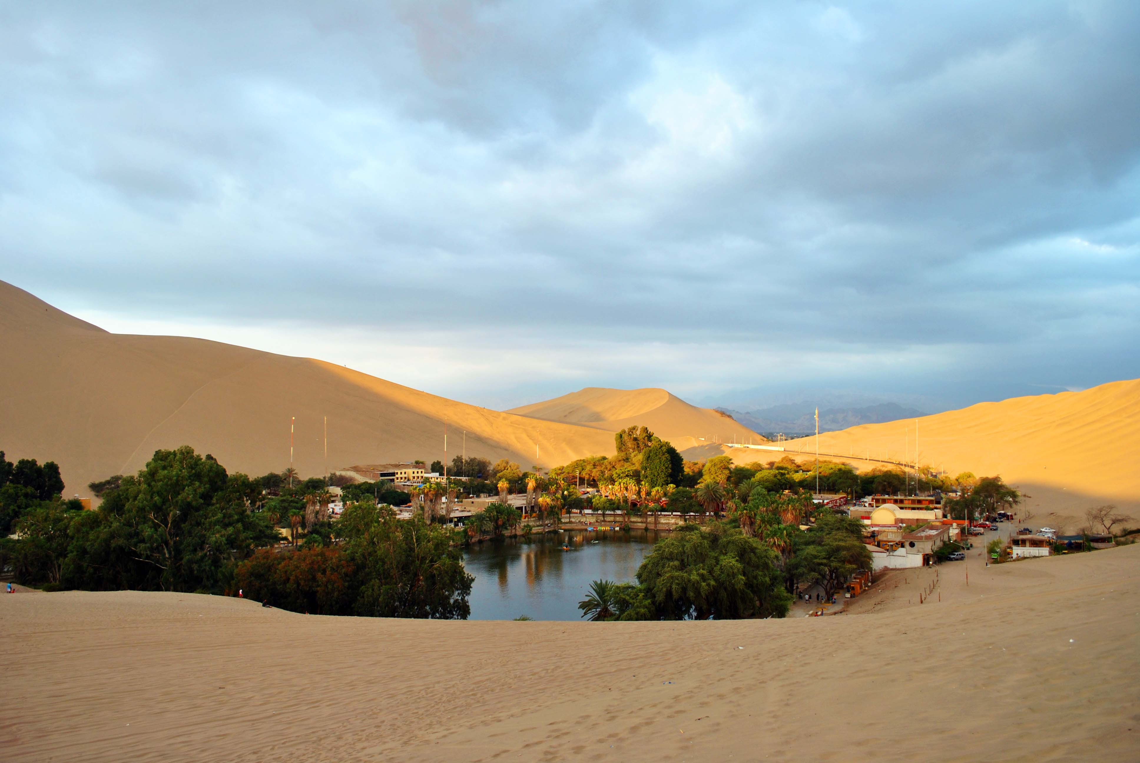
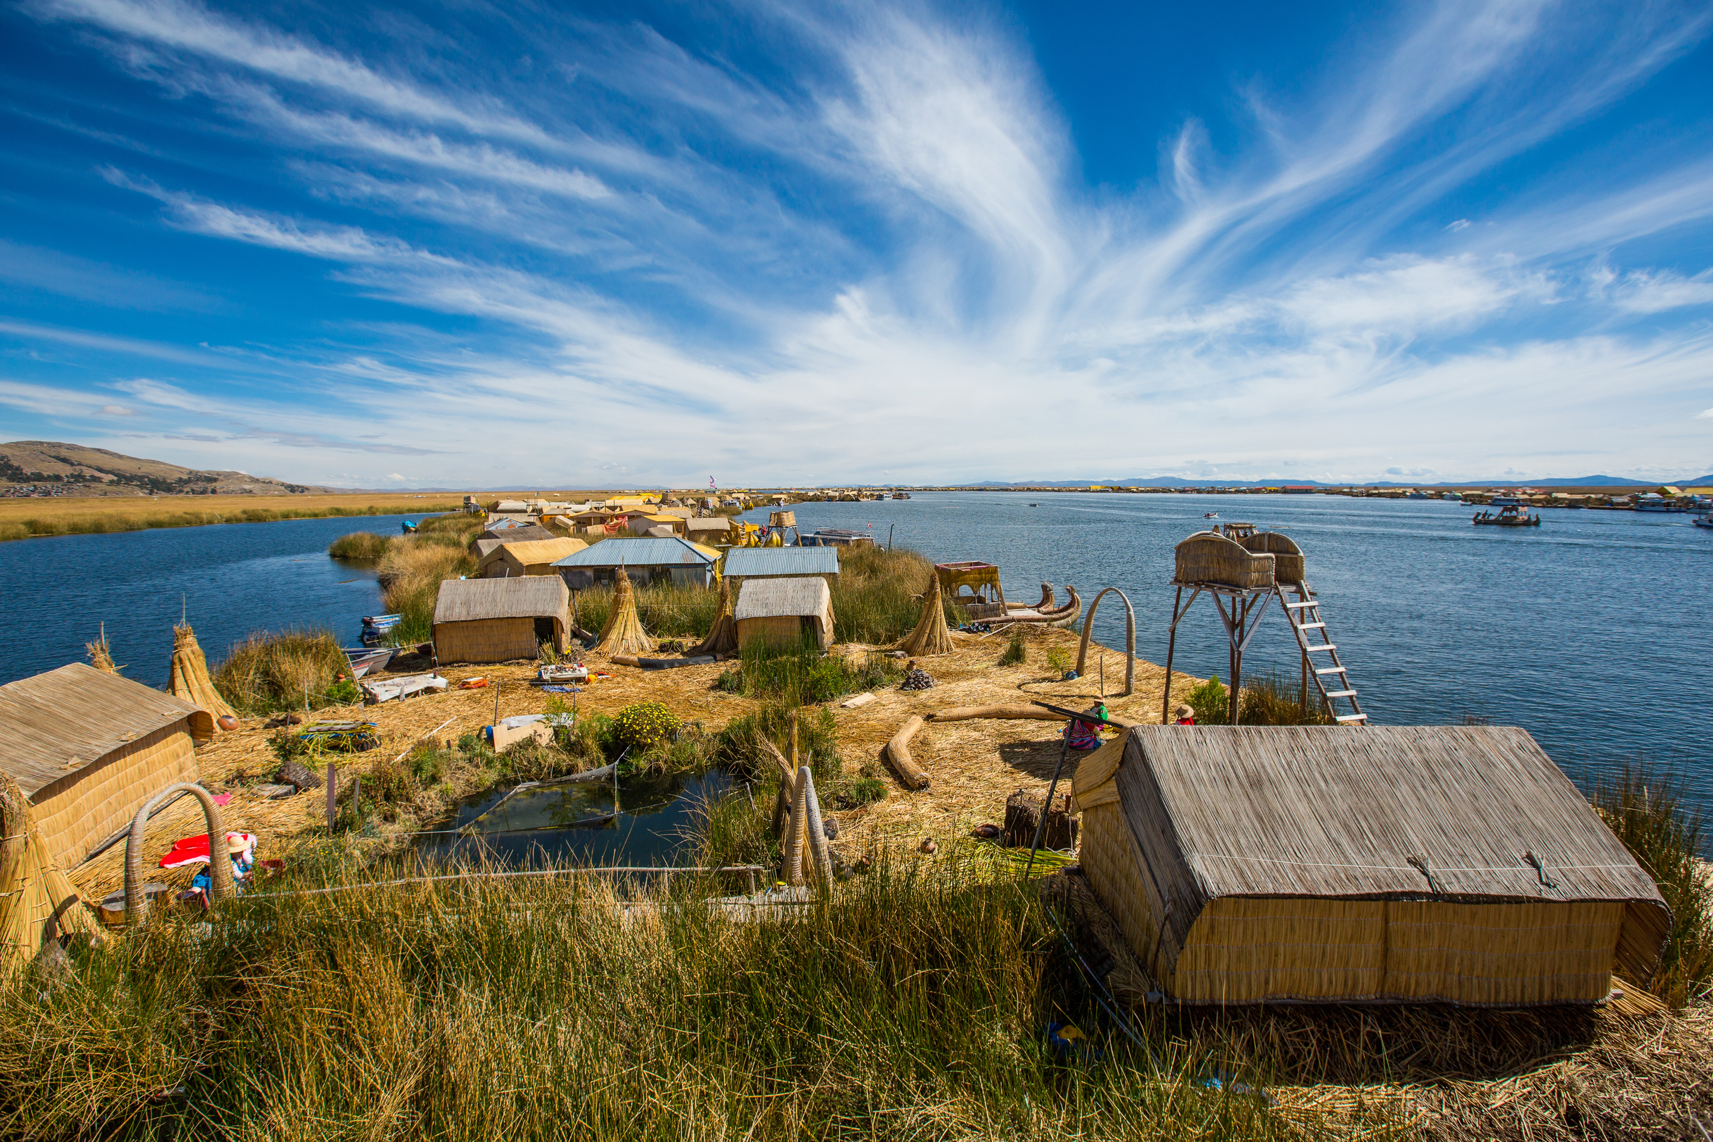
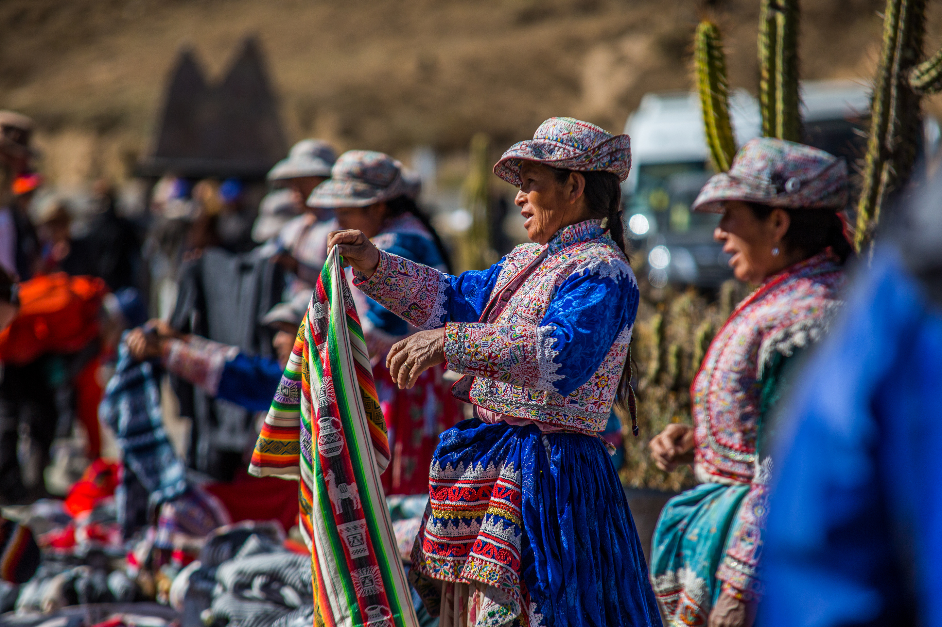
One history,
A thousing
Inspiring
Stories
Peru Itinerary
Días enumerados del itinerario con la descripción, ej:
- Day 01 – … / Lima (-/-/-)
• AM: Transfer Lima Airport / Hotel (private English speaking transferman)
• PM: Lima City tour + Larco Museum (private English speaking guide), followed by
• Dinner at Café del Museo Restaurant (set menu)
• Overnight in Lima
- Day 02 – Lima / Cusco / Sacred Valley(B/-/-)
• Transfer Airport / Lima Airport (private English speaking transferman)
• Transfer Cusco Airport / hotel Sacred Valley including Awanacancha Textile Center & Pisac Market (private English speaking guide)
• Overnight in the Sacred Valley
Colca Valley, Arequipa
Las Dunas, Ica
Uros Island, Puno
Colca Valley

Slide 4
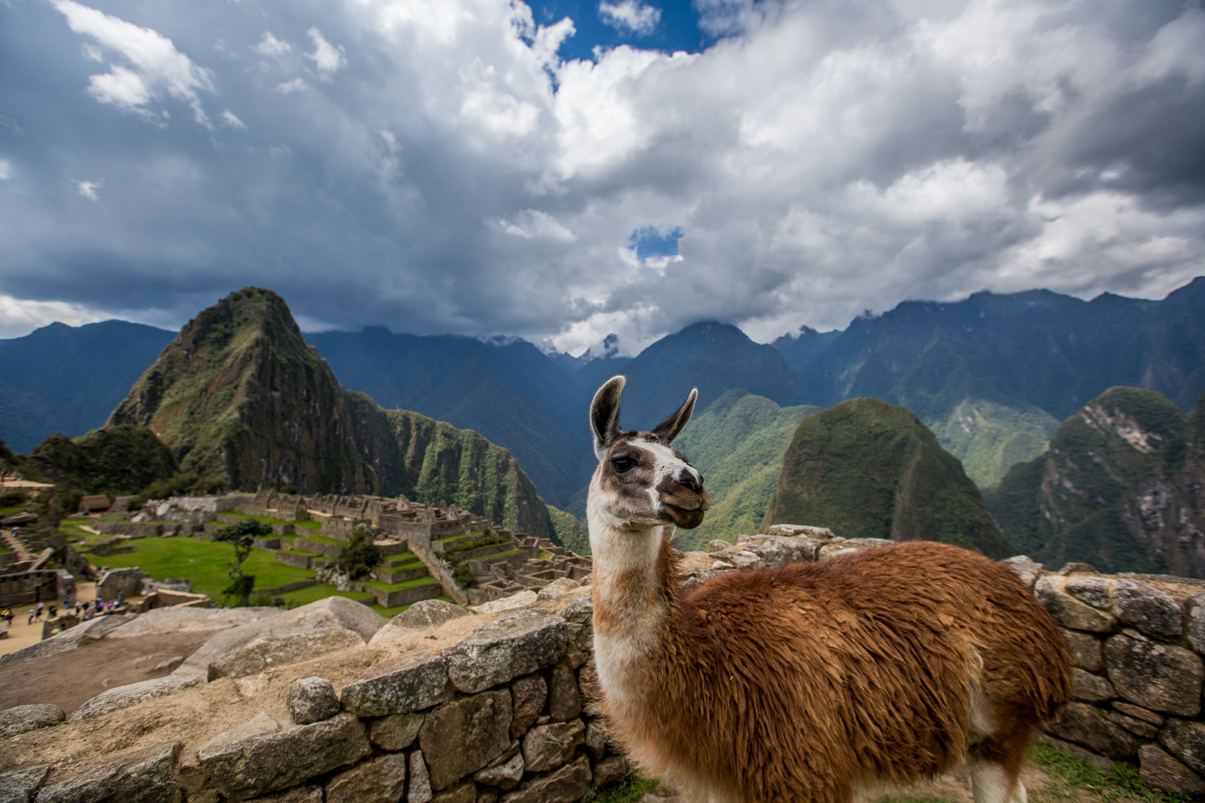
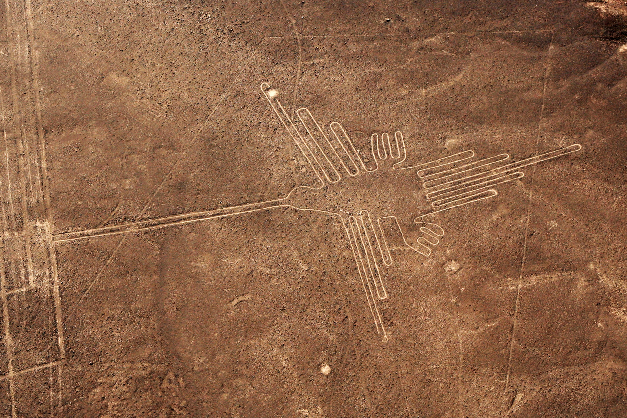
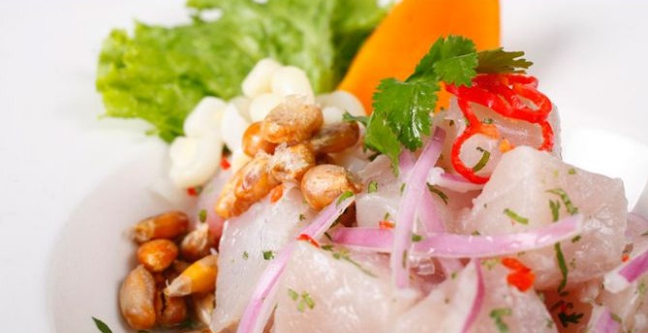
One history,
A thousing
Inspiring
Stories
Prices 2017
Prices with standard hotels 3*
Nazca Lines, Paracas
Prices with superior hotel 4*
Delicious Ceviche
Prices with deluxe hotels 5*
Titicaca Lake, Puno
Yanque, Arequipa

Slide 5
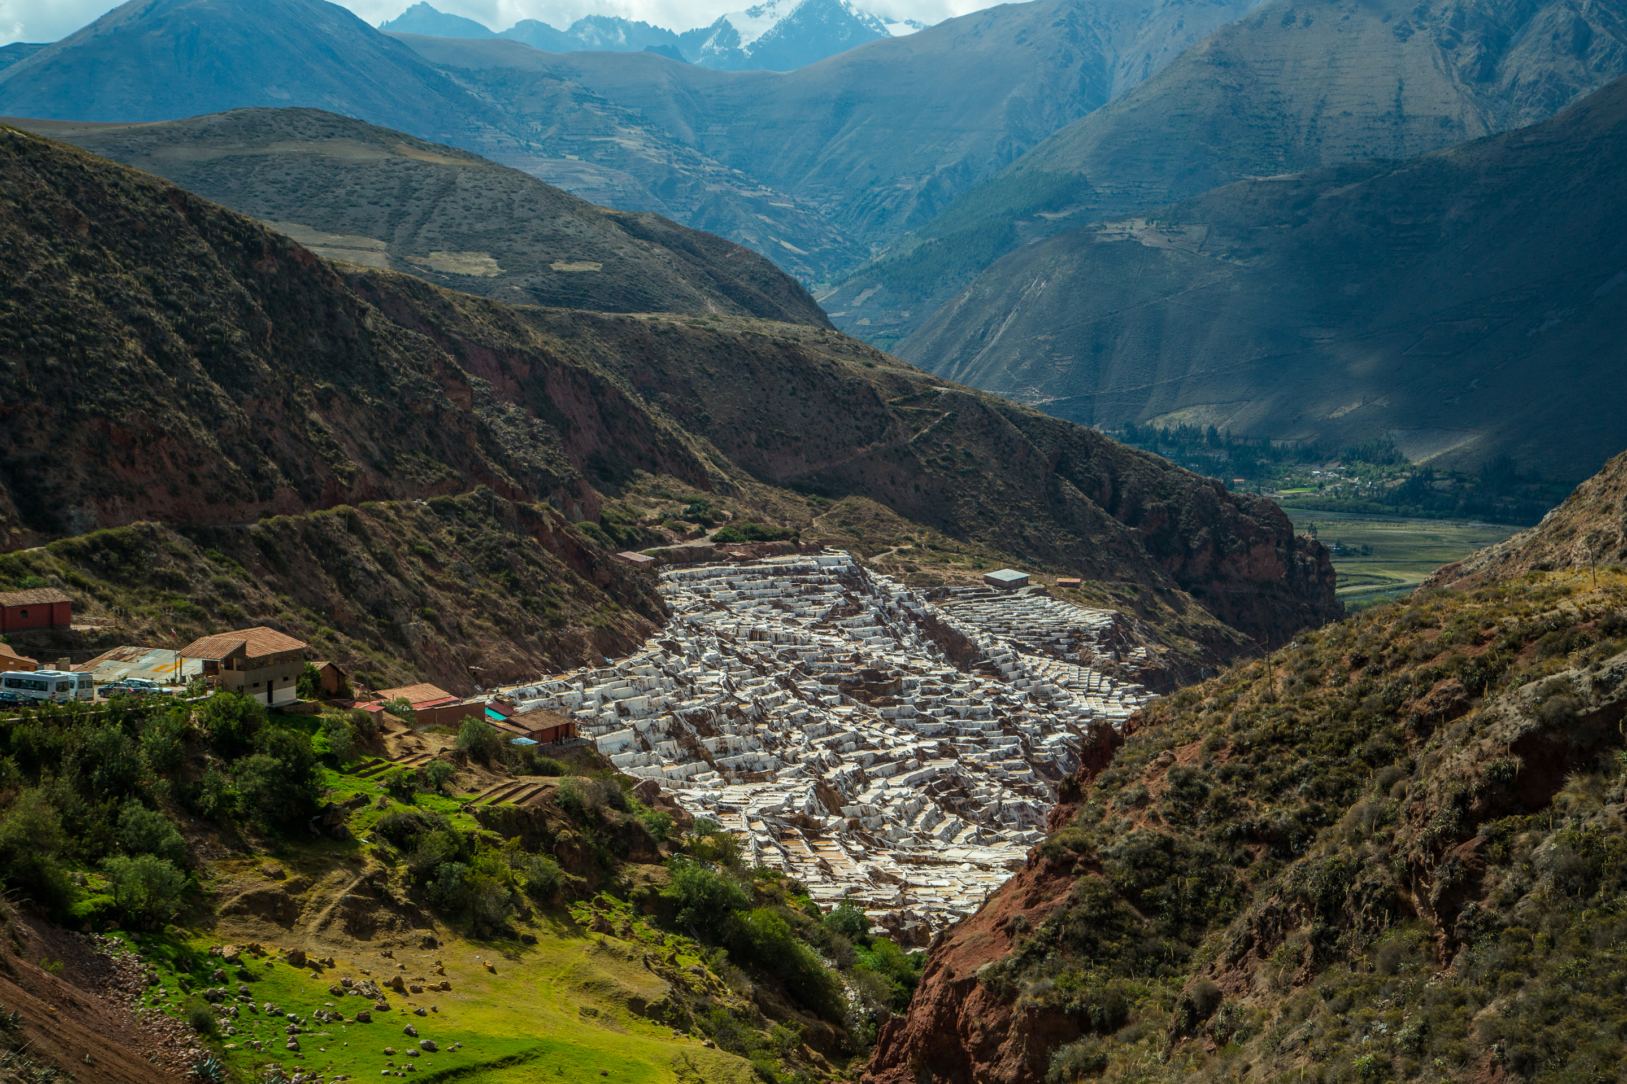
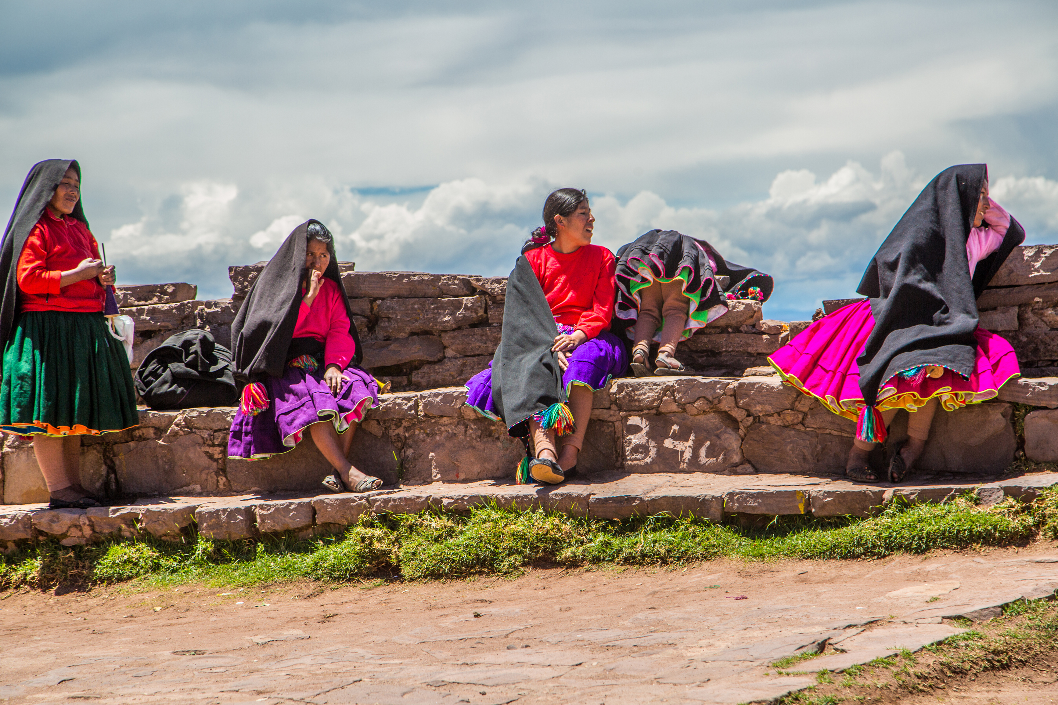
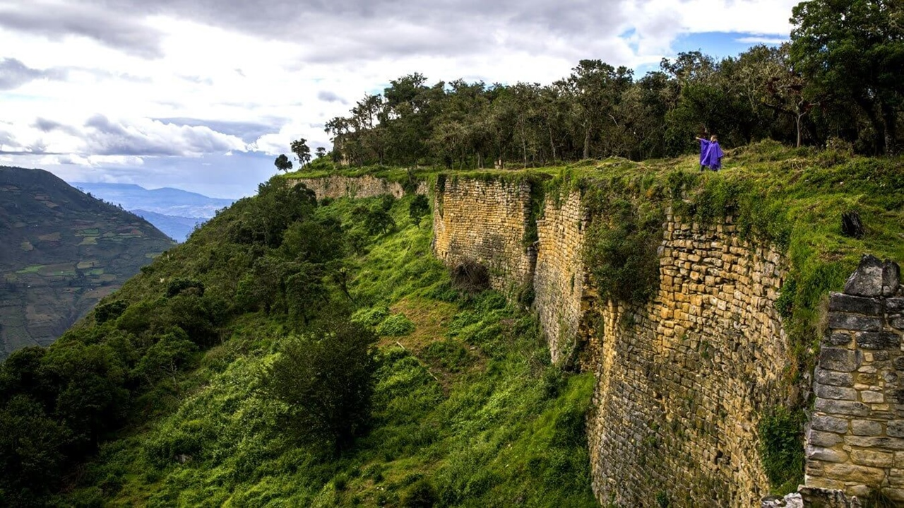
One history,
A thousing
Inspiring
Stories
Information
Inclusions
Private and shared services with local English or Spanish speaking guide, except where otherwise specified
All entrance fees to the sites mentioned above
Meals: As indicated in the itinerary
01 Roundtrip train ticket to Machu Picchu via Vistadome coach per person
02 Entrance ticket to Machu Picchu per person
02 Bus ticket to and from the Machu Picchu ruins per person
Main Square, Cusco
Exclusions
International and domestic airfares (actual price subject to changes by the airline).
Meals or any other item not described in the itinerary.
Early check-in, late check-out, services and non-mentioned meals in the itinerary
Personal expenses.
Drinks during meals, hotel extras and personal spending
Maras, Sacred Valley
NOTES
No reservations have been placed.
PRICES GIVEN ARE PER PERSON
This is a preliminary costing; hotels may vary according to availability
All services stipulated above are subject to availability at the time of booking/ reservation
No airfare nor airport taxes included in above given rates
Rates are subject to change without prior notice in case supplier conditions change and/or if there are USD exchange rate variations in Peru
Taquile Island, Puno
Kuelap, Chachapoyas

